Slide 1
Coastal Outlook: Doing Business with CPRA
American Council of Engineering
Companies of Louisiana
November 18, 2021

Slide 2
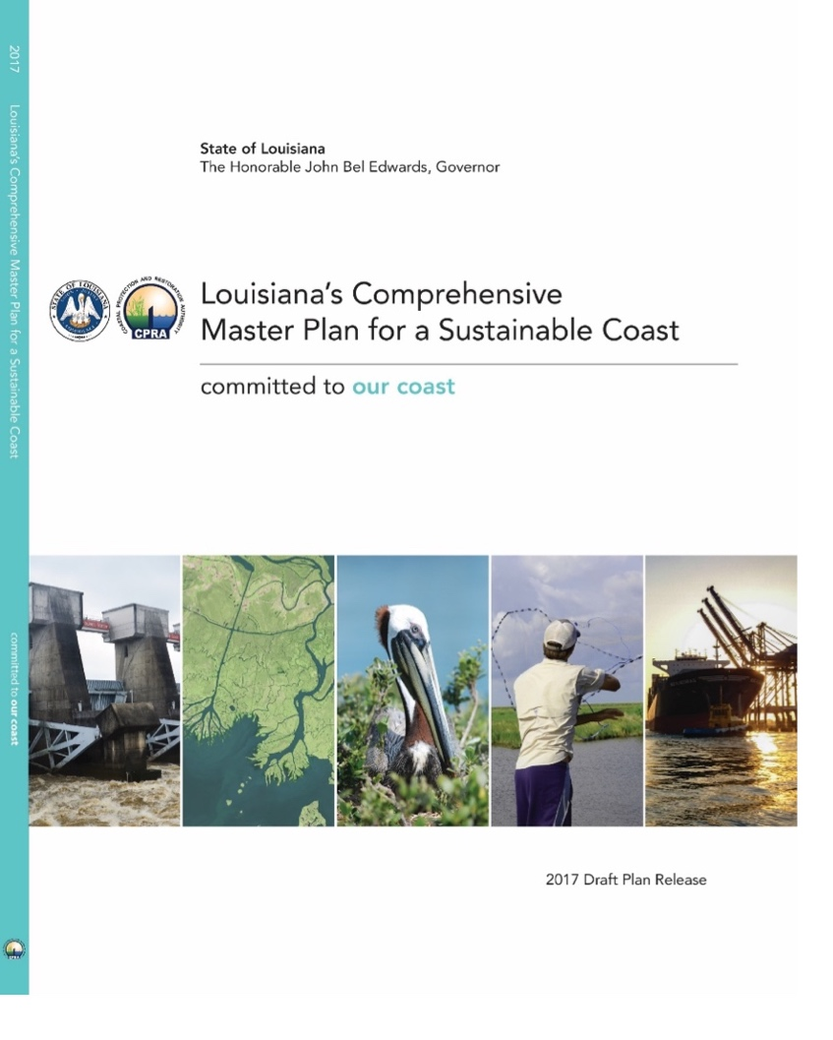
Master Plan/Annual Plan

Slide 3
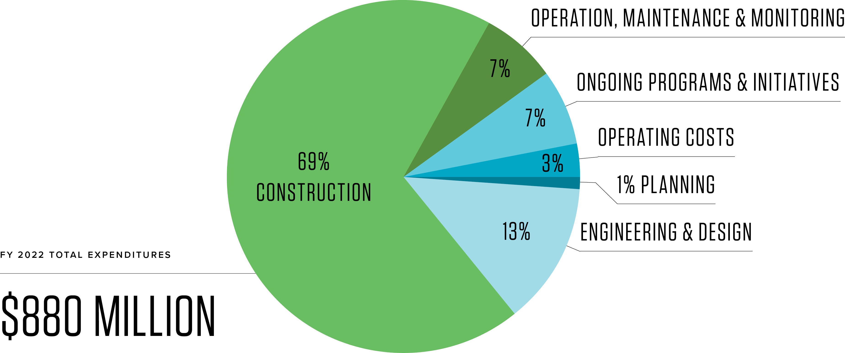
Total Projected Expenditures FY 2022
By Project Phase

Slide 4
90% Project-Associated Expenditures
Across the Coast
Planning
8 projects, $23.9 M
CONSTRUCTION
72 projects, $5.8 B 57,395 acres benefited 109 miles of levee
Engineering & Design
45 projects, $7.3 B 136,432 acres benefited
OM&M
161 projects completed, $60.7 M

Slide 5
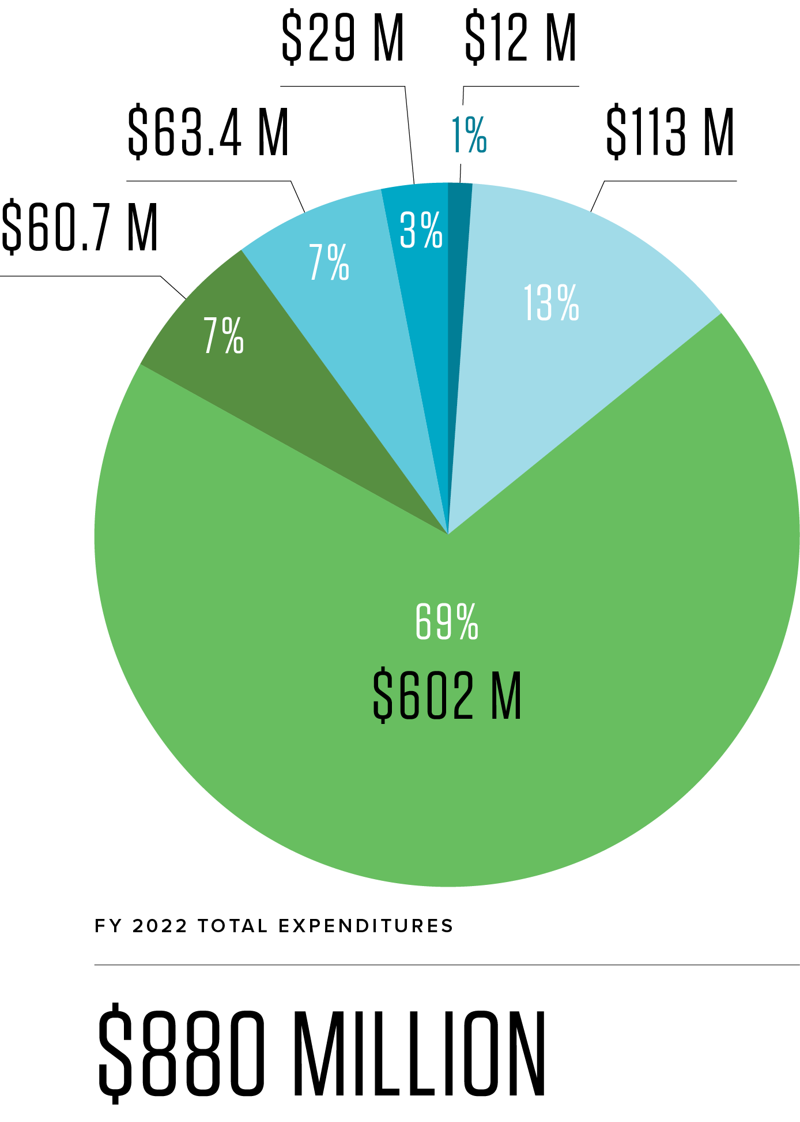
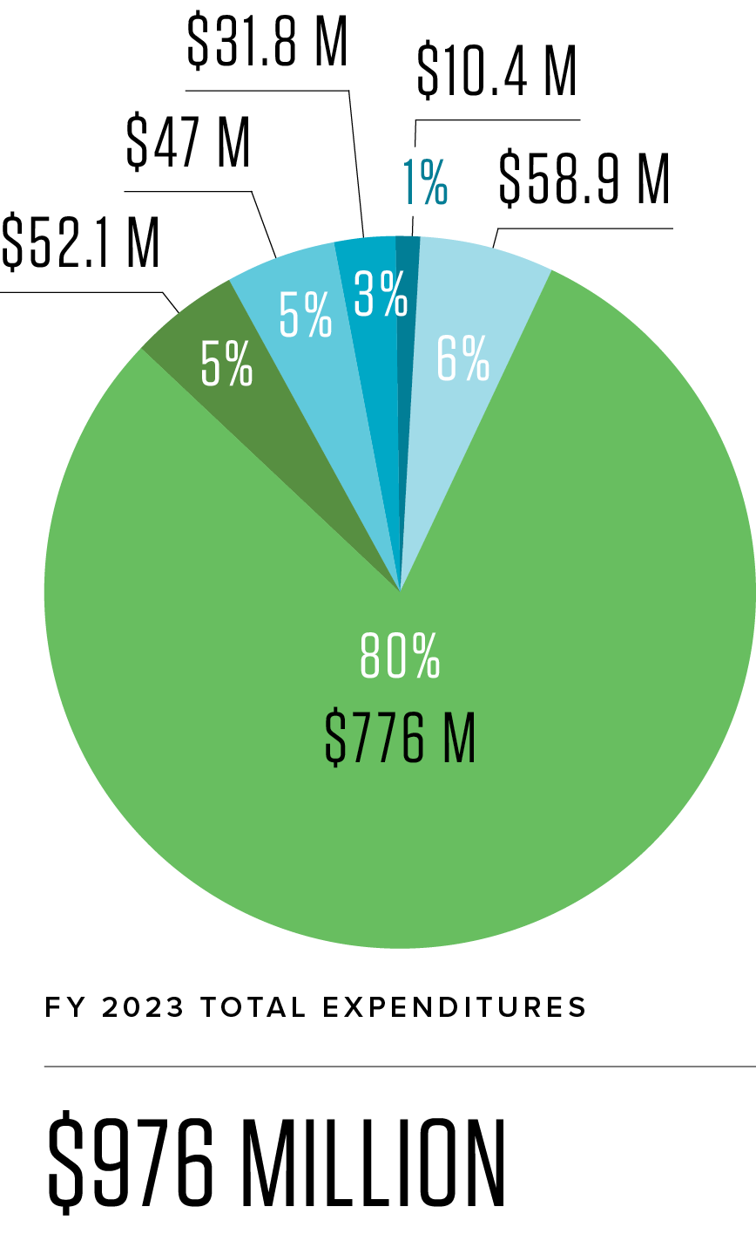
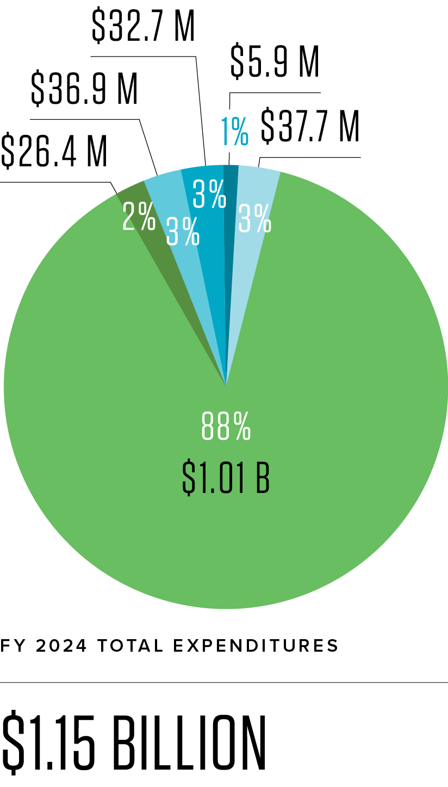
Total Projected Expenditures
By Project Phase

Slide 6
IDIQ Contracting
Update

Slide 7
Professional Services
Engineering, Geotechnical, Surveying Services
Typically acquired through Request for Solicitation of Interest and Qualifications (RSIQ)/Request for Qualifications (RFQ)
Can be awarded to one or more firms
May be project-specific or for Indefinite Delivery / Indefinite Quantity (IDIQ) contracts.
3-year term max (currently have staggered start/end contract times)

Slide 8
Professional Services
Engineering, Geotechnical, Surveying Services
All data collection efforts (surveying, geotechnical) contracted through IDIQ Task Orders
Most engineering/design related work contracted through IDIQ Task Orders
Large-scale design efforts may involve project-specific solicitations and contracts (i.e., diversion design contracts)

Slide 9
Professional Services IDIQ Contracts
Current IDIQ Quantity and Value
33 Engineering Contracts
20 General Engineering Services ($2M)
6 Coastal Engineering Services ($2M)
7 Limited Engineering Services ($1M)
7 Geotechnical Services ($1.5M)
7 Surveying ($1M)

Slide 10
Professional Services IDIQ Contracts
Current IDIQ Usage (through Sept. 2021):

Slide 11
Professional Services IDIQ Contracts
Staggered Contract Terms
Expired Aug 2021: 14 Engineering, 2 Geotech, 3 Surveying
Jan 2020 – Dec 2022: 6 Engineering, 7 Limited, 2 Geotech, 1 Surveying
Sept 2020 – Aug 2022*: 9 Engineering, 3 Geotechnical, 3 Surveying
Sept 2021 – Dec 2022*: 11 Engineering, 2 Geotechnical, 3 Surveying
*Option to Extend One Year

Slide 12
Professional Services IDIQ Contracts
Proposed Change:
Starting with the Spring 2022 advertisement, CPRA will advertise for Professional Services IDIQ Contracts once every 3 years, with contracts having a 3-yr term. Term for the 2022 advertisement will be Jan 2023 through Dec 2025
RSIQ to be posted by Q2 2022
Reevaluate the optimum capacity (quantity and value) for all contract types (engineering, surveying, and geotechnical)

Slide 13
Professional Services IDIQ Contracts
FAQs for upcoming IDIQ solicitation:
Q: What specific qualifications/skillsets is CPRA looking for when selecting firms for IDIQ contracts?
A: The majority of CPRA’s design work is related to hydraulic dredging. Therefore, an understanding of how hydraulically dredged soils behave, as well as the bidding and construction of these projects, is generally desired. A strong understanding of geotechnical and hydraulic design/analysis within the coastal zone is also scored favorably.

Slide 14
Professional Services IDIQ Contracts
FAQs for upcoming IDIQ solicitation:
Q: What type work would be expected on an IDIQ task order?
A: Most of the engineering/design task orders pertain to restoration work (marsh creation, shoreline protection, ridge restoration, barrier island restoration). Task orders may be issued for complete design services (preliminary through bidding) or for design support only. Tasks for construction administration/supervision are also commonly executed.

Slide 15
Professional Services IDIQ Contracts
FAQs for upcoming IDIQ solicitation:
Q: Can a firm submit a Statement of Interest and Qualifications (SIQ) as a Prime and also be a subcontractor under another Prime submitting?
A: No. Firms electing to submit a SIQ as a Prime contractor cannot be listed as a Subcontractor on another firm’s SIQ. Firms not submitting as Prime contractor are allowed to be listed as a Subcontractor on as many SIQs as they deem appropriate. Firms will need to determine whether they will compete as a Prime or a Subcontractor under the listed RSIQ.

Slide 16
Professional Services IDIQ Contracts
FAQs for upcoming IDIQ solicitation:
Q: Can a firm submit a SIQ as a Prime for multiple categories (for example, can a firm submit as a Prime for both the Coastal and General Engineering categories)?
A: Yes. A firm can elect to submit as a Prime on any or all of the five separate solicitations (General, Coastal, Limited, Surveying, Geotechnical). However, a firm can not submit as a Prime and also as a subcontractor in the same solicitation.

Slide 17
Professional Services IDIQ Contracts
FAQs for upcoming IDIQ solicitation:
Q: How many Professional Services contracts will CPRA award for each category?
A: It is anticipated that the number of Surveying and Geotechnical will generally remain the same. A reduction in the number of Engineering category (Coastal, General, Limited) contracts is likely. CPRA is currently evaluating upcoming Engineering and Design expenditures to determine the optimum number of Engineering category contracts.

Slide 18
Professional Services IDIQ Contracts
Future Anticipated E&D Expenditures:
FY 2022 - $112,800,659
FY 2023 - $58,861,417
FY 2024 - $37,676,878
Notes:
GOMESA Coalition/RISE Act

Slide 19
Consulting Services
Environmental, Science, Planning
Project Specific or Indefinite Delivery/Indefinite Quantity (IDIQ)
Acquired through Request for Proposals (RFP); includes cost as a factor in the scoring of a proposal
3-year term, 3 year solicitation schedule (some have staggered start and end dates)

Slide 20
Consulting Services IDIQ Contracts
Environmental, Science, Planning
10 current IDIQ contracts
Total contract value - $30M
Amount Tasked - $14M (through Nov 15)
Existing contracts begin to expire in the Spring of 2022
RFP advertisement closed on 10/7/21 (RFPs currently being evaluated)

Slide 21
Hudson/Veteran Initiative Preference
Small and emerging businesses shall be included in business offerings for state procurement and public contracts
Points for inclusion of Hudson and/or Veteran Firms included in CPRA Solicitations
Details on available points vary by solicitation; always read solicitation carefully

Slide 22
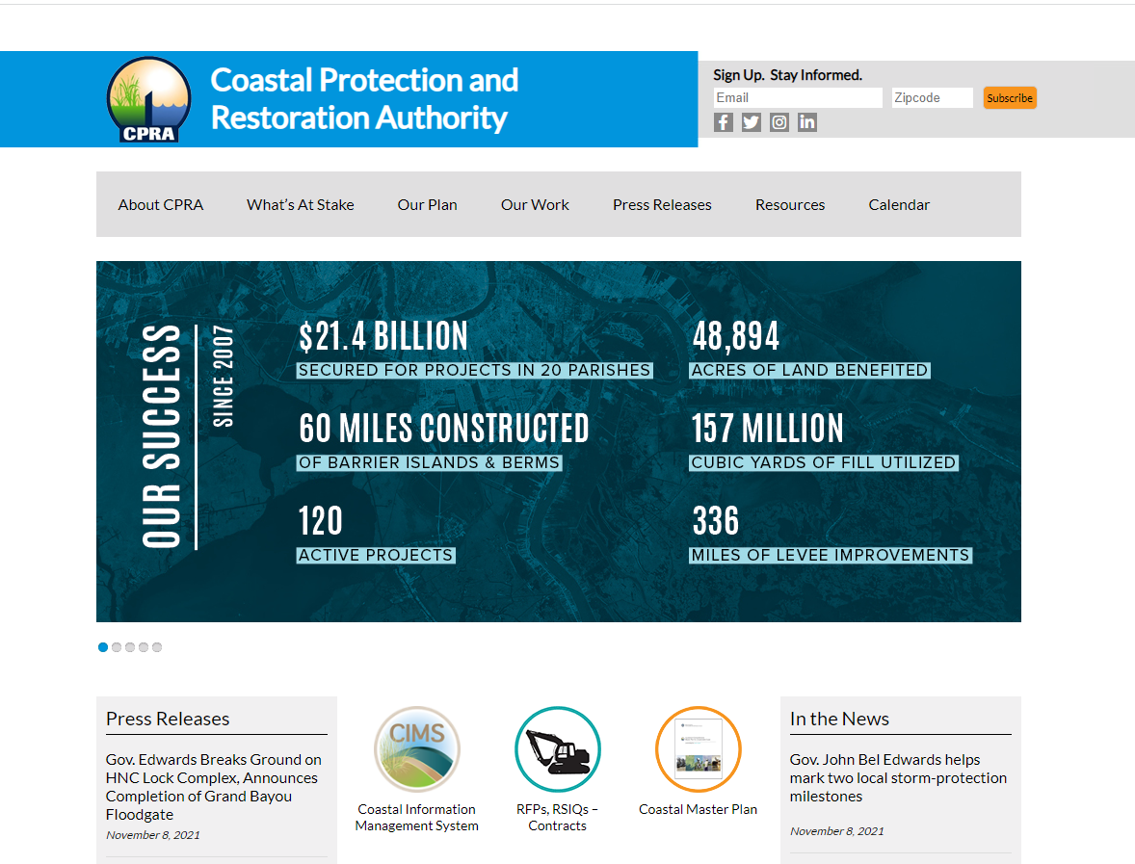
How to Find RSIQ & RFP Solicitations
CPRA HOMEPAGE: https://coastal.la.gov/

Slide 23
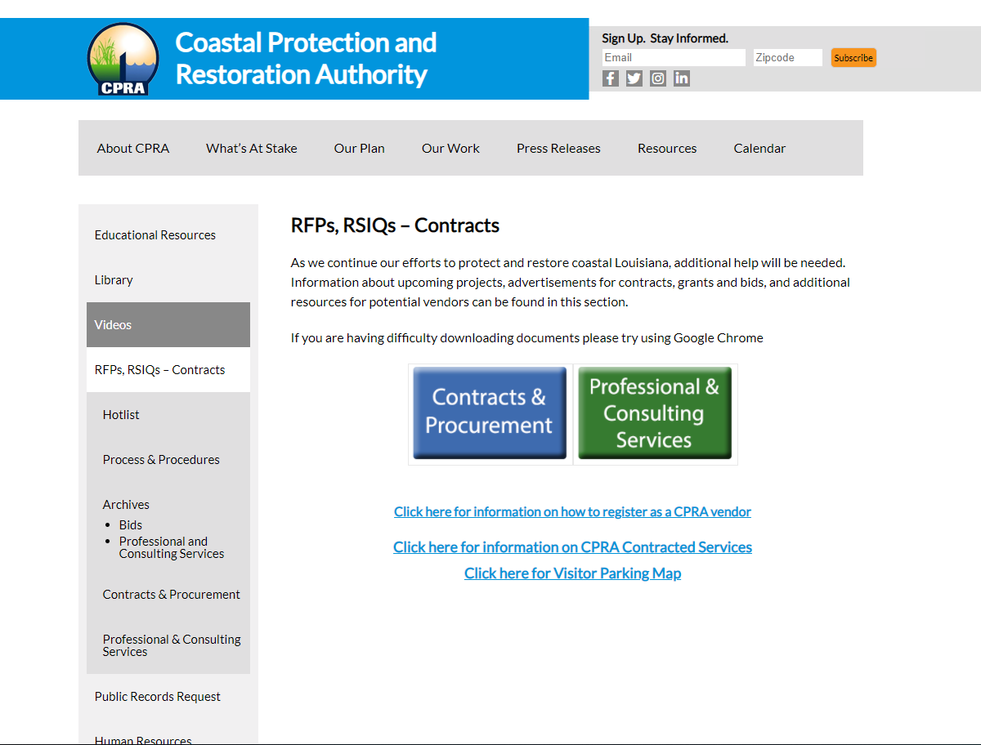
How to Find RSIQ & RFP Solicitations
Notes:
It should be noted that we also post these on the state's procurement site and we notify vendors.

Slide 24
Upcoming IDIQ Task Orders
Grand Bayou Ridge and Canal Backfilling – E&D
Calcasieu-Sabine Marsh and Hydrologic Restoration
Large-Scale Marsh Creation (multiple) – E&D
Drainage Structures – E&D
Post-Hurricane Work
Construction S&I for upcoming Marsh Creation work
Other O&M design work (through Regional Offices)
Notes:
Further, here is the long list of permits and permissions that must be granted, and highlights show where USACE receives formal public input.

Slide 25
MBSD Construction Administration, Inspection, Testing
Project Specific Request for Qualifications; Q2 2022
Scope:
Materials testing and QA
Day-to-day construction oversight
Construction progress tracking
Review of construction submittals, invoices, claims
Contract Value: ~$15M-20M
Notes:
Further, here is the long list of permits and permissions that must be granted, and highlights show where USACE receives formal public input.

Slide 26
Diversion Program Contracted Firms (114)

Slide 27
Extending Government Funding and Delivering Emergency
Assistance Act (Sept. 30, 2021)
Title I: $275M to NRCS EWP Program
Title II: $345M to NOAA
$3.4M for marine debris removal
$4.7M for hydrographic mapping and charting
$35M for research to improve forecasting
$25M for National Coastal Resilience Fund grants
Title IV (specifically USACE):
Investigations - $100M to study potential projects to reduce risk for future floods and hurricane
Construction - $3B
$1.5B for state’s with a major disaster dec. for Ida
$65M for continuing authorities
MR&T – $500M
Damage and Repairs - $2.081B
$368M for MR&T
$887M for O&M
$826M for FCCE

Slide 28
Infrastructure Investment and Jobs Act
(Nov. 15, 2021)
Ports and Waterways: $16.6 billion for coastal infrastructure, inland waterways, port infrastructure, and land ports of energy through Army Corps, DOT, USCG, GSA, and DHS.
Water Infrastructure: $55 billion for state revolving loan funds for clean and drinking water, addressing PFAS, replacing lead service lines, and supporting tribal water needs.
Power and Grid: $65 billion available for uses such as grid reliability and resiliency; securing critical minerals; improving supply chains for clean energy technologies; and advancing technology for carbon capture, hydrogen, direct air capture, energy efficiency.
Resiliency: $47.2 billion available for cybersecurity for critical infrastructure, waste management, flood and wildfire mitigation, drought management, coastal resiliency, ecosystem restoration, and weatherization.
Addressing Legacy Pollution: $21 billion to clean up brownfield and superfund sites, reclaim abandoned mine lands, and plug orphan oil and gas wells.

Slide 29
CONNECT WITH US!
SUBSCRIBE
@LouisianaCPRA

