Slide 1
Aging Water & Sewer Infrastructure
Rate Increase / Bond Programs
www.JeffParish.net

Slide 2
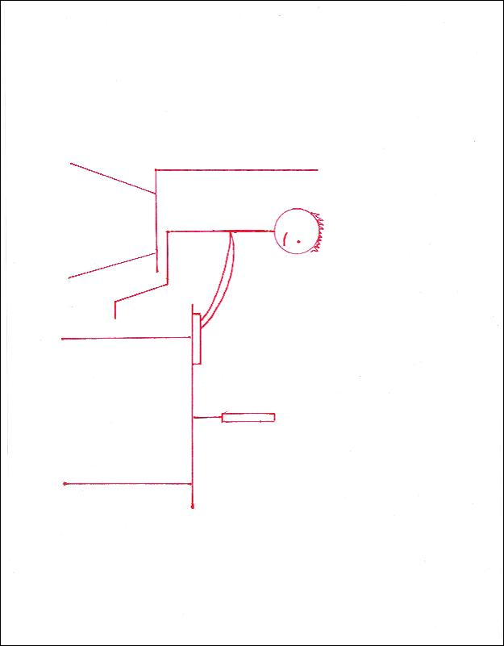
Artistic Capabilities – Action Photo
www.JeffParish.net

Slide 3
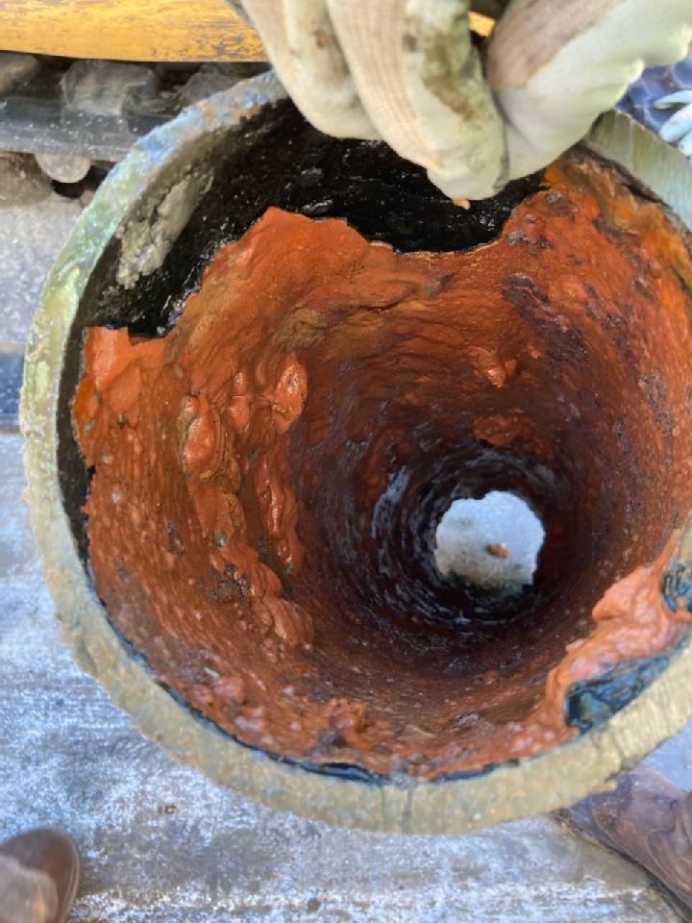
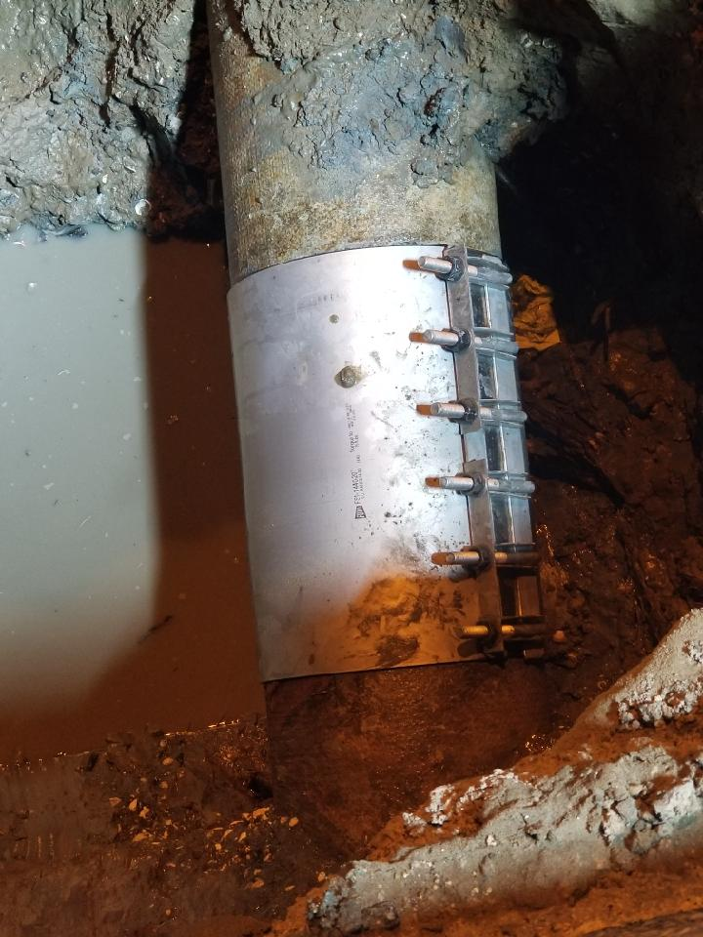
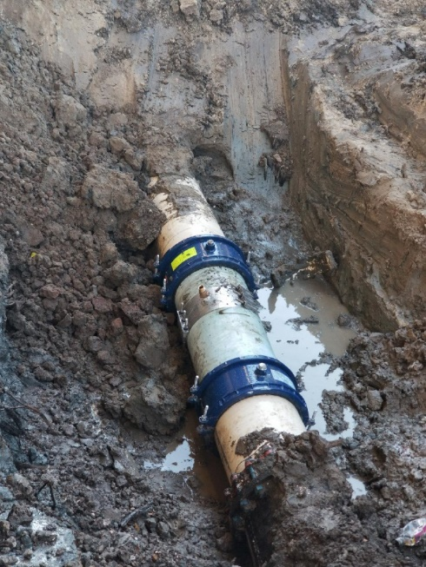
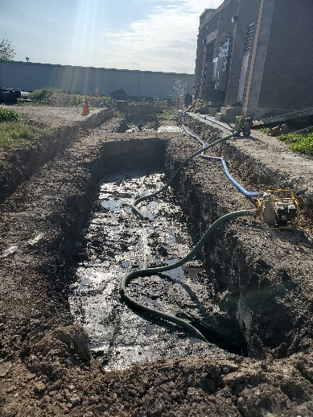
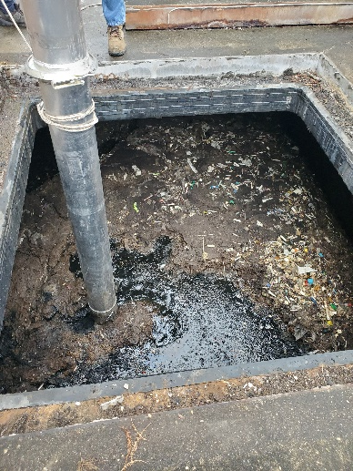
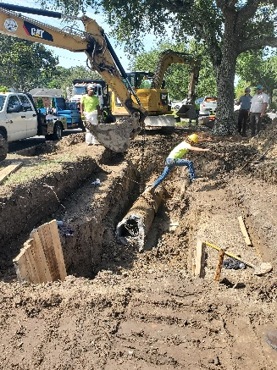
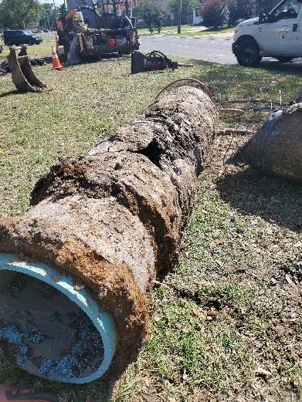
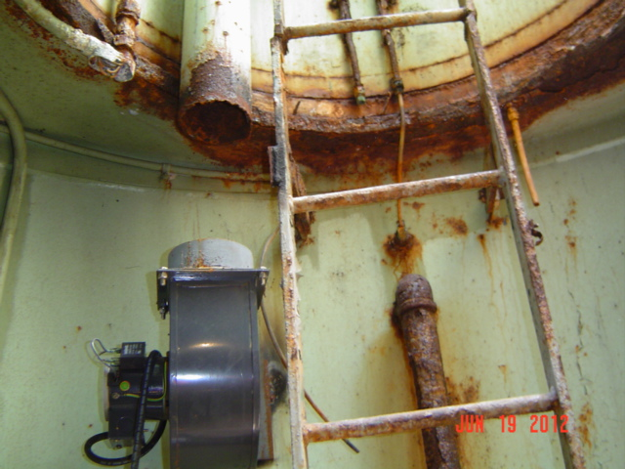
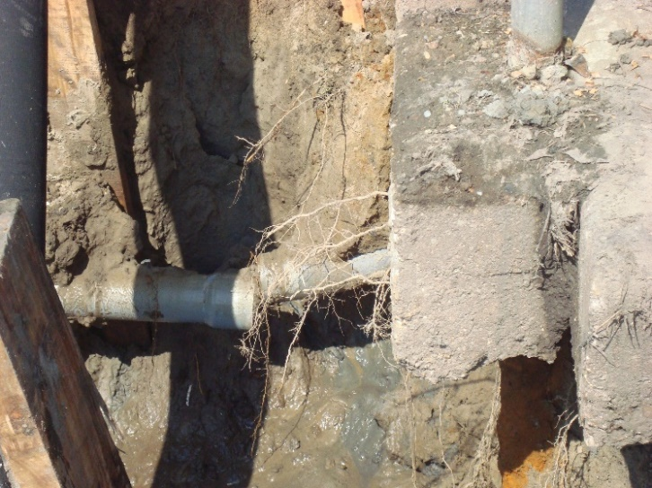
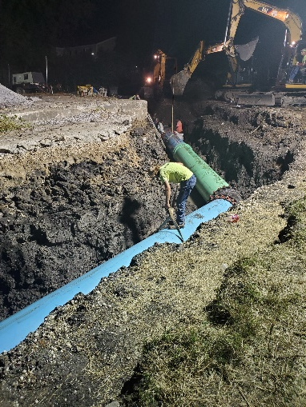
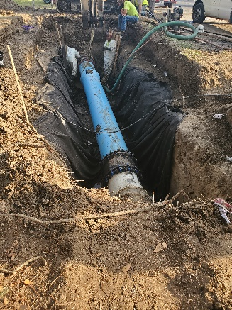
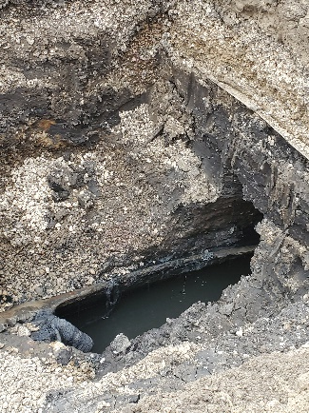
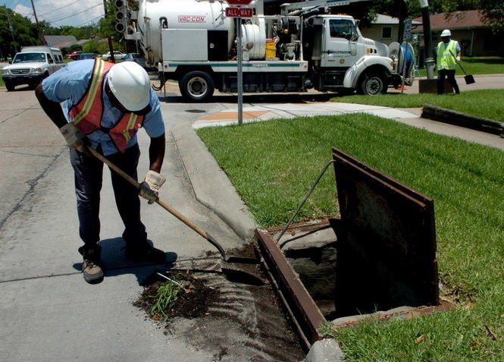
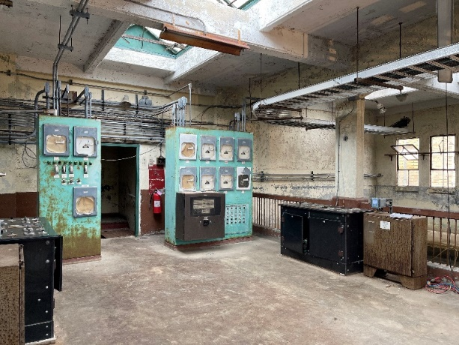
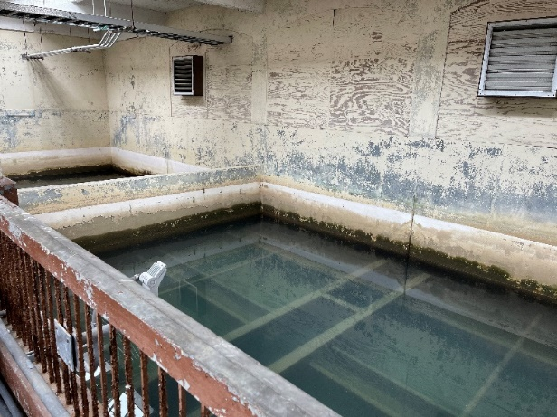
Aging Infrastructure (Water & Sewer Systems)
www.JeffParish.net

Slide 4
Water & Sewer Footprint:
Jefferson Parish provides water services to residents in:
Unincorporated Jefferson Parish
City of Kenner
City of Harahan
Town of Jean Lafitte
Town of Grand Isle
City of Gretna (Timberlane Subdivision)
City of Westwego (we sell to them)
Jefferson Parish provides sewer services to residents in:
Unincorporated Jefferson Parish
Town of Jean Lafitte
City of Gretna (Timberlane Subdivision)
www.JeffParish.net

Slide 5
East Bank Sewerage Lift Stations & Treatment Plants:
www.JeffParish.net

Slide 6
West Bank Sewerage Lift Stations & Treatment Plants:
www.JeffParish.net

Slide 7
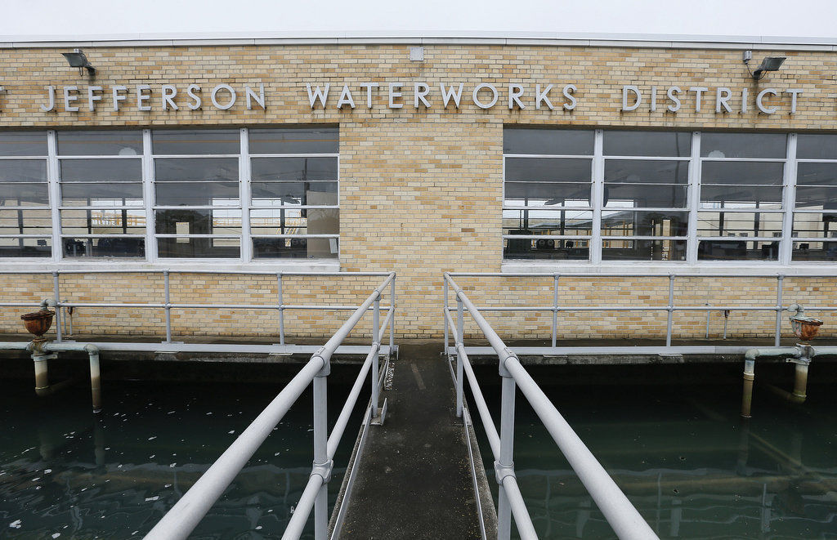
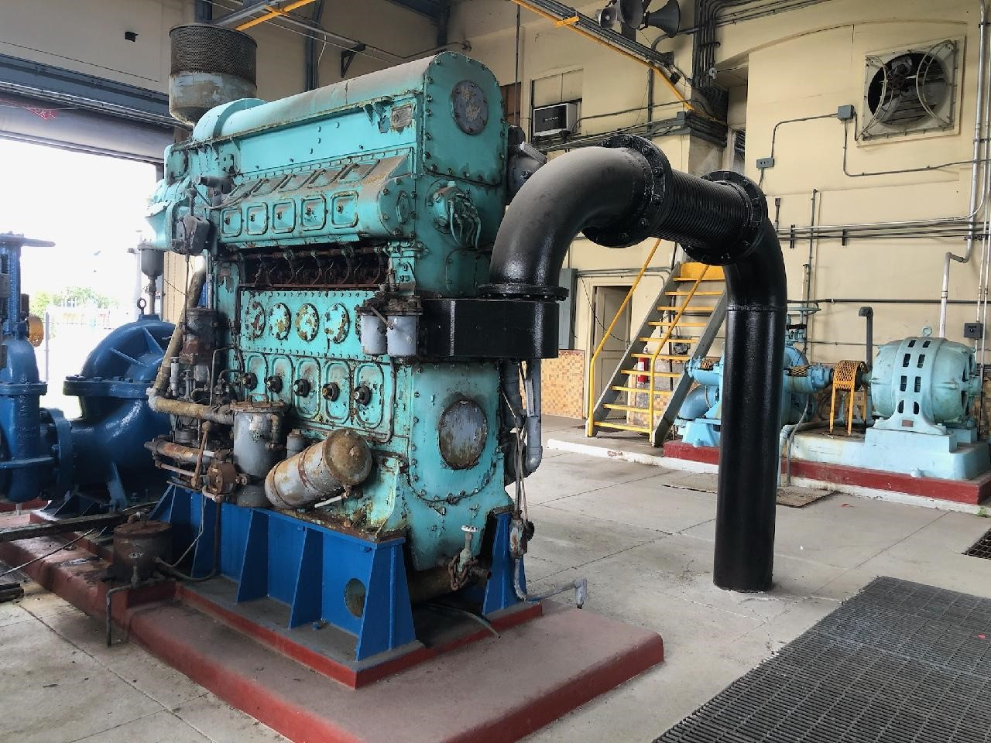
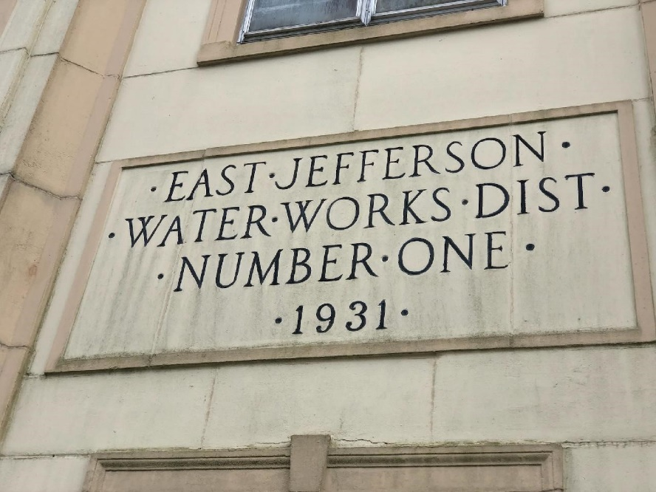
Aging Water Treatment Plant
www.JeffParish.net

Slide 8
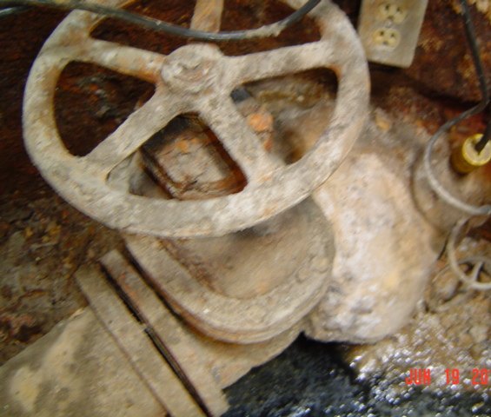
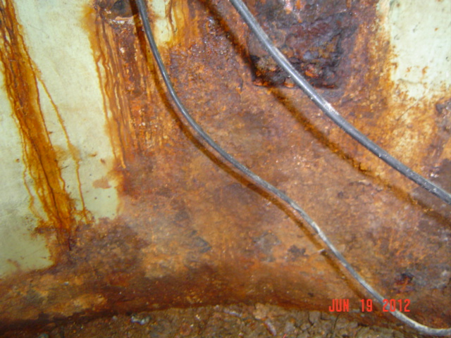
Aging Lift Stations
Example of aging lift station* infrastructure and the effects of corrosion
*Due to our topography and soil conditions, we must significantly rely on pumping to supplement the sewer gravity system.
www.JeffParish.net

Slide 9
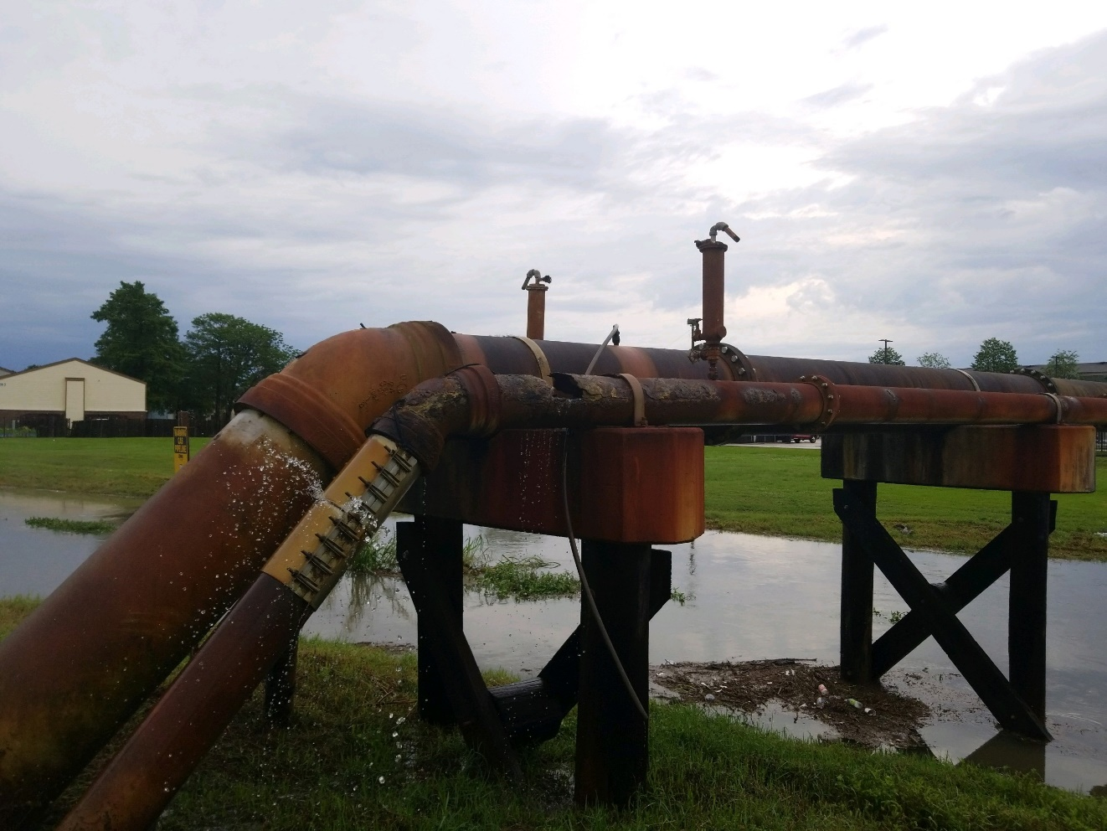
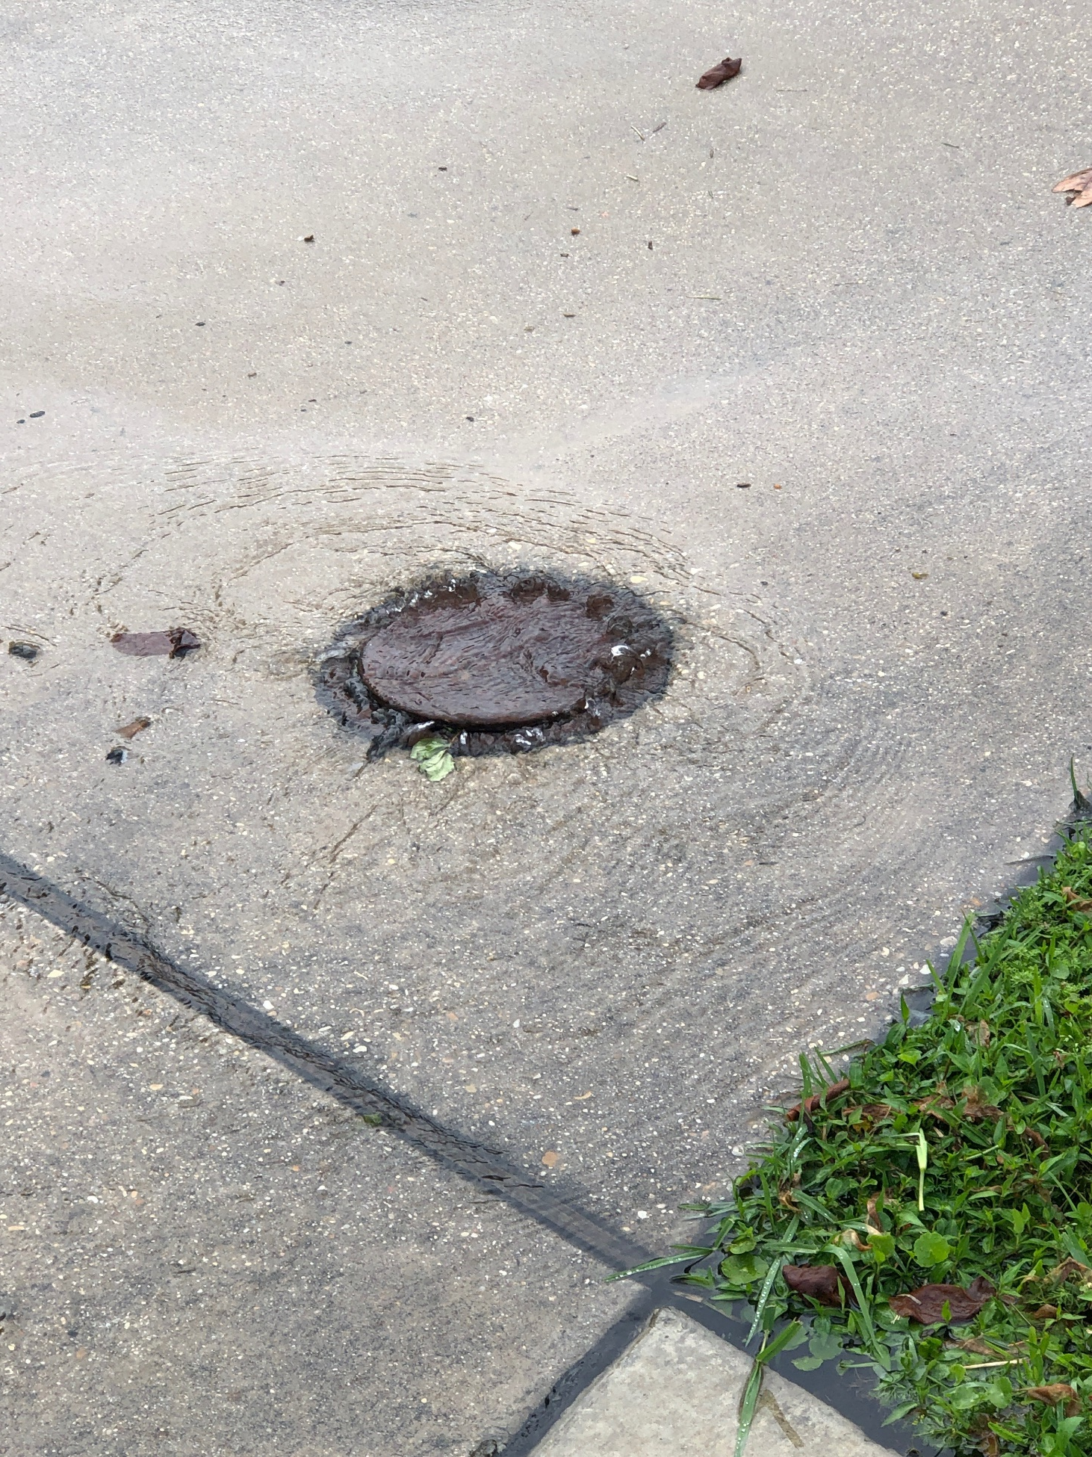
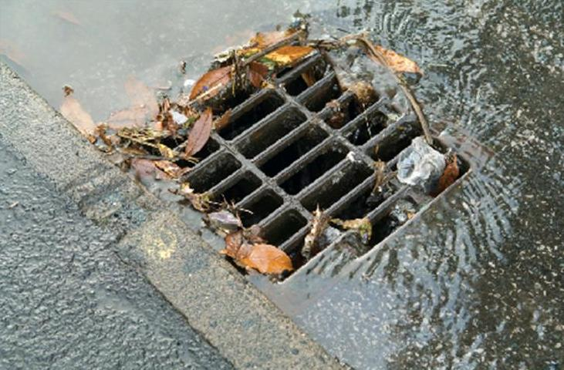
Sewer Line Repair + Inflow & Infiltration (I&I)
www.JeffParish.net

Slide 10
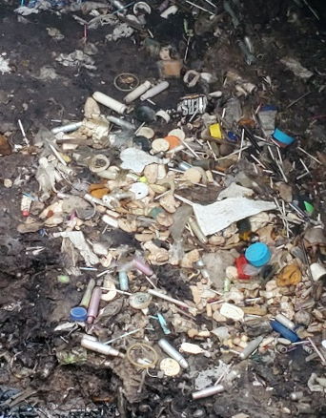
Aging Force Mains
Major force main repairs are typically performed at night under emergency conditions so as to not interrupt service to our residents.
www.JeffParish.net

Slide 11
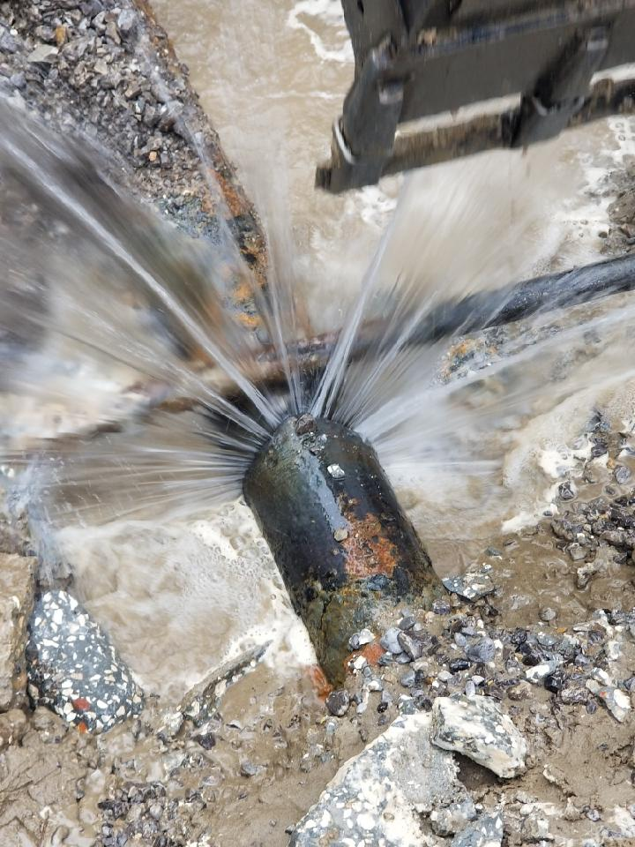
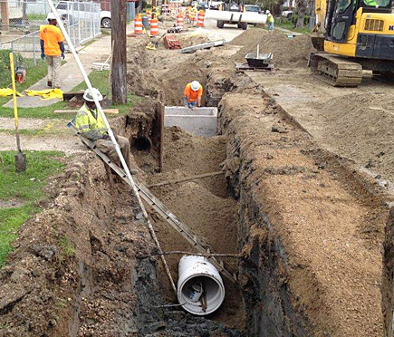
Aging Pipes
All of the underground infrastructure is aging; much of this was put in place in the 1950's.The Jefferson Parish Water Department responds to about 200 water leaks per week.
www.JeffParish.net

Slide 12
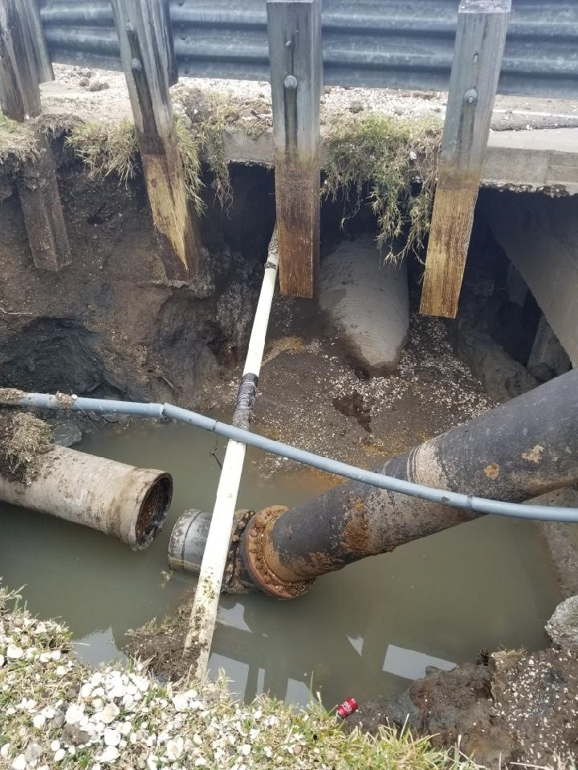
Price Brothers Pipe (Now Obsolete)
www.JeffParish.net

Slide 13
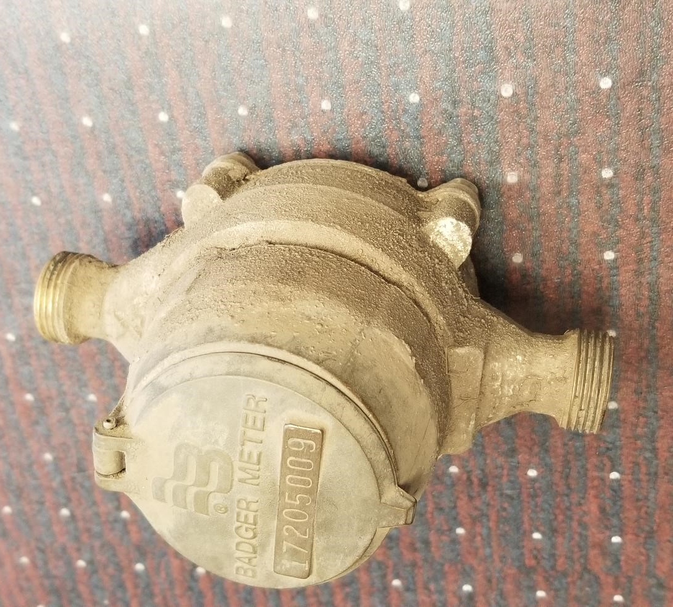
Old Water Meter (Requires In-Person Reading)
www.JeffParish.net

Slide 14
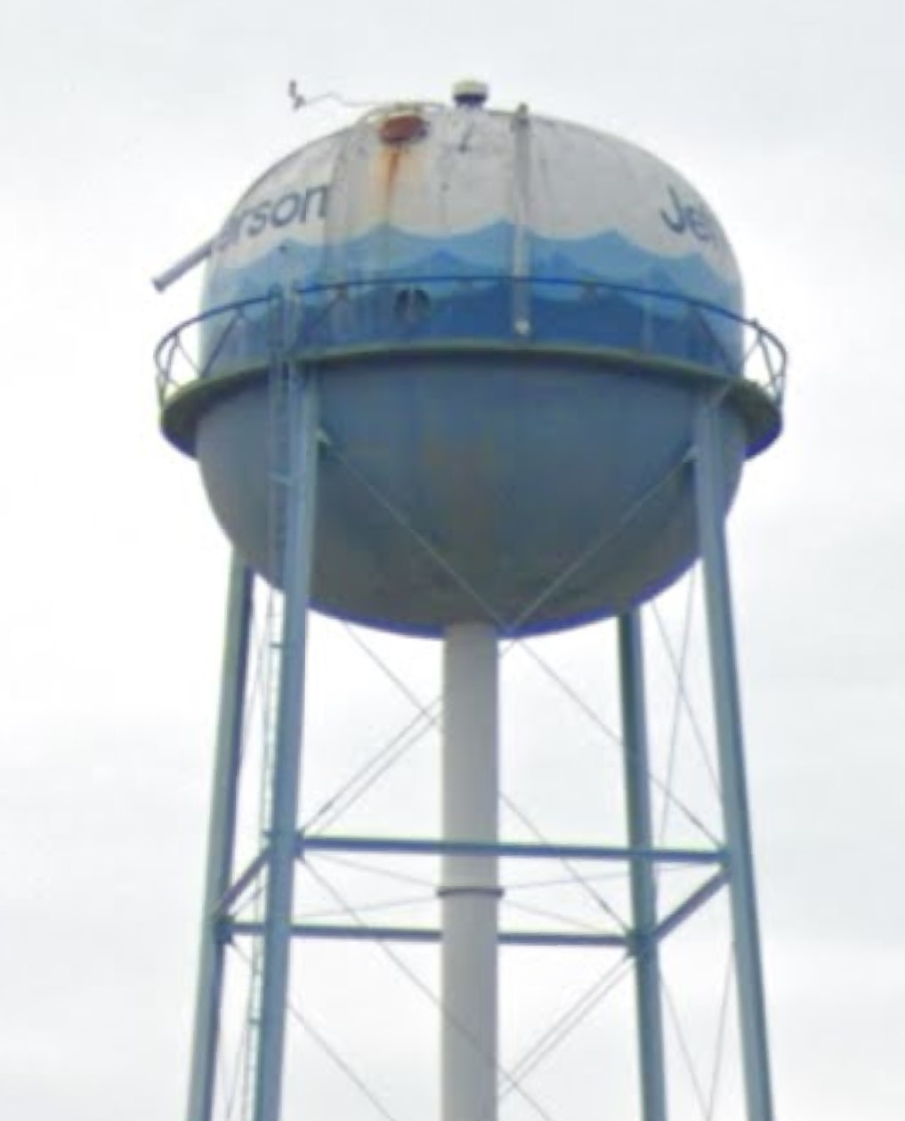
Old Water Tower in Bridge City
www.JeffParish.net

Slide 15
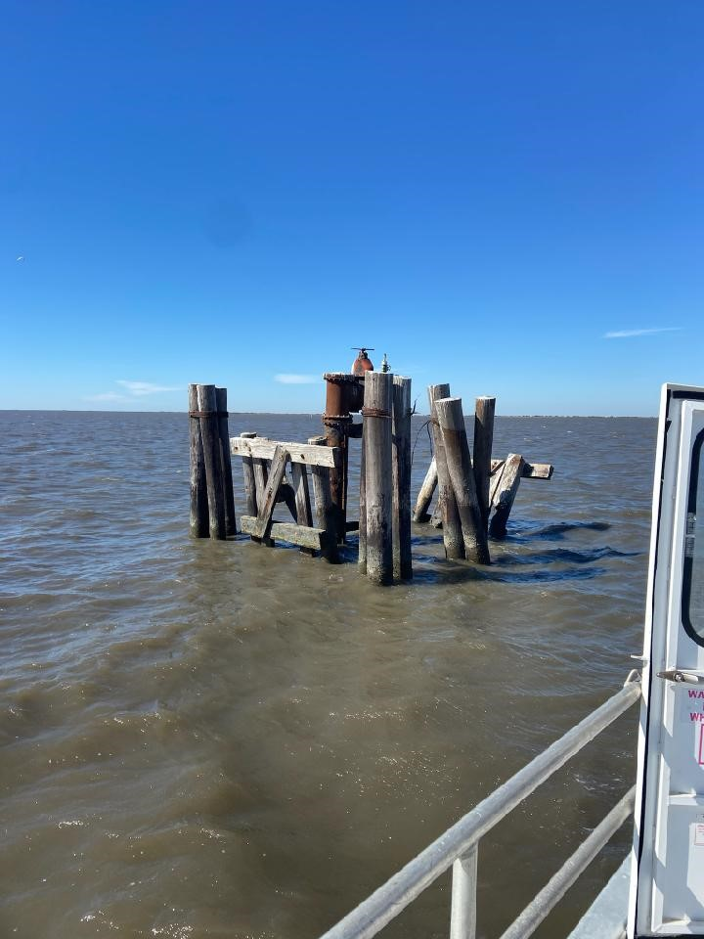
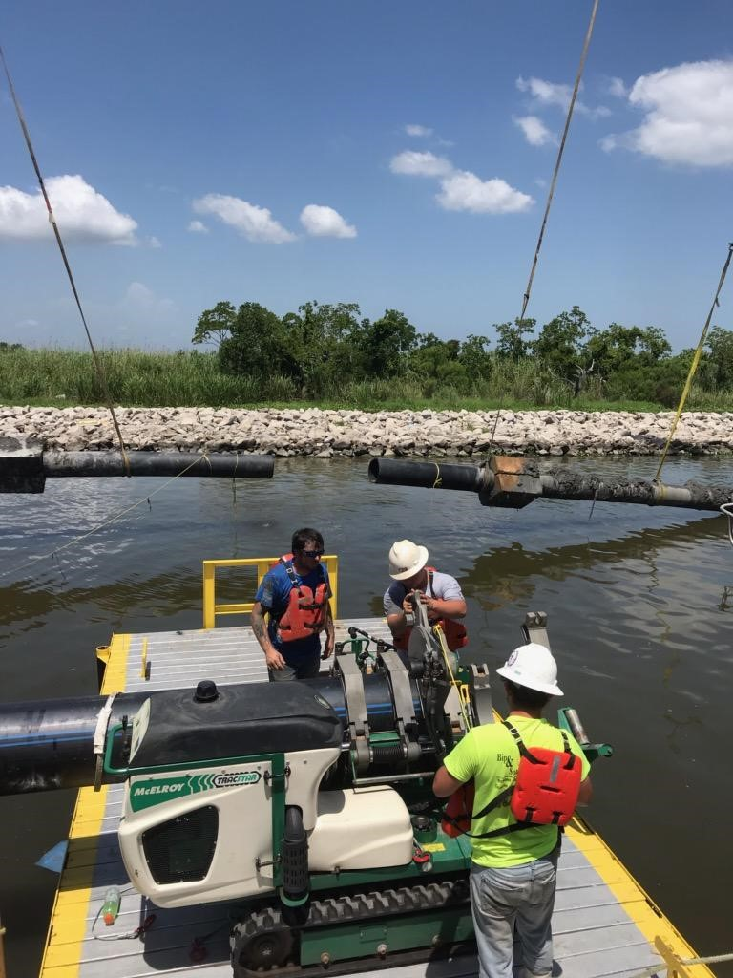
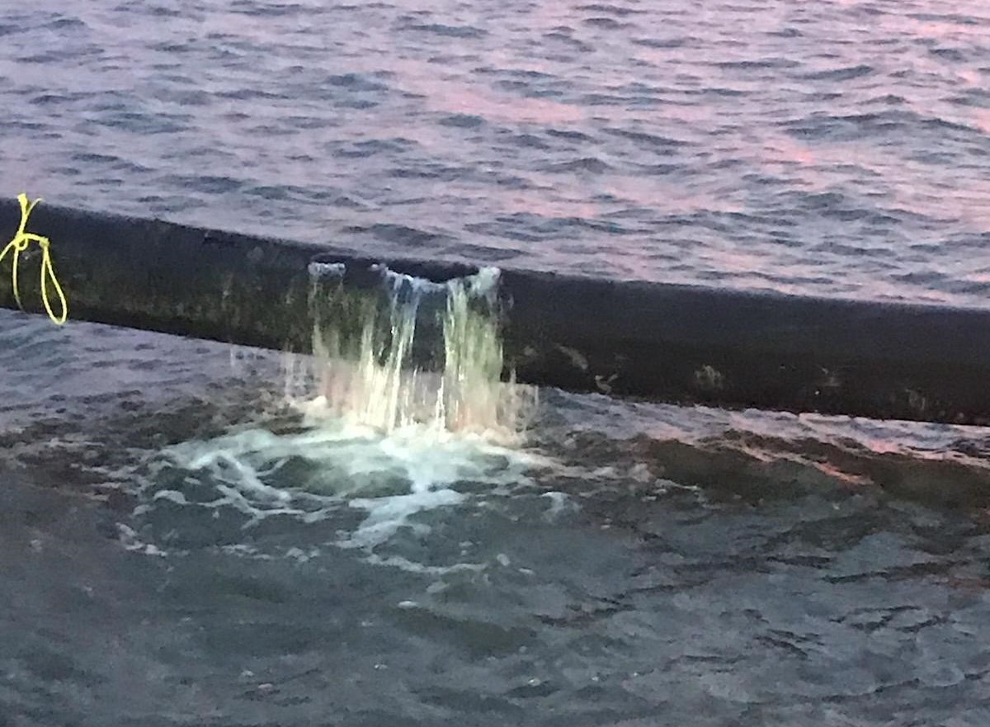
Grand Isle Water Line Break, Platforms & Repair
Repair Cost Total for the Past Five Years:
$5,501,207
www.JeffParish.net

Slide 16
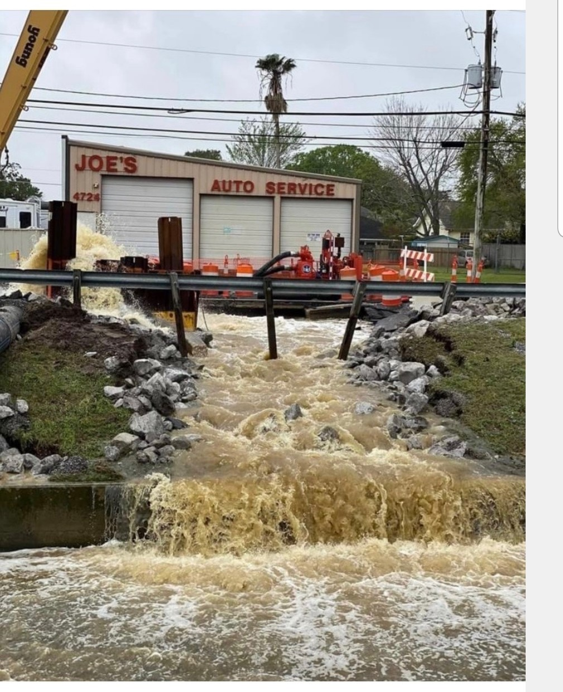
Example of Why More Funding is Needed:
February 23, 2021
*If the 66’ Sewer Force Main on West Napoleon Ave. had been replaced with a HDPP pipe, the cost to prepare a break would have been approximately $162,500 instead of the approximately $1.5 million expense associated with the Price Brothers repair.
www.JeffParish.net

Slide 17
Water Rate Increase
20 Year Outlook
www.JeffParish.net

Slide 18
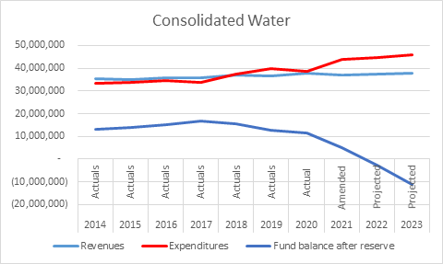
Water Department Revenues vs. Expenditures and fund balance after reserve (2014-2023)
www.JeffParish.net

Slide 19
Water Rate Comparison
(Based on Average Jefferson Parish Customer Usage of 6,200 Gallons/Month)
2021
www.JeffParish.net

Slide 20
Current Water & Sewer Rate Comparison with Surrounding Parishes & Municipalities
(Based on Average Jefferson Parish Customer Usage of 6,200 Gallons/Month)
2021
* Tangipahoa
www.JeffParish.net

Slide 21
Funds Needed for Water Department
Capital Projects (2021-2041)
Water treatment plant renovation total cost is $137 million and we have $71 million in existing funds
$66 million short
Automated Meter Reading Program total cost is estimated $88.1 million; $8.1 million for commercial properties in existing funds
$80 million for residential properties short
Rehab of 8 water towers total cost is $26.5 million; $4.5 million in existing funds
$22 million short
Grand Isle water line total cost is $12 million; $0 in existing funds;
$12 million short
System equipment replacement ($2 million/year) total cost is $42 million; $2 million in existing funds
$40 million short
DOTD/Emergency Capital Projects ($2 million/year) total cost is $42 million; $0 in existing funds
$42 million short
Water system pipe replacement recommendation from 2008 total cost is $790 million; $0 in existing funds
$790 million short
TOTAL FUNDS NEEDED: $1.1 Billion
www.JeffParish.net

Slide 22
Assumptions for Financial Projections
2023 Water Millage set at 3.33 Mills
Annual CPI increase is 1%
Annual operating cost increase is 5%
In 2022, Water Department bonds $192 million at a 20 year payback
www.JeffParish.net

Slide 23
Approved Water Rate Increase
Average Monthly Residential Water Bill (Based upon Average Consumption of 6,200 Gallons/Month and Annual 1% CPI)
Year | Service Charge | Minimum Charge for 0 to 3,000 Gal | Rate for 1,000 Gallons over 3,000 Gal | Additional Charge for 3,200 Gal | Total Bill | *Increase from Previous Year
2021 | $2.16 | $3.14 | $2.21 | $6.63 | $11.91
2022 | $2.18 | $4.12 | $2.90 | $8.71 | $14.99 | $3.08
2023 | $2.20 | $5.12 | $3.60 | $10.80 | $18.10 | $3.11
2024 | $2.23 | $6.12 | $4.31 | $12.92 | $21.24 | $3.14
2025 | $2.25 | $7.13 | $5.02 | $15.06 | $24.41 | $3.17
2026 | $2.27 | $8.15 | $5.74 | $17.22 | $27.62 | $3.20
2027 | $2.29 | $9.19 | $6.47 | $19.40 | $30.85 | $3.24
2028 | $2.32 | $10.23 | $7.20 | $21.60 | $34.12 | $3.27
2029 | $2.34 | $11.28 | $7.94 | $23.82 | $37.42 | $3.30
2030 | $2.36 | $12.35 | $8.69 | $26.07 | $40.76 | $3.33
2031 | $2.39 | $13.42 | $9.45 | $28.34 | $44.13 | $3.37
2032 | $2.41 | $13.87 | $9.76 | $29.29 | $45.56 | $1.43
2033 | $2.44 | $14.33 | $10.09 | $30.26 | $47.00 | $1.44
2034 | $2.46 | $14.79 | $10.41 | $31.23 | $48.45 | $1.46
2035 | $2.48 | $15.26 | $10.74 | $32.21 | $49.93 | $1.47
2036 | $2.51 | $15.72 | $11.07 | $33.20 | $51.41 | $1.49
2037 | $2.53 | $16.20 | $11.40 | $34.20 | $52.91 | $1.50
2038 | $2.56 | $16.68 | $11.74 | $35.22 | $54.43 | $1.52
2039 | $2.59 | $17.16 | $12.08 | $36.24 | $55.96 | $1.53
2040 | $2.61 | $17.65 | $12.42 | $37.27 | $57.51 | $1.55
2041 | $2.63 | $18.14 | $12.77 | $38.31 | $59.07 | $1.56
*Average monthly residential water bill increases as follows: 2022-2031, $2.93 each year plus the Annual CPI adjustment 2032-2041, $0.98 each year plus the Annual CPI adjustment
www.JeffParish.net

Slide 24
Approved Water Rate Increase for Minimum Usage Customers (Approximately 36% of Parish residents)
Minimum Charge User Monthly Residential Water Bill (Based upon Consumption under 3,000 Gallons/Month and Annual 1% CPI)
Year | Service Charge | Minimum Charge for 0 to 3,000 Gal | Total Bill | *Increase from Previous Year
2021 | $2.16 | $3.14 | $5.28
2022 | $2.18 | $4.12 | $6.28 | $1.00
2023 | $2.20 | $5.12 | $7.30 | $1.01
2024 | $2.23 | $6.12 | $8.32 | $1.02
2025 | $2.25 | $7.13 | $9.36 | $1.03
2026 | $2.27 | $8.15 | $10.40 | $1.04
2027 | $2.29 | $9.19 | $11.46 | $1.06
2028 | $2.32 | $10.23 | $12.52 | $1.07
2029 | $2.34 | $11.28 | $13.60 | $1.08
2030 | $2.36 | $12.35 | $14.69 | $1.09
2031 | $2.39 | $13.42 | $15.79 | $1.10
2032 | $2.41 | $13.87 | $16.26 | $0.48
2033 | $2.44 | $14.33 | $16.74 | $0.48
2034 | $2.46 | $14.79 | $17.23 | $0.48
2035 | $2.48 | $15.26 | $17.72 | $0.49
2036 | $2.51 | $15.72 | $18.21 | $0.49
2037 | $2.53 | $16.20 | $18.71 | $0.50
2038 | $2.56 | $16.68 | $19.21 | $0.50
2039 | $2.59 | $17.16 | $19.72 | $0.51
2040 | $2.61 | $17.65 | $20.24 | $0.51
2041 | $2.63 | $18.14 | $20.76 | $0.52
*Average monthly residential water bill increases as follows: 2022-2031, $0.94 each year plus the Annual CPI adjustment 2032-2041, $0.32 each year plus the Annual CPI adjustment Approximately 36% of Residential customers use under 3,000 Gallons/Month
www.JeffParish.net

Slide 25
Current 2021 Water Revenue vs Operating Cost vs Capital Funds
 | Operating Revenue
 | Total Water Sales | Add. Funding | Total | Operating Cost | Available Capital Funds After Operating Expenses | Capital Millage Funds | Total Available Capital Funds
2021 | $26,868,965 | $10,000,000 | $36,868,965 | $41,211,602 | ($4,342,637) | $11,590,357 | $7,247,720
Projected 2022 Water Revenue vs Operating Cost vs Capital Funds
 | Operating Revenue
 | Total Water Sales | Add. Funding | Total | Operating Cost | Available Capital Funds After Operating Expenses | Capital Millage Funds | Total Available Capital Funds
2022 | $35,278,951 | $10,000,000 | $45,278,951 | $43,272,182 | $2,006,769 | $11,700,000 | $13,706,769
www.JeffParish.net

Slide 26
Projected 2031 Water Revenue vs Operating Cost vs Capital Funds
 | Operating Revenue
 | Total Water Sales | Add. Funding | Total | Operating Cost | Available Capital Funds After Operating Expenses | Capital Millage Funds | Total Available Capital Funds
2031 | $114,856,026 | $10,000,000 | $124,856,026 | $67,129,357 | $57,726,669 | $12,796,118 | $70,522,787
Projected 2041 Water Revenue vs Operating Cost vs Capital Funds
 | Operating Revenue
 | Total Water Sales | Add. Funding | Total | Operating Cost | Available Capital Funds After Operating Expenses | Capital Millage Funds | Total Available Capital Funds
2041 | $155,264,499 | $10,000,000 | $165,264,499 | $109,346,649 | $55,917,850 | $14,134,875 | $70,052,724
www.JeffParish.net

Slide 27
Immediate Spending Plan for Water Capital Projects with $192 Million of Bond Funds
Funds needed for Eastbank Water Treatment Plant (estimated completion 2024) | $ 66,000,000
Funds needed for Residential Portion of Automated Meters (estimated completion 2029) | $ 80,000,000
Funds needed for Current Cycle Water Tower Upgrades (Total of 8) (estimated completion 2025) | $ 9,000,000
Funds needed for Grand Isle Water Line (estimated completion 2023) | $ 12,000,000
Remaining Funds to begin $770,000,000 pipe replacement program to be used in 2022, 2023, 2024 | $ 25,000,000
Total Bond Funds Generated (with increased water rate and millage remaining same, 3.33 mills) | $ 192,000,000
www.JeffParish.net

Slide 28
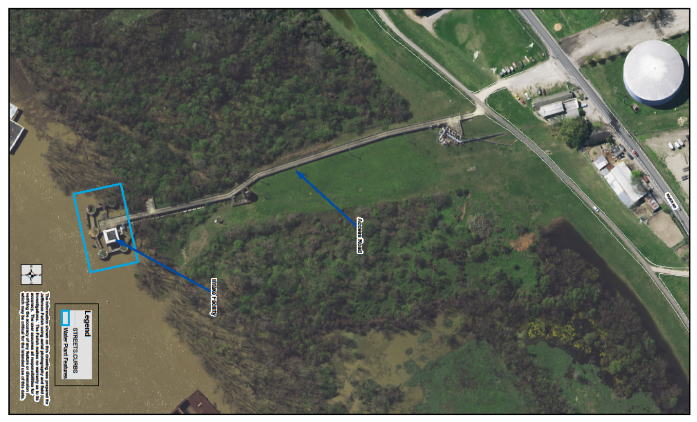
Blue House Raw Water Intake Rehabilitation ($5.9 Million) & Levee Pump Station Rehabilitation ($5 Million)
Blue
House
Levee
Pump
Station
28
www.JeffParish.net

Slide 29
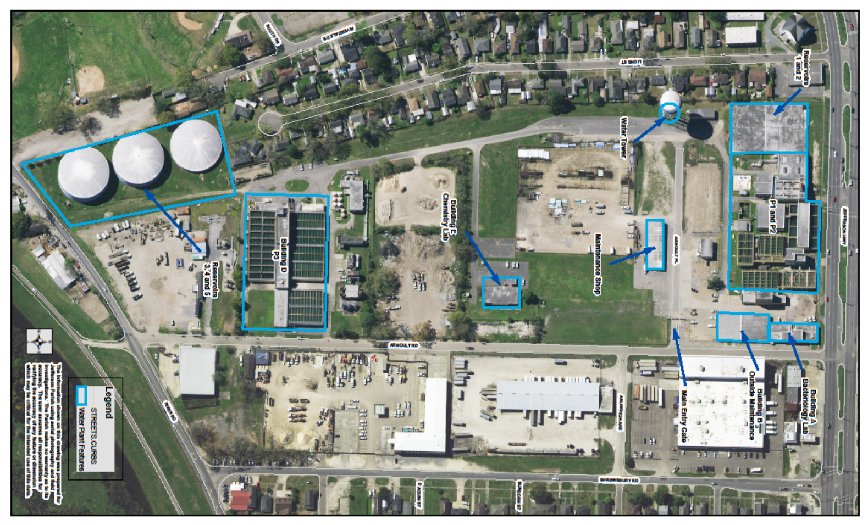
Existing Jefferson Parish East Bank Water Treatment Plant (52 Million Gallons/Day Capacity)
P1 - 1931
&
P2 - 1955
P3 - 1969
with
1990 Upgrade
29
www.JeffParish.net

Slide 30
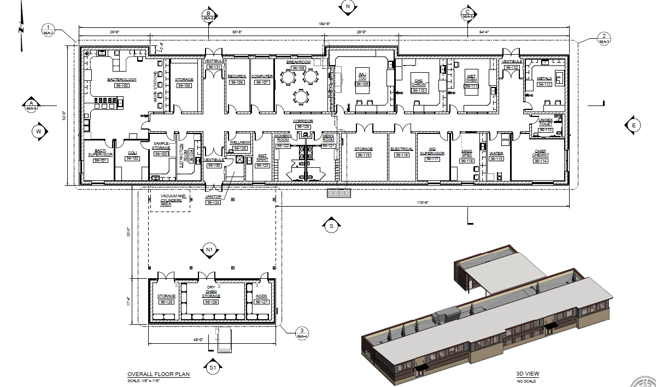
New Jefferson Parish East Bank Water Quality Laboratory ($5.5 Million)
30
www.JeffParish.net

Slide 31
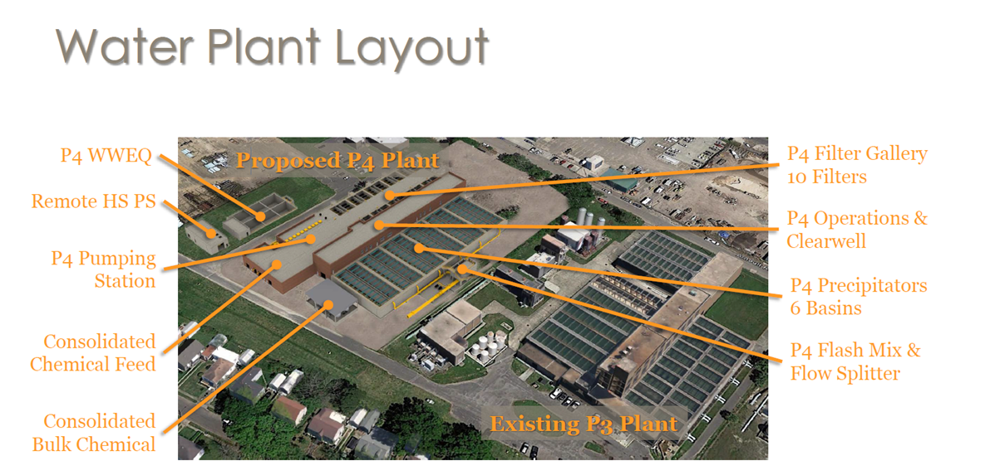
New East Bank P4 Water Treatment Plant ($115 Million)
(40 Million Gallons/Day Initial Capacity with
Potential Expansion to 60 Million Gallons/Day)
31
www.JeffParish.net

Slide 32
Water System Pipe Replacement Program
YEAR | AVAILABLE FUNDS
2022 | $ 5 Million
2023 | $12 Million
2024 | $13 Million
2025 | $23 Million
2026 | $26 Million
2027 | $27 Million
2028 | $29 Million
2029 | $33 Million
2030 | $47 Million
2031 | $52 Million
2032 | $52 Million
2033 | $52 Million
2034 | $52 Million
2035 | $52 Million
2036 | $52 Million
2037 | $52 Million
2038 | $52 Million
2039 | $53 Million
2040 | $53 Million
2041 | $53 Million
TOTAL | $790 Million
32
www.JeffParish.net

Slide 33
Sewer Rate Increase
20 Year Outlook
www.JeffParish.net

Slide 34
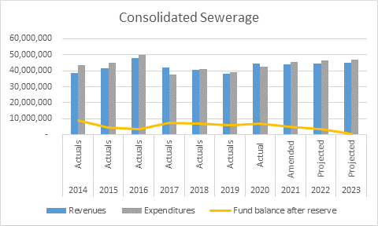
Sewer Department Revenues vs. Expenditures and fund balance after reserve (2014-2023)
www.JeffParish.net

Slide 35
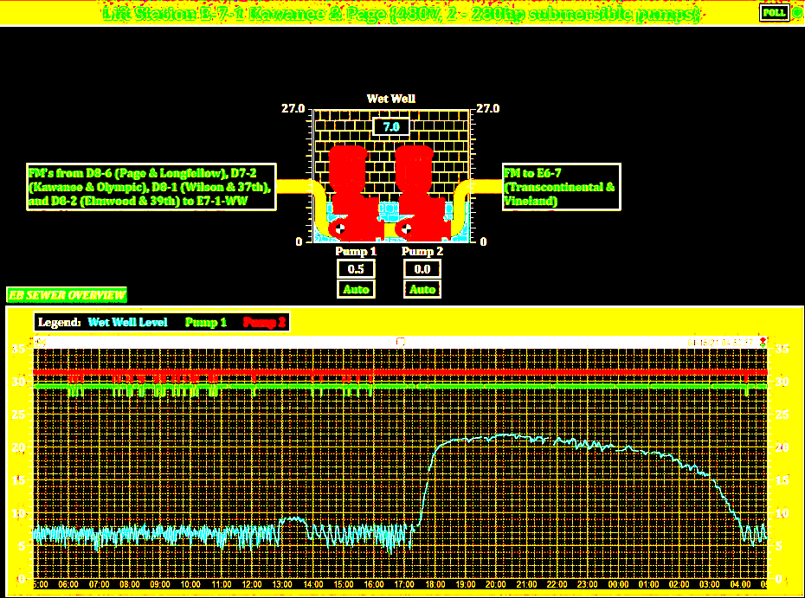
SCADA System
Demonstrates the effect of I&I and rain water flows into our Sewer System
www.JeffParish.net

Slide 36
Funds Needed for Sewer Capital Projects (2021-2041)
Treatment plant upgrades and rehab total cost is $96,290,000 and we have $31,290,000 in existing funds
$65 million short
Lift stations upgrades and rehab total cost is $194,580,000; $49,580,000 in existing funds
$145 million short
Force main upgrades and rehab total cost is $47,530,000; $7,530,000 in existing funds
$40 million short
Price Brothers pipe rehab total cost is $24,960,000; $960,000 in existing funds
$24 million short
www.JeffParish.net

Slide 37
Funds Needed for Sewer Capital Projects (2021-2041)
Gravity system upgrades and rehab total cost is $109,100,000; $9,100,000 in existing funds
$100 million short
SCADA installation and operation total cost is $6,200,000; $2,200,000 in existing funds
$4 million short
Odor control upgrades total cost is $8,000,000; no existing funds
$8 million short
Generator installation and operation total cost is $32,000,000; no existing funds
$32 million short
I/I pipe replacement program total cost is $800,000,000
$800 million short
TOTAL FUNDS NEEDED: $1.2 Billion
www.JeffParish.net

Slide 38
Current Sewer Rate Comparison
Jefferson Parish vs. New Orleans & Baton Rouge
(Based on Average Jefferson Parish Customer Usage of 6,200 Gallons/Month)
2021
www.JeffParish.net

Slide 39
Assumptions for Financial Projections
2023 Sewer Millage set at 3.36 Mills
Annual CPI increase is 1%
Annual operating cost increase is 5%
In 2022, Sewer Department bonds $100 million at a 20 year payback
www.JeffParish.net

Slide 40
Approved Sewer Rate Increase
Average Monthly Residential Sewer Bill (Based upon 85 % of Average Water Consumption of 6,200 Gallons/Month and Annual 1% CPI)
Year | Service Charge | Minimum Charge for 0 to 3,000 Gal | Rate for 1,000 Gallons over 3,000 Gal | Additional Charge for 2,700 Gal | Total Bill | *Increase from Previous Year
2021 | $1.42 | $2.32 | $3.38 | $6.76 | $10.50
2022 | $1.43 | $3.28 | $4.78 | $9.56 | $14.27 | $3.77
2023 | $1.45 | $4.25 | $6.19 | $12.39 | $18.08 | $3.81
2024 | $1.46 | $5.23 | $7.62 | $15.24 | $21.93 | $3.85
2025 | $1.48 | $6.22 | $9.06 | $18.12 | $25.82 | $3.89
2026 | $1.49 | $7.22 | $10.52 | $21.04 | $29.75 | $3.93
2027 | $1.51 | $8.23 | $11.99 | $23.98 | $33.71 | $3.97
2028 | $1.52 | $9.25 | $13.47 | $26.95 | $37.72 | $4.01
2029 | $1.54 | $10.28 | $14.97 | $29.95 | $41.76 | $4.05
2030 | $1.55 | $11.32 | $16.49 | $32.98 | $45.85 | $4.09
2031 | $1.57 | $12.37 | $18.02 | $36.04 | $49.98 | $4.13
2032 | $1.58 | $12.96 | $18.88 | $37.77 | $52.31 | $2.33
2033 | $1.60 | $13.56 | $19.75 | $39.51 | $54.67 | $2.36
2034 | $1.62 | $14.16 | $20.63 | $41.27 | $57.05 | $2.38
2035 | $1.63 | $14.77 | $21.52 | $43.05 | $59.45 | $2.40
2036 | $1.65 | $15.39 | $22.42 | $44.84 | $61.88 | $2.43
2037 | $1.67 | $16.01 | $23.33 | $46.66 | $64.34 | $2.45
2038 | $1.68 | $16.64 | $24.24 | $48.49 | $66.81 | $2.48
2039 | $1.70 | $17.28 | $25.17 | $50.34 | $69.32 | $2.50
2040 | $1.72 | $17.92 | $26.10 | $52.21 | $71.84 | $2.53
2041 | $1.73 | $18.57 | $27.05 | $54.10 | $74.40 | $2.55
*Average monthly residential sewer bill increases as follows: 2022 - 2031, $3.63 plus the Annual CPI adjustment 2032 - 2041, $1.82 plus the Annual CPI adjustment
www.JeffParish.net

Slide 41
Approved Sewer Rate Increase for Minimum Usage Customers (Approximately 36% of Parish Residents)
Monthly Residential Sewer Bill (Based upon 85% of Water Usage under 3,530 Gallons/Month and Annual 1% CPI)
Year | Service Charge | Minimum Charge for 0 to 3,000 Gal | Total Bill | *Increase from Previous Year
2021 | $1.42 | $2.32 | $3.74
2022 | $1.43 | $3.28 | $4.71 | $0.97
2023 | $1.45 | $4.25 | $5.70 | $0.98
2024 | $1.46 | $5.23 | $6.69 | $0.99
2025 | $1.48 | $6.22 | $7.70 | $1.00
2026 | $1.49 | $7.22 | $8.71 | $1.01
2027 | $1.51 | $8.23 | $9.74 | $1.02
2028 | $1.52 | $9.25 | $10.77 | $1.03
2029 | $1.54 | $10.28 | $11.82 | $1.04
2030 | $1.55 | $11.32 | $12.87 | $1.06
2031 | $1.57 | $12.37 | $13.94 | $1.07
2032 | $1.58 | $12.96 | $14.55 | $0.61
2033 | $1.60 | $13.56 | $15.16 | $0.61
2034 | $1.62 | $14.16 | $15.78 | $0.62
2035 | $1.63 | $14.77 | $16.41 | $0.63
2036 | $1.65 | $15.39 | $17.04 | $0.63
2037 | $1.67 | $16.01 | $17.68 | $0.64
2038 | $1.68 | $16.64 | $18.32 | $0.65
2039 | $1.70 | $17.28 | $18.98 | $0.65
2040 | $1.72 | $17.92 | $19.63 | $0.66
2041 | $1.73 | $18.57 | $20.30 | $0.66
*Average monthly residential sewer bill increases as follows: 2022 - 2031, $0.93 plus the Annual CPI adjustment 2032 - 2041, $0.46 plus the Annual CPI adjustment Approximately 36% of Residential customers use under 3,530 Gallons/Month.
www.JeffParish.net

Slide 42
Current 2021 Sewer Revenue vs Operating Cost vs Capital Funds
 | Operating Revenue
 | Sewer Sales | Millage | Additional Funding | Operating Cost | Available Capital Funds After Operating Expenses
2021 | $23,242,186 | $9,640,900 | $6,984,475 | $41,327,975 | ($1,460,414)
Projected 2022 Sewer Revenue vs Operating Cost vs Capital Funds
 | Operating Revenue
 | Sewer Sales | Millage | Additional Funding | Operating Cost | Available Capital Funds After Operating Expenses
2022 | $32,864,451 | $9,737,309 | $6,984,475 | $43,394,374 | $6,191,861
www.JeffParish.net

Slide 43
Projected 2031 Sewer Revenue vs Operating Cost vs Capital Funds
 | Operating Revenue
 | Sewer Sales | Millage | Additional Funding | Operating Cost | Available Capital Funds After Operating Expenses
2031 | $123,912,368 | $10,649,551 | $6,984,475 | $67,318,916 | $74,227,478
Projected 2041 Sewer Revenue vs Operating Cost vs Capital Funds
 | Operating Revenue
 | Sewer Sales | Millage | Additional Funding | Operating Cost | Available Capital Funds After Operating Expenses
2041 | $185,995,610 | $11,763,730 | $6,984,475 | $109,655,421 | $95,088,394
www.JeffParish.net

Slide 44
Immediate Spending Plan for Sewer Capital Projects with $100 Million of Bond Funds (2022-2025)
Funds needed for Treatment Plants Upgrades and Rehab | $3,823,500
Funds needed for Lift Stations Upgrades and Rehab | $8,520,000
Funds needed for Force Main Upgrades and Rehab | $6,000,000
Funds needed for Price Brothers Pipe Rehab | $3,600,000
Funds needed for Gravity System Upgrades & Rehab | $15,000,000
www.JeffParish.net

Slide 45
Spending Plan for Sewer Capital Projects with
$100 Million of Bond Funds (2022-2025)
Funds needed for SCADA Installation and Operation | $3,000,000
Funds needed for Odor Control Upgrades | $3,750,000
Funds needed for Generator Installation and Operation | $14,250,000
Remaining Funds needed to begin I/I Pipe Replacement Program | $42,056,500
Total Bond Funds Generated (with increased sewer rate and millage remaining same, 3.36 mills) | $100,000,000
www.JeffParish.net

Slide 46
Sewer System Infiltration/Inflow Pipe Replacement Program
YEAR | AVAILABLE FUNDS
2022 | $ 9 Million
2023 | $16 Million
2024 | $16 Million
2025 | $16 Million
2026 | $16 Million
2027 | $18 Million
2028 | $22 Million
2029 | $30 Million
2030 | $37 Million
2031 | $44 Million
2032 | $48 Million
2033 | $50 Million
2034 | $52 Million
2035 | $55 Million
2036 | $57 Million
2037 | $58 Million
2038 | $61 Million
2039 | $64 Million
2040 | $65 Million
2041 | $66 Million
TOTAL | $800 Million
46
www.JeffParish.net

Slide 47
Current Compliance Orders
As of January 1, 2021, Jefferson Parish has 10 outstanding LDEQ Compliance Orders (CO):
Jonathan Davis- 2 COs
Rosethorne-2 warning letters
Eastbank Plant-3 COs
Bridge City-1 CO
Harvey Plant-3 COs
Marrero-1 COs
Reasons for the COs and warning letters include but are not limited to
Multiple overflows
Biological Oxygen Demand (BOD) exceedances
Significant Non-Compliance (SNC) cited by the Environmental Protection Agency (EPA)
Significant repairs and new construction are required in order to remedy the violations in these orders. LADEQ issued compliance orders are often coupled with potential penalty notices that are of great cost to Jefferson Parish
www.JeffParish.net

