Slide 1
ACEC COVID-19 Business Impact Survey - Wave 2
March 26, 2020

Slide 2
Demographics

Slide 3
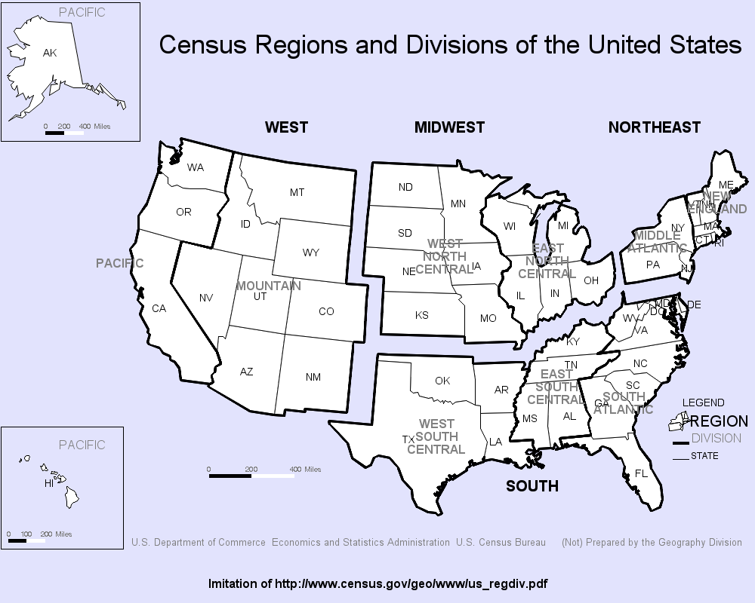

Slide 4
The geographic location of Respondents’ organizations are statistically the same between Wave 1 and wave 2.
For an analysis of trends by region, please refer to the report for Wave 1.
Q13. In which state is your organization headquartered?
Notes:
79% of educators are members.

Slide 5
Consistent with Wave 1, More than half (53%) of respondents indicate there are 25 or fewer Full-time equivalents at their organization. The median firm size is also identical between the two time series.
The largest organization in Wave 1 reported 11,000 FTEs compared to 10,000 in Wave 2.
Although the average number of FTEs in Wave 2 (124) is larger than in Wave 1 (107), the median is the exact same (23), indicating that some very large firms are skewing the average size. Therefore, the median is a more helpful metric to use in this analysis.
Throughout this report meaningful, statistically significant differences between firm size are noted.
Q14. How many full-time equivalent employees (FTEs) do you have? If you are not sure, please provide your best estimate.
Notes:
79% of educators are members.

Slide 6
Travel Restrictions

Slide 7
Although 82% of firms indicated they do not normally travel internationally, among those that do, nearly all have restricted travel for training / events / conferences and air travel.
* NOTE: Although the same question was asked in Wave 1 and Wave 2, two response options were displayed slightly differently between the two waves, likely causing the differences shown in the graph. In Wave 1, “None of the above” and “ We don’t normally travel internationally” were combined as one option while in Wave 2 they were separated. Despite this change, the trend is the same in terms of the top restrictions imposed.
As detailed on the following slide there are some statistically significant differences by firm size.
Generally speaking, the larger the firm size, the more likely employees are to travel internationally, and therefore, are more likely to report restricting all forms of international travel.
Q2. As a result of COVID-19, which of the following, if any, has your company restricted or prohibited regarding international travel?
Select All That Apply
Notes:
79% of educators are members.

Slide 8
International Travel Restrictions Due to COVID-19 by Firm Size (FTE)
 | Total |  | 0 to 10 | 11 to 25 | 26 to 50 | 51 to 200 | 201 to 500 | 501 or more
Air travel | 17% |  | 9% | 13% | 15% | 23% | 50% | 57%
Travel for training / events / conferences | 16% |  | 8% | 13% | 16% | 21% | 38% | 57%
Client-related travel | 13% |  | 7% | 11% | 14% | 14% | 38% | 29%
Use of mass transit (trains, busses, etc.) | 11% |  | 6% | 9% | 10% | 12% | 29% | 29%
Car rentals | 9% |  | 5% | 9% | 10% | 10% | 24% | 24%
Use of ground transportation (Uber, Lyft, taxi, etc.) | 9% |  | 7% | 8% | 8% | 10% | 24% | 24%
Other | 1% |  | 0% | 1% | 3% | 1% | 0% | 0%
None of the above / We don't normally travel internationally | 82% |  | 91% | 86% | 83% | 76% | 50% | 43%
Q2. As a result of COVID-19, which of the following, if any, has your company restricted or prohibited regarding international travel?
Select All That Apply

Slide 9
Compared to wave 1, More firms have implemented some type of domestic travel restrictions (79% up from 71%). This has led to an increase in restrictions of all types of travel.
As detailed on the following slide there are some statistically significant differences by firm size.
The larger the firm size, the more likely an organization has restricted travel for training / events / conferences, air travel and use of mass transit.
Smaller firms are more likely to have restricted use of ground transportation compared to larger firms.
Q3. As a result of COVID-19, which of the following, if any, has your company restricted or prohibited regarding domestic travel?
Select All That Apply
Notes:
79% of educators are members.

Slide 10
Domestic Travel Restrictions Due to COVID-19 by firm size (FTE)
 | Total |  | 0 to 10 | 11 to 25 | 26 to 50 | 51 to 200 | 201 to 500 | 501 or more
Travel for training / events / conferences | 73% |  | 62% | 71% | 79% | 80% | 94% | 95%
Air travel | 62% |  | 52% | 56% | 70% | 69% | 80% | 95%
Client-related travel | 44% |  | 41% | 42% | 48% | 49% | 40% | 33%
Use of mass transit (trains, busses, etc.) | 38% |  | 39% | 39% | 36% | 33% | 46% | 52%
Use of ground transportation (Uber, Lyft, taxi, etc.) | 29% |  | 32% | 34% | 29% | 23% | 23% | 14%
Car rentals | 28% |  | 31% | 27% | 32% | 25% | 26% | 10%
Other | 3% |  | 2% | 3% | 3% | 3% | 6% | 5%
None of the above | 21% |  | 31% | 26% | 14% | 14% | 6% | 5%
Q3. As a result of COVID-19, which of the following, if any, has your company restricted or prohibited regarding domestic travel?
Select All That Apply

Slide 11
Workstyle Impacts

Slide 12
Although the percentage of firms that have changed their leave policy is nearly the same (48% versus 46% in wave 1), there has been a shift towards providing various types of paid leave instead of unpaid leave.
More firms are providing emergency paid leave compared to Wave 1 (32% versus 23%) and/or have increased the number of paid leave hours provided to employees (10% versus 6%).
As detailed on the following slide there are some statistically significant differences by firm size.
The larger the firm size, the more likely the firm is to provide emergency paid leave and/or increase the number of paid leave hours for employees.
Firms with more than 200 employees are also more likely to encourage employees to donate their paid leave to others who need it.
Many firms noted in the “other” comments that they are allowing employees to borrow leave or go into a negative leave balance.
Q5. Which of the following, if any, has your company implemented regarding its leave policy? Select All That Apply
Notes:
79% of educators are members.

Slide 13
Leave Policy Changes by firm size (FTE)
 | Total |  | 0 to 10 | 11 to 25 | 26 to 50 | 51 to 200 | 201 to 500 | 501 or more
Emergency paid leave for those who become sick, must self-quarantine, or care for others | 32% |  | 24% | 25% | 39% | 33% | 64% | 55%
Emergency unpaid leave for those who become sick, must self-quarantine, or care for others | 11% |  | 7% | 12% | 7% | 14% | 9% | 36%
Encouraging employees to donate their paid leave to others who need it | 4% |  | 1% | 2% | 3% | 3% | 18% | 27%
Increased the number of paid leave hours to each employee | 10% |  | 3% | 9% | 13% | 15% | 18% | 27%
Increased the number of unpaid leave hours to each employee | 2% |  | 2% | 2% | 2% | 1% | 9% | 5%
We already have an unrestricted leave policy | 14% |  | 22% | 13% | 10% | 11% | 3% | 5%
Other | 8% |  | 3% | 5% | 14% | 11% | 12% | 14%
None of the above | 38% |  | 46% | 46% | 28% | 36% | 24% | 9%
Q5. Which of the following, if any, has your company implemented regarding its leave policy? Select All That Apply

Slide 14
There has been a significant increase in the percentage of firms that have implemented some type of telework policy (93% up from 80% in wave 1). As a result, there has been a large increase in firms mandating employees work from home (28% up from 8%).
More firms are also requiring certain employees work from home due to potential exposure / health reasons (12% up from 7%).
As detailed on the following slide there are some statistically significant differences by firm size.
Firms with between 51 and 500 FTEs are more likely to be mandating work from home, while smaller firms with 25 or fewer employees are more likely to be allowing employees to work from home as needed.
Firms with more than 200 FTEs are more likely to be encouraging all employees to work from home, if possible.
Q4. Which one of the following best describes your current telework / work from home policy?
Notes:
79% of educators are members.

Slide 15
Telework / Work from Home Policy by firm size (FTE)
 | Total |  | 0 to 10 | 11 to 25 | 26 to 50 | 51 to 200 | 201 to 500 | 501 or more
We are allowing employees to work from home as needed | 22% |  | 27% | 26% | 20% | 18% | 9% | 14%
We are encouraging all employees to work from home, if possible, but it’s not mandatory | 29% |  | 20% | 30% | 37% | 30% | 40% | 41%
We are requiring certain employees to work from home due to potential exposure / health reasons | 12% |  | 10% | 10% | 13% | 12% | 11% | 23%
We have made it mandatory to work from home until otherwise notified | 28% |  | 25% | 25% | 23% | 38% | 34% | 23%
Other | 2% |  | 1% | 1% | 4% | 2% | 6% | 0%
We have not changed our policy; it is business as usual | 7% |  | 17% | 8% | 2% | 1% | 0% | 0%
Q4. Which one of the following best describes your current telework / work from home policy?

Slide 16
Compared to wave 1, more firms have implemented various methods of working with clients to ensure work continuation. Social distancing (84% up from 77%) and allowing virtual work (84% up from 73%) still top the list.
More firms are also limiting access to offices, project/construction sites and group meetings (68% up from 52%), and implementing site restrictions (37% up from 23%).
As detailed on the following slide there are some statistically significant differences by firm size.
Generally speaking, the larger the firm size, the more likely the firm has implemented all methods.
Q6. In which of the following ways, if any, are you working with your client counterparts to ensure projects can be executed and work can continue? Select All That Apply
Notes:
79% of educators are members.

Slide 17
Methods of Working With Clients to Ensure Work Continuation by firm size (FTE)
 | Total |  | 0 to 10 | 11 to 25 | 26 to 50 | 51 to 200 | 201 to 500 | 501 or more
Allowing virtual-work opportunities | 84% |  | 72% | 87% | 89% | 88% | 100% | 100%
Ensuring social distancing to reduce risk factors | 84% |  | 76% | 81% | 91% | 88% | 91% | 100%
Limiting access to offices, project and constructions sites, and group meetings | 68% |  | 57% | 67% | 76% | 75% | 73% | 91%
Focusing on meeting and project site hygiene | 47% |  | 31% | 42% | 52% | 58% | 88% | 91%
Continuing onsite engagement (as permitted within travel policies) | 45% |  | 33% | 43% | 51% | 48% | 76% | 86%
Implementing site restrictions | 37% |  | 30% | 33% | 44% | 43% | 33% | 68%
Other | 2% |  | 1% | 3% | 2% | 3% | 6% | 0%
None of the above | 2% |  | 5% | 0% | 0% | 0% | 0% | 0%
Q6. In which of the following ways, if any, are you working with your client counterparts to ensure projects can be executed and work can continue? Select All That Apply

Slide 18
Business impacts

Slide 19
Similar to Wave 1, Very few organizations (5%) report problems with public clients due to protective measures conflicting with contract terms.
Although percentages vary by firm size, the differences are not statistically significant:
0 to 10 FTEs = 4% “Yes”
11 to 25 FTEs = 5%
26 to 50 FTEs = 4%
51 to 200 FTEs = 8%
201 to 500 FTEs = 0%
501 or more FTEs = 5%
Q7. Has your company experienced problems with public clients when protective measures may conflict with contract terms?
Notes:
79% of educators are members.

Slide 20
Between Wave 1 and Wave 2 there has been a large increase in the percentage of firms (24% up to 40%) reporting delays in RFPs/RFQs or Awards due to COVID-19.
As firm size increases, so too does the percentage of firms reporting delays:
0 to 10 FTEs = 27% “Yes”
11 to 25 FTEs = 36%
26 to 50 FTEs = 45%
51 to 200 FTEs = 48%
201 to 500 FTEs = 61%
501 or more FTEs = 73%
The percentage of firms experiencing delays not only increased overall between the two waves, but also increased for each firm size group.
Q9. Is your firm experiencing delays in the issuance of RFPs/RFQs or awards as a result of COVID-19?
Notes:
79% of educators are members.

Slide 21
Between Wave 1 and Wave 2 there has been a large increase in the percentage of firms (44% up to 58%) reporting project delays or cancellations due to COVID-19.
As firm size increases, so too does the percentage of firms reporting delays/cancellations, with the exception of the largest firm size category:
0 to 10 FTEs = 49% “Yes”
11 to 25 FTEs = 55%
26 to 50 FTEs = 59%
51 to 200 FTEs = 67%
201 to 500 FTEs = 91%
501 or more FTEs = 68%
The percentage of firms experiencing delays/cancellations not only increased overall between the two waves, but also increased for each firm size group, with the exception of the largest firm size category where it stayed about the same.
Q8. Is your firm experiencing project delays or cancellations as a result of COVID-19?
Notes:
79% of educators are members.

Slide 22
Desired congressional actions

Slide 23
Nearly 9 out of 10 firms (87%) report receiving no assistance from creditors at this time, or at least are not aware of any.
As detailed on the following slide there are some statistically significant differences by firm size.
Firms with more than 500 FTEs are more likely to report receiving assistance of any kind.
Firms with between 51 and 500 FTEs are also more likely to report receiving assistance regarding increasing amounts of existing credit lines and offers of new credit lines.
* Not asked in Wave 1
Q10. Which of the following, if any, are your creditors doing to assist your organization with managing the financial challenges related to COVID-19? Select All That Apply
Notes:
79% of educators are members.

Slide 24
Creditor Assistance Managing Financial Challenges by firm size (FTE)
 | Total |  | 0 to 10 | 11 to 25 | 26 to 50 | 51 to 200 | 201 to 500 | 501 or more
Offering interest only payments | 2% |  | 0% | 2% | 3% | 3% | 3% | 14%
Deferring payments for up to 30 days | 1% |  | 1% | 0% | 2% | 1% | 0% | 9%
Deferring payments for up to 60 days | 1% |  | 0% | 1% | 1% | 1% | 0% | 5%
Deferring payments for up to 90 days | 1% |  | 1% | 1% | 2% | 1% | 3% | 5%
Increasing the amount of your existing credit line(s) | 4% |  | 0% | 2% | 5% | 9% | 16% | 18%
Offering new credit lines / loans | 6% |  | 3% | 4% | 7% | 9% | 13% | 9%
Other | 2% |  | 1% | 1% | 2% | 3% | 9% | 14%
Don’t know | 36% |  | 43% | 34% | 33% | 39% | 19% | 14%
None of the above | 51% |  | 50% | 57% | 53% | 42% | 53% | 50%
Q10. Which of the following, if any, are your creditors doing to assist your organization with managing the financial challenges related to COVID-19? Select All That Apply

Slide 25
Nearly half (47%) of firms believe congress should delay payment of the Company’s share of Social Security payroll taxes, while nearly as many favor increasing interest deductibility for businesses (44%).
As detailed on the following slide there are some statistically significant differences by firm size.
Firms that have between 51 and 200 FTEs and those with between 201 and 500 FTEs are more likely to favor all three options tested.
There were a large number of “other” suggestions focused on the following areas (see next slide for a sample of verbatim comments):
No interest loans
Tax credits / deductions
Grants to cover payroll expenses
Direct payments / unemployment insurance for laid off employees
* Not asked in Wave 1
Q11. Congress has passed legislation to provide help to certain firms impacted by the costs of new family/medical leave requirements with refundable tax credits. What additional measures should Congress adopt to help mitigate against cash flow problems? Select All That Apply
Notes:
79% of educators are members.

Slide 26
Sample verbatim comments regarding “other” steps congress can take to mitigate cash flow challenges:
No Interest Loans
Tax Credits/Deductions
“Zero to low interest loans for payroll purposes for small businesses that cannot absorb paid leave, sick, etc. for extended period of time and are having their projects put on hold because of the virus!.”
“Allow deduction of salaries for employees in areas with mandatory shelter at home rules.”
“Expand eligibility of refundable tax credits, as needed, with fewer restrictions.”
“Provide interest free loans to small business to float for a year (30% of their revenue).”
Grants to Cover Payroll
Direct Payments / Unemployment to Employees
“Make cash available immediately and easily to offset payroll and benefit costs to allow retention of staff.”
“Pay for employees if they get furloughed.”
“Pay the affected staff directly.”
“Make state unemployment insurance mandatory and immediate so we can furlough workers and not worry about them having some income.”
“Provide grants to small businesses to continue paying staff.”

Slide 27
Steps Congress Should Take to Mitigate Cash Flow Problems by firm size (FTE)
 | Total |  | 0 to 10 | 11 to 25 | 26 to 50 | 51 to 200 | 201 to 500 | 501 or more
Allow businesses to delay payment of their share of Social Security payroll taxes | 47% |  | 39% | 46% | 48% | 54% | 70% | 50%
Increase interest deductibility for businesses | 44% |  | 39% | 40% | 44% | 50% | 58% | 45%
Expand net operating loss rules | 39% |  | 37% | 39% | 34% | 46% | 48% | 27%
Other | 18% |  | 14% | 22% | 18% | 15% | 24% | 23%
Not sure | 26% |  | 32% | 24% | 24% | 24% | 12% | 18%
None of the above | 5% |  | 7% | 6% | 4% | 4% | 3% | 5%
Q11. Congress has passed legislation to provide help to certain firms impacted by the costs of new family/medical leave requirements with refundable tax credits. What additional measures should Congress adopt to help mitigate against cash flow problems? Select All That Apply

Slide 28
Other impacts

Slide 29
When asked to describe any other business issues that organizations are experiencing related to COVID-19 respondents answers fell into several main categories:
Loss of productivity / efficiency due majority of staff working from home.
Challenges related with staff having varied Internet speed / efficiency / access.
Challenges with distracted staff.
Many report that projects which weren’t already underway are being delayed. Anxiety expressed regarding any future work.
Banks are inundated with requests; firms are uncertain of response time.
Many commented that cash flow challenges are top of mind. There is uncertainty that clients will pay in a timely manner.
Concerns about the timing of government assistance - will it be in time before my firm runs out of cash; will the process be “impossible?”
Anxiety and concern over the economy.

Slide 30
Research Conducted by
Joseph Bates
President & Founder
The Institute for Association and Nonprofit Research
jbates@IfAssociationResearch.com

Slide 31
Methodology – Wave 1
The Institute for Association and Nonprofit Research (IFANR) invited individuals from among the database list of member companies provided by the American Council of Engineering Companies (ACEC) to participate in this survey. One invitation was sent per member company.
Data collection occurred on March 17 and 18, 2020.
A total of 3,456 invitations were emailed, although 294 bounced and 17 opted-out, resulting in a total of 3,145 potential respondents.
Individuals who did not respond to the first email were sent one follow-up reminder.
In all, 794 individuals responded to the email invitations for an overall response rate of 25%.
Individuals could respond using a laptop/desktop computer, tablet or smartphone; 12% of respondents completed the survey using a mobile device.
Throughout the report for Wave 1 meaningful, statistically significant differences are noted by geographic region.

Slide 32
Methodology – Wave 2
The Institute for Association and Nonprofit Research (IFANR) invited individuals from among the database list of member companies provided by the American Council of Engineering Companies (ACEC) to participate in this survey. One invitation was sent per member company.
Data collection occurred on March 24 and 25, 2020.
A total of 3,438 invitations were emailed, although 298 bounced and 20 opted-out, resulting in a total of 3,120 potential respondents.
Individuals who did not respond to the first email were sent one follow-up reminder.
In all, 738 individuals responded to the email invitations for an overall response rate of 24%.
Individuals could respond using a laptop/desktop computer, tablet or smartphone; 11% of respondents completed the survey using a mobile device.
Throughout this report meaningful, statistically significant differences are noted by number of FTEs.

Slide 33
Statistical Notes
Statistically significant differences are evaluated at a 95% confidence interval (for a description of tests used, please see the Appendix).
There is no margin of sampling error as this was a census of all individuals in the ACEC database.
Although every effort was taken to minimize survey bias, there is no way to completely eliminate all sources of potential bias. Sources of potential bias include, but are not limited to, the following:
Non-response bias
Confounding bias
Question wording bias
Question order bias
Habituation
Sponsor bias
Confirmation bias
Notes:
Statistical Power - http://rpsychologist.com/d3/NHST/
Bias - https://www.quirks.com/articles/9-types-of-research-bias-and-how-to-avoid-them

