Slide 1


DAN MACDONALD, PE, MBA
Dwrlf Program engineer
November 18, 2021
For the: American Council of Engineering Companies of Louisiana

Slide 2
What is the Drinking Water Revolving Loan Fund (DWRLF)?
State Drinking Water Infrastructure Bank sponsored by EPA and the Louisiana Department of Health’s Office of Public Health.
A mechanism for the State to provide below market low-interest loans to public water systems for capital improvement projects and to provide technical assistance where needed.
Formed in 1997 with the enactment of the Amendments to the Safe Drinking Water Act.

Slide 3
DWRLF Mission & Purpose
MISSION:
  To improve the public health of Louisiana citizens by assisting public water systems with delivering safe and affordable drinking water.
PURPOSE:
  To provide support in the form of low-interest loans and technical assistance to Louisiana public water systems in order to help promote compliance with state and federal drinking water regulations, which helps ensure the provision of safe drinking water to protect public health.

Slide 4
How does the DWRLF work?
The Louisiana Department of Health (LDH) applies for and is awarded a State Revolving Fund (SRF) Capitalization Grant each year from the USEPA. SRF & DWRLF used interchangeably.
Our most recent SRF Grant (FY21/Grant Number 24) from EPA was $16,465,000.
State Match of 20% is required!
  For the FY21 Grant, our State Match was $3,293,000.
  First 2 years of program – LA Legislature provided our State Match from the State’s General Funds; but on our own after that:
    Loan monies and loan repayments can’t be used as match…BUT loan interest repayments can be used to pay off program debt.
    So…Louisiana developed a unique State Match strategy (now used by over half of the other States), wherein State Match is borrowed from a bank and immediately paid off with loan interest repayments.

Slide 5
‘Set-Asides’ Role in the DWRLF
SET-ASIDES: A specified percentage of each years funds, called ‘set-asides’, are designated by federal law to be set aside from the actual loan funds and are to be used towards:
  Administration of the DWRLF program
  Providing technical assistance to water systems
  Management of the State’s Safe Drinking Water Program
  Other related Safe Drinking Water Act programs.
EPA Grant + State Match – Set-Asides = $ Available for Water System Infrastructure Improvement Loans

Slide 6
What are ‘Set-Asides’ Used For?
4 CATEGORIES OF SET-ASIDES:
Administration of the DWRLF Loan Fund (~4%)
  Staff salaries, office supplies and equipment, office rental, etc.
Small System Technical Assistance (2%)
  Contractors hired to provide technical assistance where needed
State Program Management (10%)
  Public Water Supply Supervision (Louisiana’s Safe Drinking Water Program housed in LDH)
  Operator Certification Program (housed in LDH)
  Capacity Development Program (housed in LDH)
Local and Other Program Assistance (15%)
  Area Wide Optimization Program (Engineering assistance provided to systems to evaluate treatment, disinfection, etc.)
  Capacity Development Program (Technical, Managerial, and Financial capacity assistance provided to water systems)

Slide 8
How is the Amount of LA’s Capitalization Grant Determined?
Based on the results of the latest NEEDS Survey – an assessment of water system infrastructure needs conducted every 4 years in each state (just completed the 7th one in 2021, which was supposed to have been done in 2020, but something happened).
EPA utilizes a formula based on the most recent NEEDS survey to determine how much over 1% each state’s revolving fund (SRF) programs will receive. Any state that opts out of conducting the NEEDS survey will just receive the 1%.
There is another State Revolving Fund (SRF) program housed in LDEQ specifically for wastewater systems called the “Clean Water Revolving Loan Fund.” We are two completely different programs.
Notes:
What applies in one program doesn’t necessarily apply in the other.

Slide 9
2017 - 2021 Allotment of Federal Funds for LA, MS, and TX
STATE: | FY 2017 | FY 2018 - 2021 % of Funds | FY 2018 | FY 2019 | FY 2020 | FY 2021
Louisiana | $11,299,000 | 1.50% | $16,625,000 | $16,470,000 | $16,480,000 | $16,465,000
Mississippi | $8,534,000 | 1.08% | $11,957,000 | $11,845,000 | $11,853,000 | $11,842,000
Texas | $59,590,000 | 7.84% | $87,040,000 | $86,225,000 | $86,280,000 | $86,202,000
If 1.5% = $16M, then that 0.5% difference above 1% equates to $5.3M every year for 4-5 years (totaling around $25M), making the NEEDs survey one of the most important things for our State to get right.
Notes:
The next NEEDS survey (2024/2025) could possibly be contracted out to a local firm….this is being considered because the survey requirements keep growing (LSL, Operator Workforce, etc.).

Slide 10
DWRLF Loans Made to Date
192 Loans Made
To 112 Water Systems
Since the First Loan was Closed in 1999 (Town of Church Point)
Totaling $484,000,000
Notes:
*112 systems because some came back for more.

Slide 11
Current DWRLF Loan Info
FY21 - 13 loans were made totaling $38,500,000
2.45% is the current interest rate (1.95% + Admin Fee 0.5%)
44 Active Applications totaling $251,000,000
36 Active Loans Currently In Construction totaling $123,000,000
Notes:
*112 systems because some came back for more.
*The current interest rate is actually down 1% from what it was when the program began.

Slide 12
Eligibility
Eligible Systems:
  Privately-owned and publicly-owned community water systems
  Non-profit non-community water systems
Example Eligible Projects:
  New or refurbished water storage tanks/towers
  Additional or replacement water distribution lines
  Refurbished or new treatment plants
  New water wells, intakes, and transmission lines
  Automated water meter systems

Slide 13
Engineering Requirements
Engineering Contract
Engineering Report – System Improvement Plan (SIP)
Environmental Review (CATEX/FONSI)
Plans and Specifications
Bid Documentation
Payment Requests
Construction Inspections
Notes:
Plenty of Guidance Documents available for all of these items on our website provided at end of presentation (or if googled).

Slide 14
Financial & Managerial Requirements
Business Plan
  Dedicated Source of Revenue
  Past 3 years’ audits
  Chain of Command
  Properly Certified Operator
Pre-Closing Package
  OMB Circular A-133
  Project Budget & Description

Slide 15
Legal Requirements
PSC or SBC?
  Public Service Commission
    ACT 444 of the 2016 Legislative Session
      Non-Profit Water Systems
        LDH loan – LDH approves rate change requests
        USDA loan – USDA approves rate change requests
        Neither – Legislative Auditor approves requests
        Both – USDA approves and LDH concurs
  State Bond Commission
Notes:
System will need a good Bond Attorney

Slide 16
Why Borrow from the DWRLF?
2.45% Fixed Interest
No Prepayment Penalty
20, 25 or 30-year Amortization (new)
Flexible Terms
Economic Benefits
Sustainable Fund for Louisiana Water Systems
Notes:
Usually there is some form of grant or principal forgiveness available and I’ll go over what we offer now in a few slides.

Slide 17
What is New and Improved?
20, 25 or 30-year Amortization
Two Principal Forgiveness Programs Available
  Disadvantaged Program for Systems Under an Administrative Order
  Public Health Consolidation Initiative

Slide 18
Loan Term Amortization
Until this grant year, the maximum time a loan could be financed was 20 years.
That time has been increased to allow for 25 or 30-year loans, BUT….
  Consultant Engineer must certify in the System Improvement Plan that the design life of all major project components will last for the entire term of the loan.

Slide 19
Disadvantaged Systems Under Administrative Orders
Assistance is necessary to correct a threat to public health as a result of a noncompliance issue with the SDWA resulting in an Administrative Order.
Assistance must be to resolve the noncompliance issue(s) that resulted in the Administrative Order being issued against the water system.
The public water system serves a community with a population under 10,000.

Slide 20
Disadvantaged Systems Under Administrative Orders
The loan will have principal forgiveness of up to 30% of the loan principal, with a cap of $200,000 of principal forgiveness per loan/project.
Fund availability for this program is limited.
Notes:
For example, we already know which systems/projects are getting the Disadvantaged allotment this year and most of the next year.

Slide 21
Consolidation Initiative
Public Health Water Infrastructure Consolidation Initiative. This initiative will provide 100% principal forgiveness loans for consolidation projects across the state that would eliminate public water systems that are NOT in compliance with the SDWA requirements and pose a threat to public health.
Fund availability for this program is limited.
Notes:
For example, we already know which systems/projects are getting the Consolidation allotment this year and most of the next year.

Slide 22
Infrastructure Investment and Jobs Act (IIJA)
Chart of Water Spending included in Infrastructure Investment and Jobs Act (as passed by the US Senate - from USWateralliance.org)
Program | Funding | Notes
Clean Water SRF | $11.713 billion over 5 years | 49% Principal Forgiveness/Grants, 10% state match for first 2 years
Drinking Water SRF | $11.713 billion over 5 years | 49% Principal Forgiveness/Grants through the DWSRF, 10% state match for first 2 years; then 20%/year
Lead Service Lines | $15 billion over 5 years | 49% Principal Forgiveness/Grants, through the DWSRF, 0% state match
Emerging Contaminants in Wastewater | $1 billion over 5 years | 49% Principal Forgiveness/Grants, through the CWSRF, 0% state match
PFAS in Drinking Water | $4 billion over 5 years | 100% Principal Forgiveness/Grants, through the DWSRF, 0% state match
Emerging Contaminants in Small and Disadvantaged Communities | $5 billion over 5 years | 100% grants through SDWA section 1459A, waive any matching/cost share requirements
Low-Income Water Bill Assistance | $0 | Creation of 40 city pilot, no funding
Notes:
Just passed by the US House and Senate and signed by the President Monday of this week. Still lots to be determined regarding implementation.

Slide 23
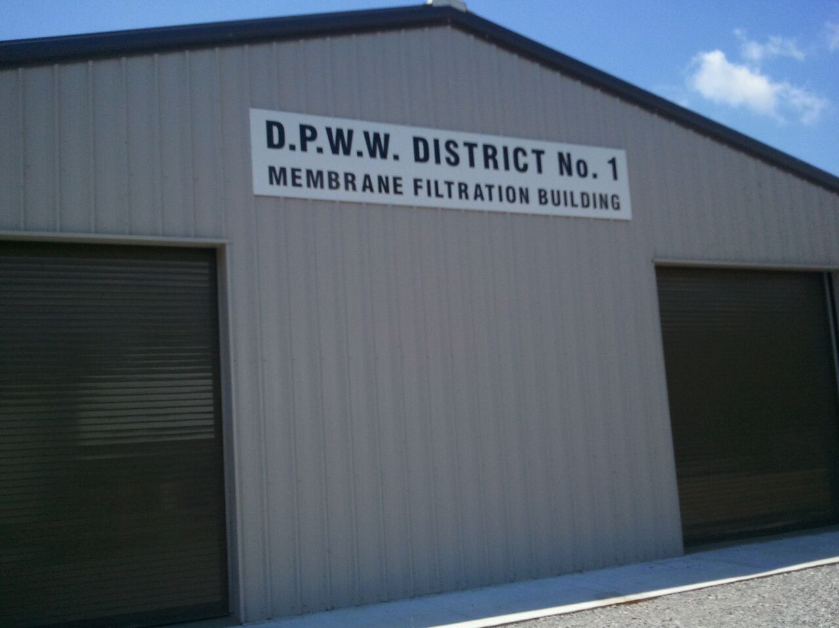
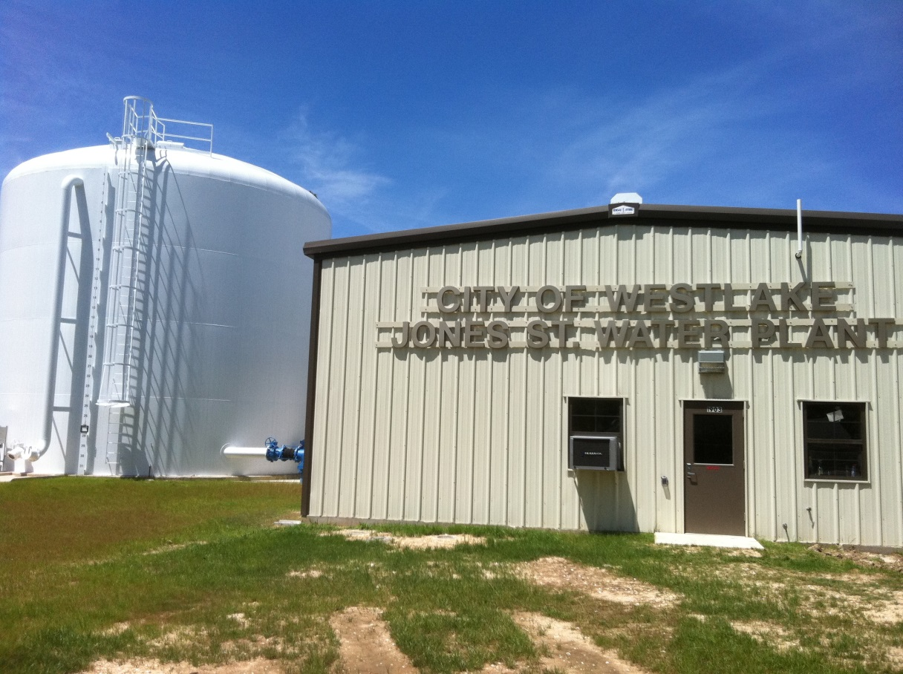
DWRLF PROJECT PHOTOS
Water Treatment Plant

Slide 24
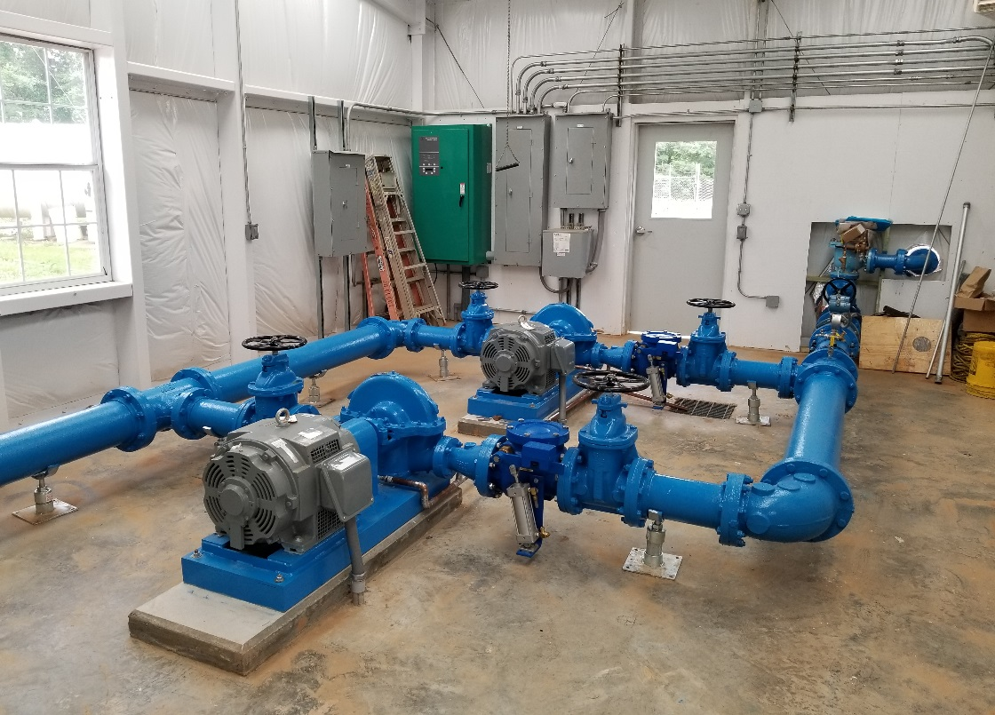
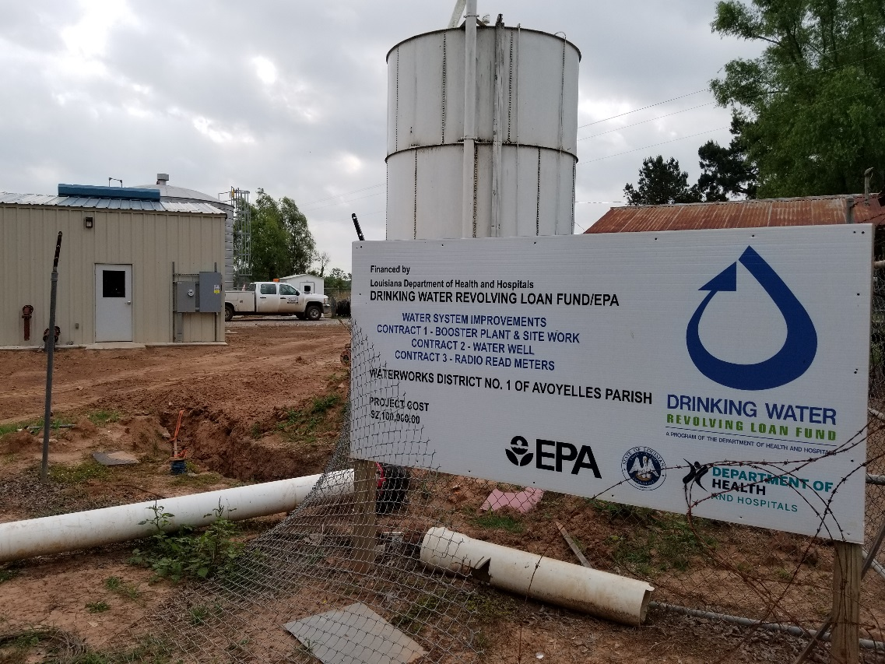
NEW BOOSTER PUMP STATIONS/BUILDINGS

Slide 25
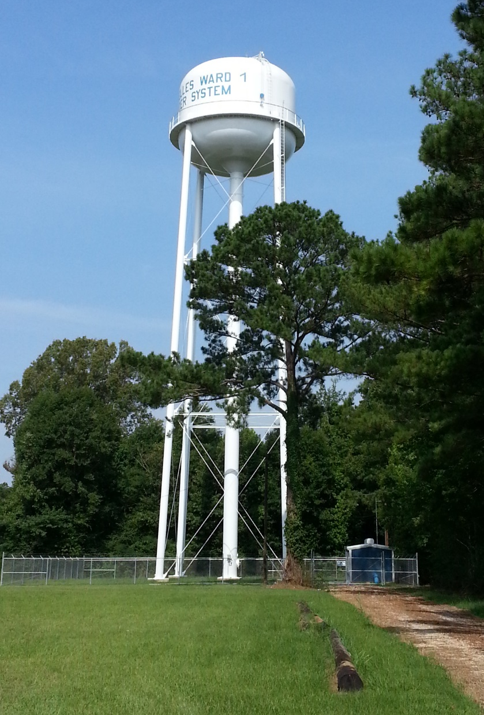
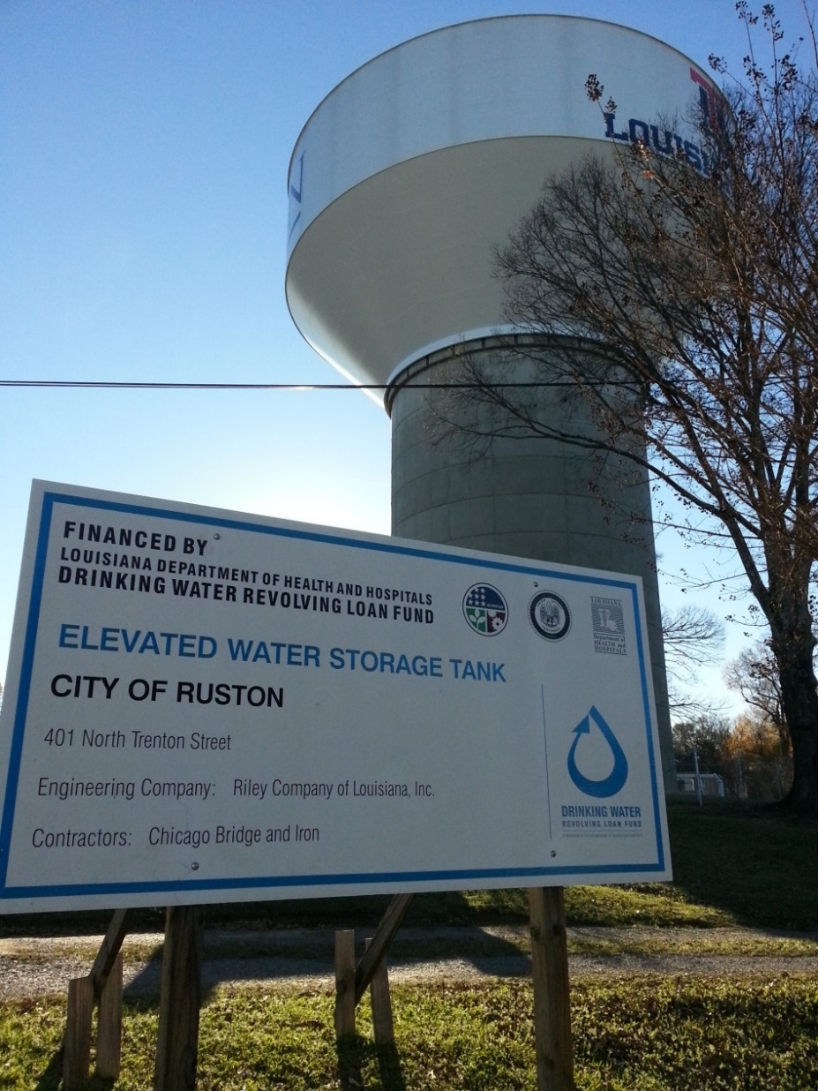
NEW ELEVATED STORAGE TANK (EST) INSTALLATION PROJECTS

Slide 26
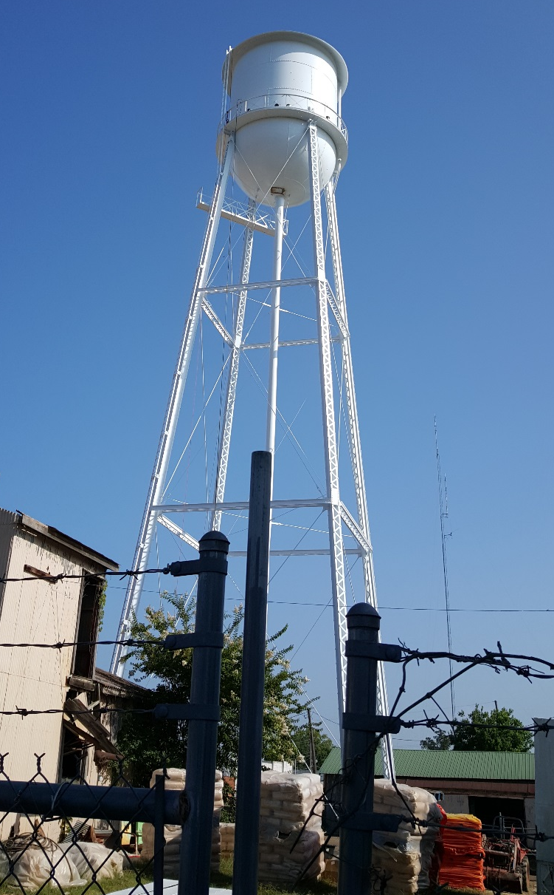
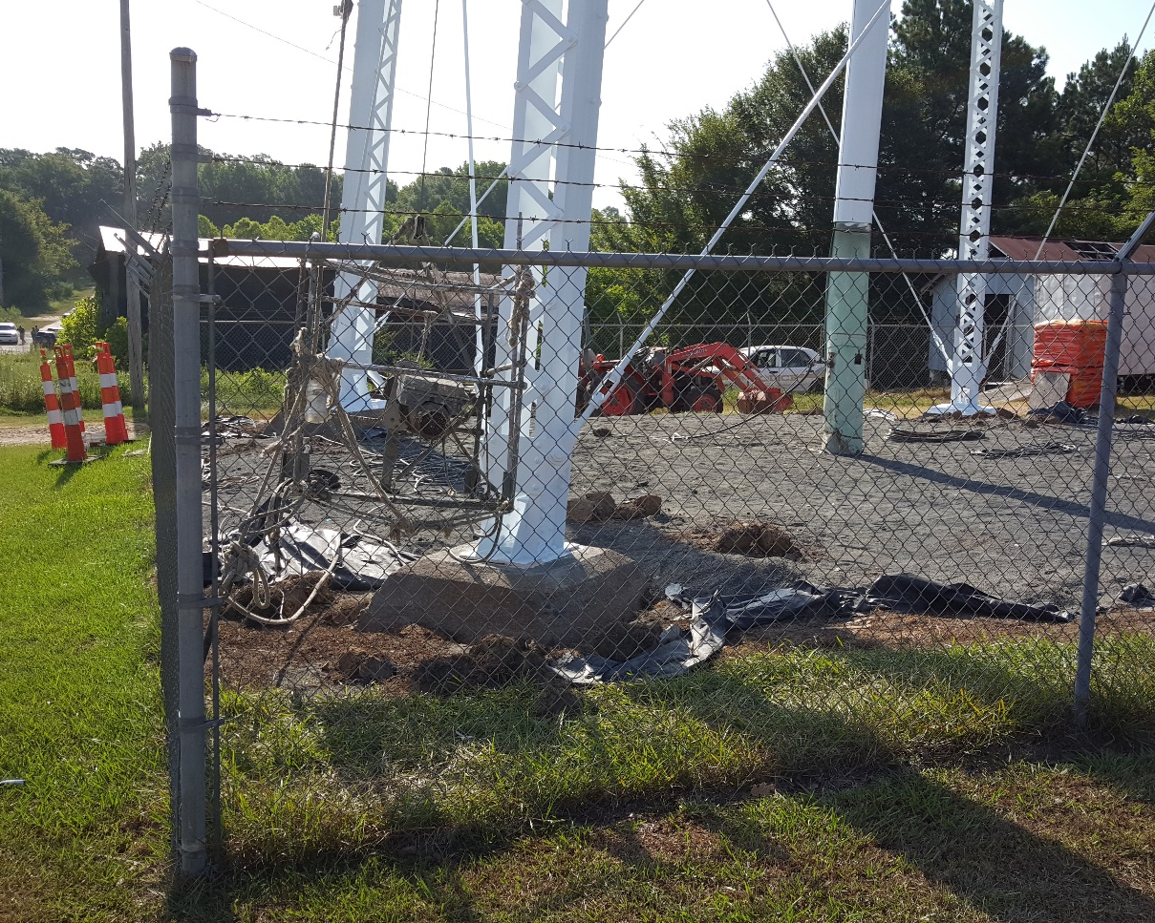
ELEVATED STORAGE TANK (EST) REHABILITATION PROJECTS

Slide 27
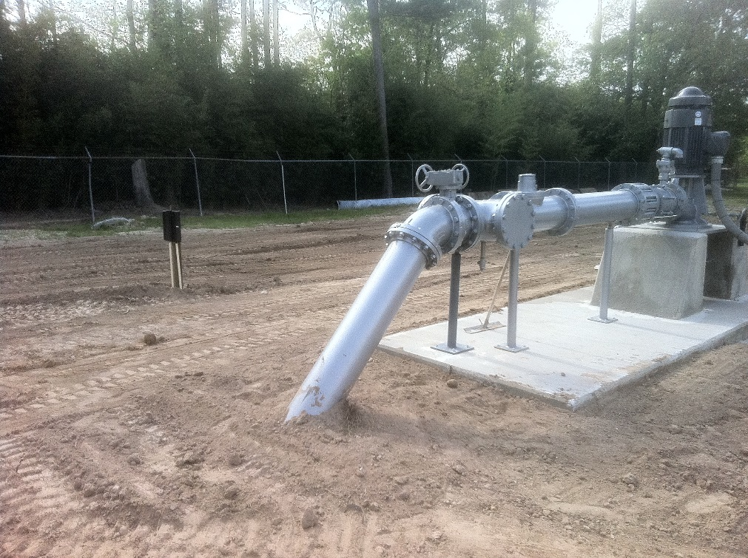
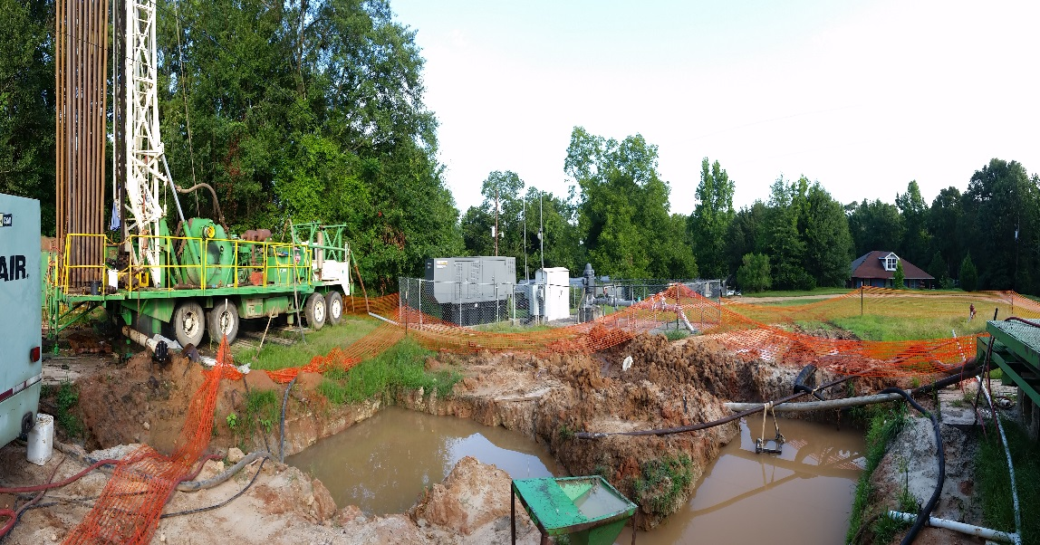
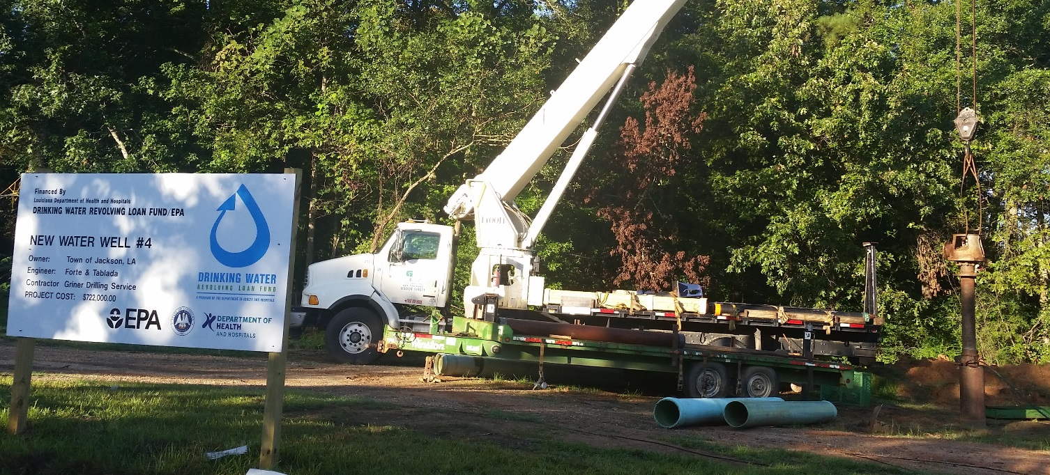
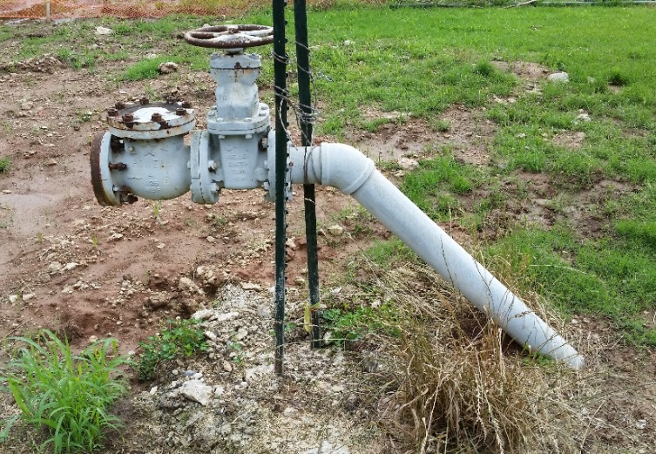
NEW AND ABANDONED WATER WELL PROJECTS

Slide 28
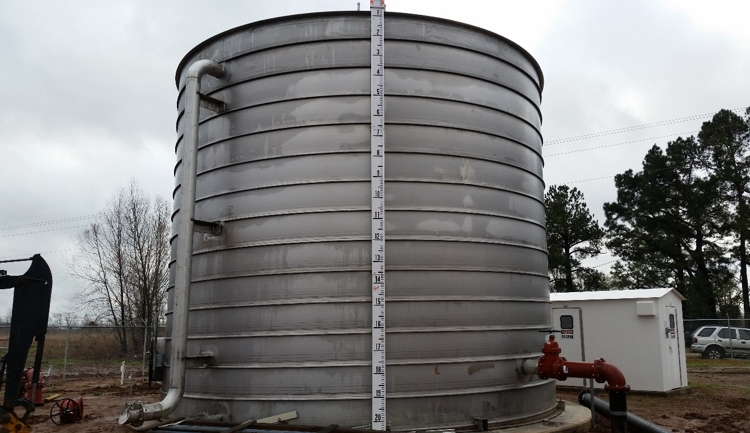
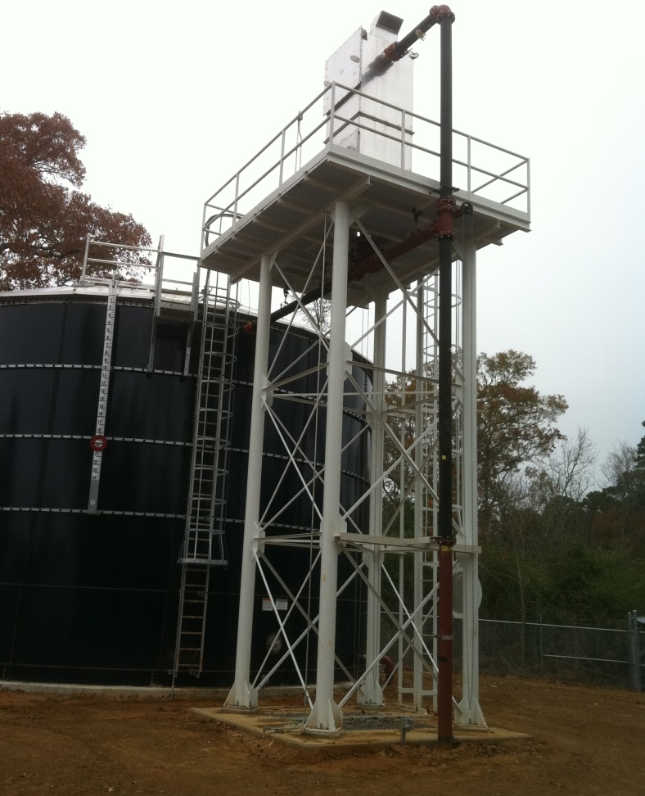
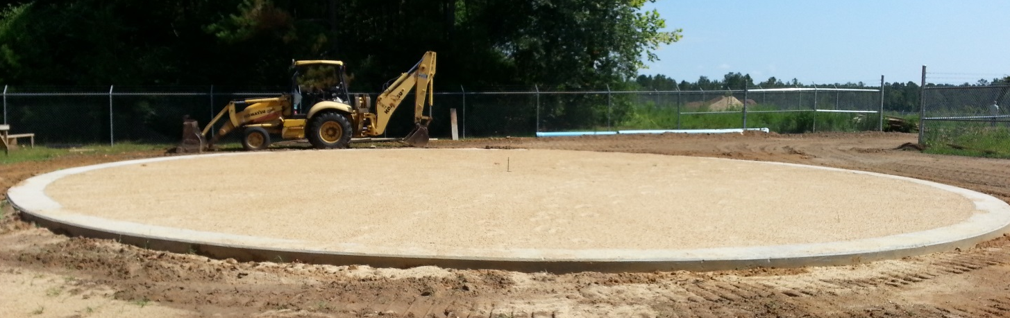
GROUND STORAGE TANKS (GSTs) AND AERATOR INSTALLATION PROJECTS

Slide 29
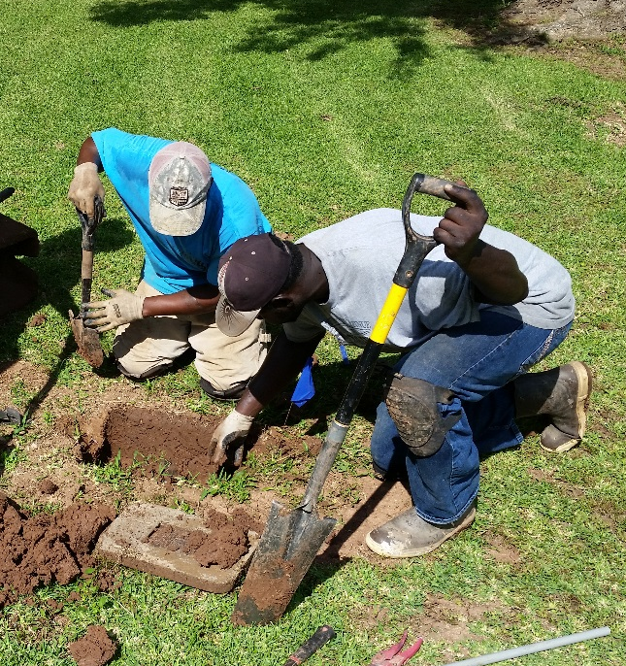
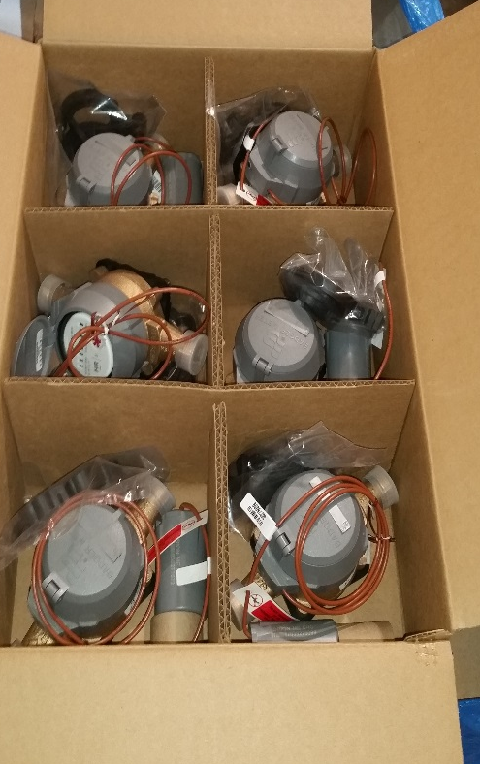
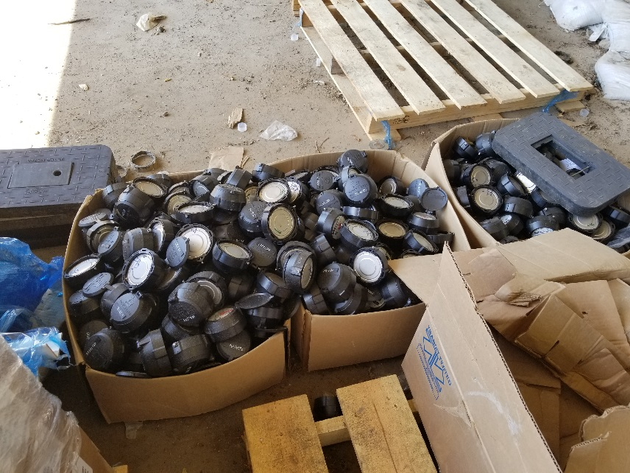
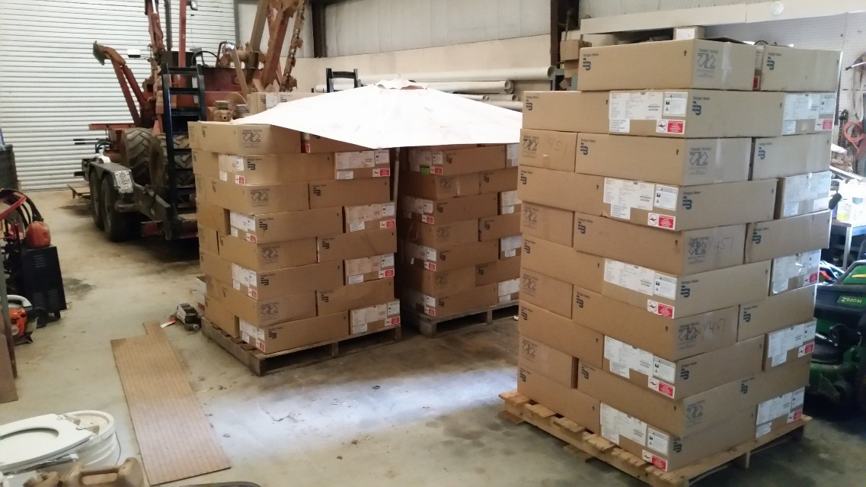
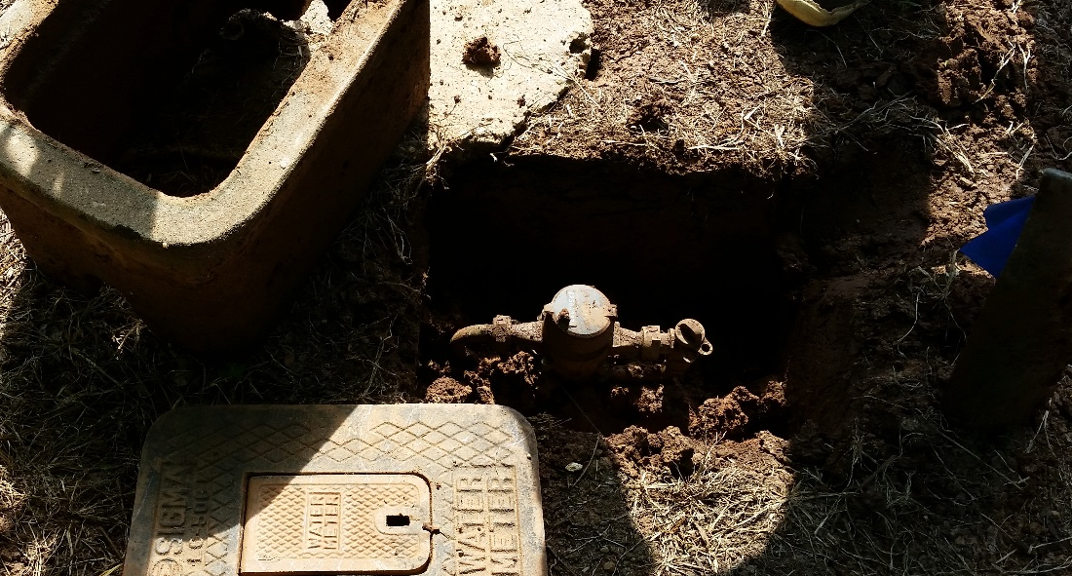
METER REPLACEMENT PROJECTS

Slide 30
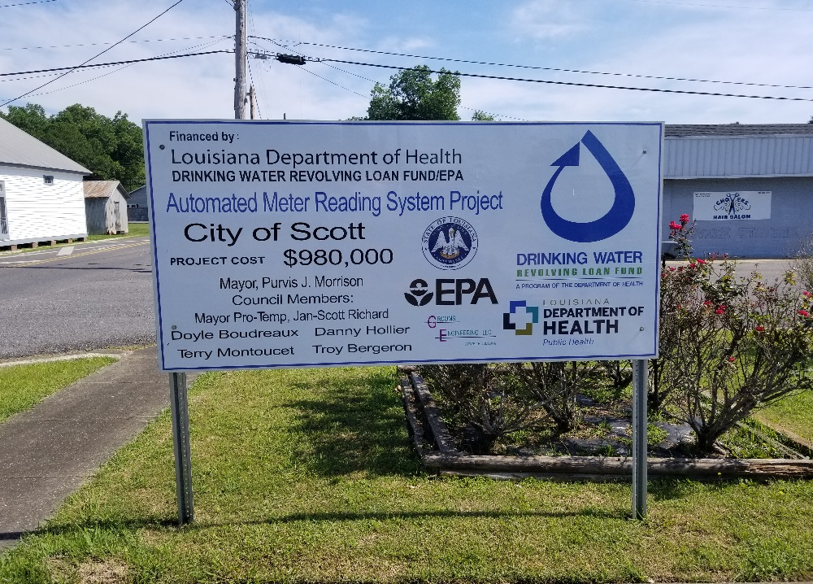
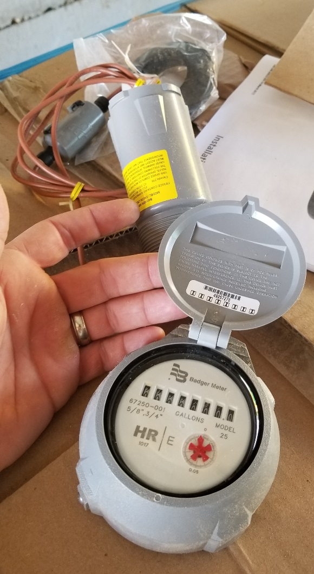
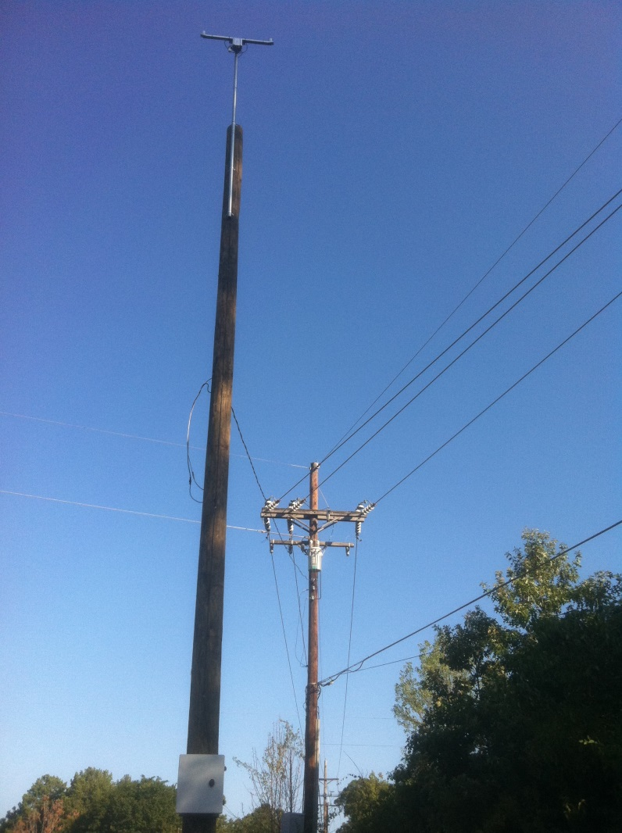
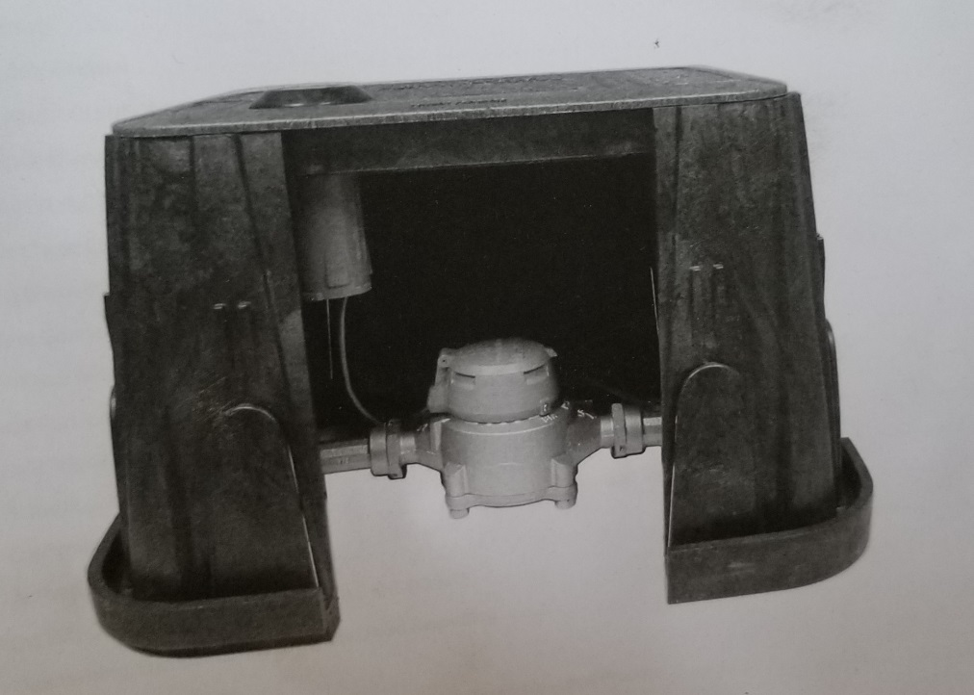
AUTOMATIC METER READING (AMR) SYSTEM INSTALLATIONS

Slide 31
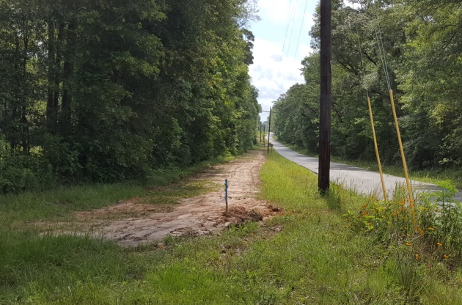
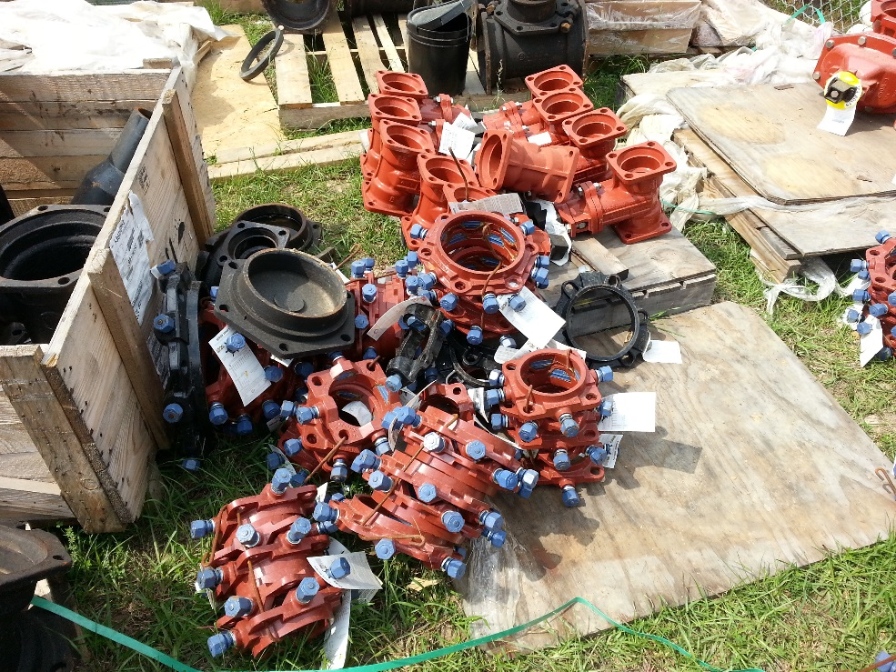
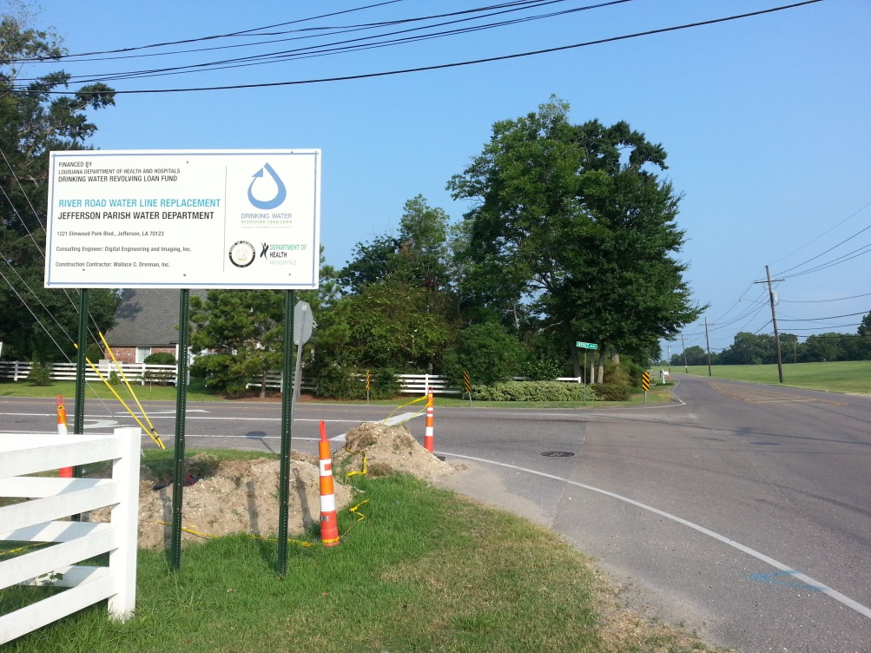
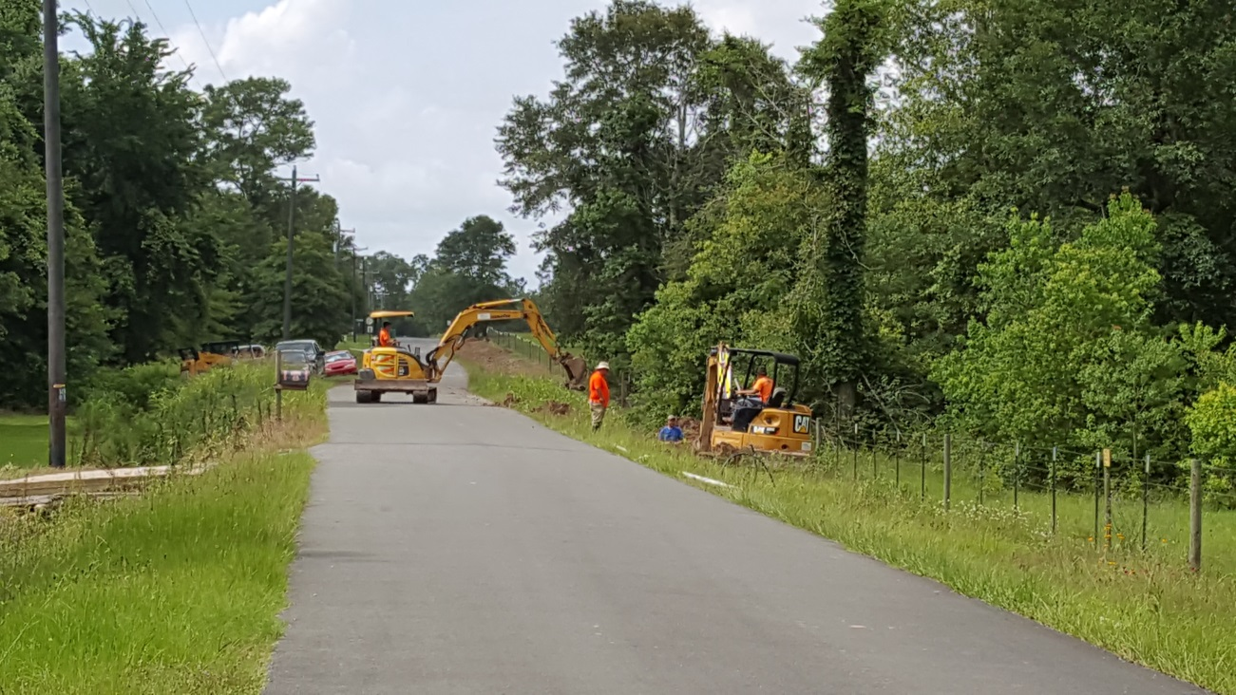
WATERLINE REPLACEMENT PROJECTS

Slide 32
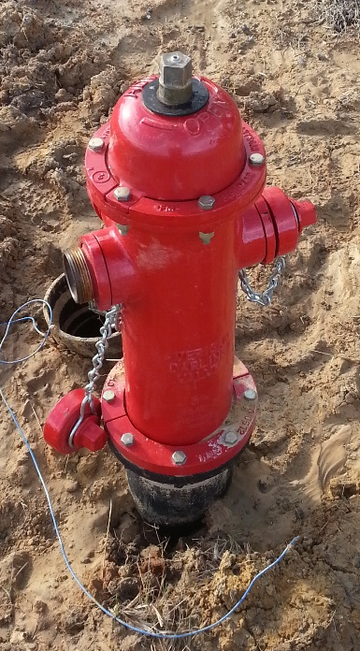
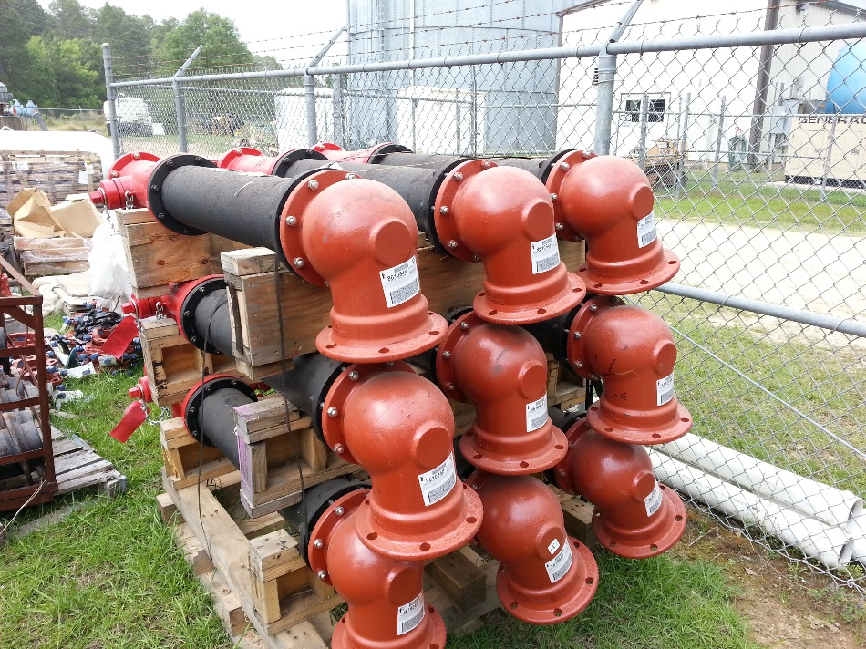
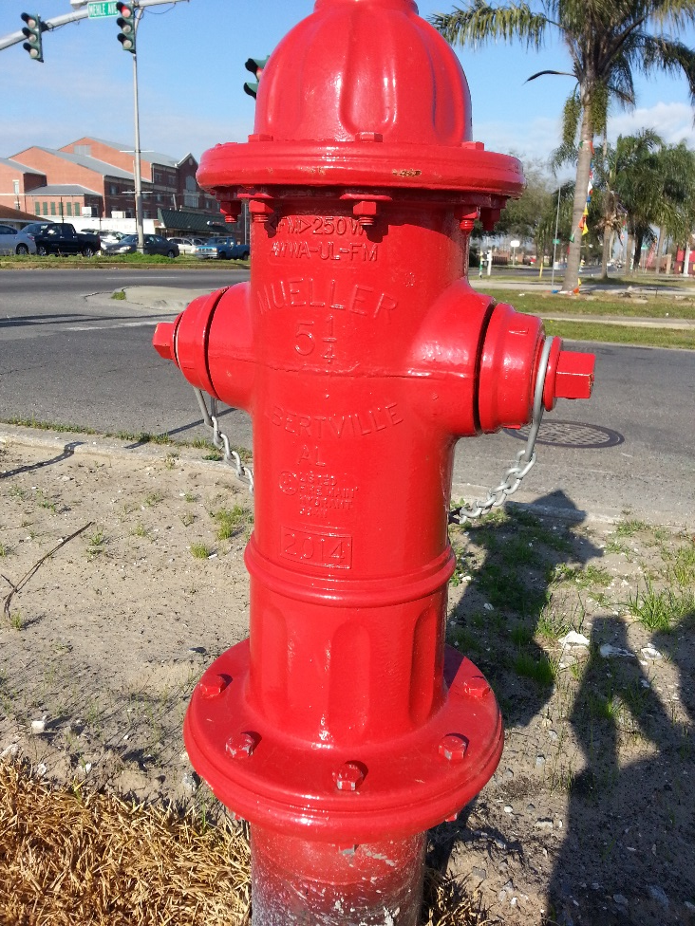
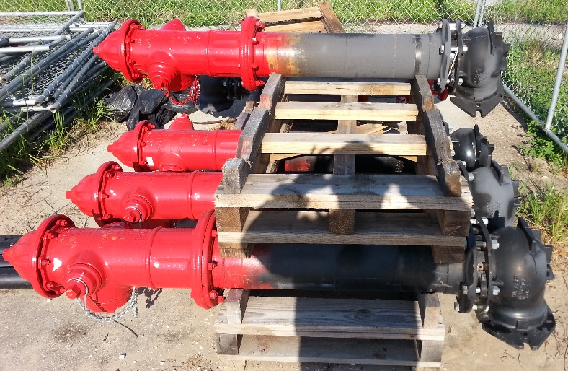
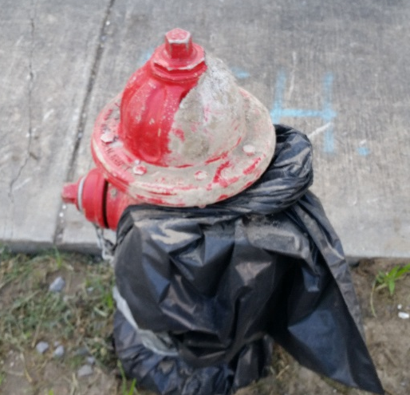
FIRE PROTECTION (JUST CAN’T BE MAIN PROJECT PURPOSE)

Slide 33
How do I contact the DWRLF?
  Call us:
  225-342-7499
  Visit our website: https://ldh.la.gov/index.cfm/page/430
  Google us (easier than remembering ):
  Louisiana Drinking Water Revolving Loan Fund
  Facebook (‘like’ us to receive program updates):
  Drinking Water Revolving Loan Fund

Slide 34
Questions?

