Slide 1
LAPELS
Today’s presentation
Rules of the board including
Pending and recent changes
Compliance and Enforcement
Information on NCEES Exams, Licensure & the Board
Questions

Slide 2
Laws and rules of the Board
The rules of the board is a 45 page document and gets updated about once a year.
Licensees should be familiar with all chapters, but especially chapters 21 (Renewals), 23 (Firms), 25 (Professional Conduct), 27 (Use of Seals) and 31 (CPD).
But, what is the most important rule?

Slide 3
Chapter 25 – Professional Conduct
First and foremost…..your responsibility as a professional engineer is to ‘safeguard life, health and property and to promote the public welfare….’ (2501 A)
Second….Professional conduct is to have knowledge of the existence of the laws/rules of the board and to be familiar and understand the provisions (2501 B)
If you have knowledge of any violation of the laws/rules of the board, of any licensee or non licensee, you SHALL report it to the board (2501 D)

Slide 4
If your primary responsibility is to safeguard life, health and public property, ask yourself these 7 Questions when making decisions and practicing in your area of Engineering
1. Is it safe and legal?
Could the decision become habit forming?
Is it the right and fair thing to do?
4. Will this stand the test of public review?
5. If something bad happened, could I defend my actions?
6. How will this make me feel about myself?
7. Would I want my Mom to know what I am doing?

Slide 5
Pending and Recent changes to the
Laws and Rules of the Board
1309 B – decoupling experience for taking the PS Exam
§1507 B – co-op experience
LA R.S. 37:698 (2) (C) – ACT 2 applications
§2305 A - Supervising Professional
Chapter 31 - CPD requirements
§105 – Definitions
The practice of engineering/incidental practice of engineering for architects
Notes:
Skip this section and come back at the end, more questions about CPD requirements now.

Slide 6
§1309 B – Approval to take the Examinations
B. An individual who has already been duly certified as
a land surveyor intern by the board may be permitted to take
the examination in the principles and practice of land
surveying, even though such individual has not yet met the
experience requirement for licensure as a professional land
surveyor.

Slide 7
§1507 B – Engineering experience subsequent to Degree
B. Up to one year of engineering experience may be obtained prior to graduation, if obtained through a college or university-sponsored co-op program as part of an accredited engineering curriculum approved by the board, and only after completion of the first half of the curriculum. The co-op program work must appear on the applicant’s college or university transcript for it to be considered. The amount of credit given for co-op program work will be based on the amount of co-op program work performed, will be limited by the applicant’s academic course load and will only include co-op program work performed during an academic term.

Slide 8
2020 Special legislative session SB 17/ACT 2 – effective January 1, 2021*
§693. (2) A professional engineer shall be…..
(A)…
(B)…
(C) A graduate of an accredited engineering curriculum of four years or more approved by the board as being of satisfactory standing, who has twenty years or more of progressive engineering experience in work acceptable to the board, which is of good character and reputation, who has passed the examinations required by the Board, and who has satisfied the requirements of R. S. 37:694.
* As of 11/15/2021, six candidates have been licensed.

Slide 9
Chapter 23: Firms – effective October 20, 2020
§2305 Supervising Professional
A. 1. Each firm licensed with the board shall designate one or more supervising professionals. Each supervising professional shall be a licensed professional:
A. whose primary employment is with the firm, provided the supervising professional works for the firm for a 12-month average of at least 30 hours per week or 130 hours per month; OR
B. whose employment is with the firm, provided the supervising professional has at least a 25 percent ownership in the firm.
A. 2. – E……..

Slide 10
Chapter 31 – Recent & Pending revisions in 2021
3115 – Licensees are required to obtain and maintain certificates, transcripts or other proof of attendance/completion substantiating any PDHs earned. Such certificates, transcripts, or other proof should include, at a minimum, the dates and titles/descriptions of the courses/activities, the names of the sponsor providers, the licensee’s name, and the number of PDHs earned.
3105 (F.) – As used in this section, the phrase designs buildings and/or building systems shall mean the design of and/or specifications for any component of any building and/or building system including but not limited to architectural engineering design, site work, foundations, structural, electrical, mechanical, fire protection system, communications and associates appurtenances.

Slide 11
CPD Requirements
CPD rule changes were effective January 2017.
Your biennial renewal cycles will remain unchanged.
You’re assigned to a spring/fall odd/even year based on your initial licensure date with LAPELS.
The way your log your Professional Development Hours has changed
How many of you renew your license in 2022?
Notes:
The only reason your renewal cycle will change is if your status changes to “Expired”.
As of right now, no one is under the “Old” requirements.

Slide 12
Specific CPD Requirements
A professional engineer must earn 15 professional development hours in a calendar year ( January 1 – December 31).
Of the 15 hours, at least one hour must be in Ethics.
If you design buildings/ building systems in Louisiana, you must earn at least 4 hours in Life Safety Code, ADA Accessibility Guidelines or applicable building codes.
No more than 8 hours can be earned in a 24 hour period.
No more than 7 hours can be carried forward to the next year.

Slide 13
Active vs. Inactive Status
An individual who elects not to offer or provide engineering/surveying services;
This individual does not need to meet the CPD requirements;
This individual does not meet the requirements to be in the Retired or in the Retired Waiver Granted Statuses;
The fee is $120 to maintain this status;
Can represent as PE-Inactive;
At the time the individual wishes to return to Active status, he/she can notify the Board and submit a LAPELS CPD activity log, along with all supporting documentation of hours earned in the 24 months prior to submitting the request to change statuses.

Slide 14
Retired Status
An individual who choses not to offer or provide engineering/surveying services;
Is at least 70 years old OR has been licensed for at least 35 years with LAPELS;
The fee is $60 to maintain this status;
Can represent as PE-Retired;
If an individual wishes to return to Active status, he/she can notify the Board and submit a LAPELS CPD activity log, along with all supporting documentation of hours earned in the 24 months prior to submitting the request to change statuses.

Slide 15
Retired Waiver Granted Status
An individual who choses not to offer or provide engineering/surveying services;
Is at least 70 years old AND has been licensed for at least 35 years with LAPELS;
Has no disciplinary action in any jurisdiction or the courts;
The fee is waived to maintain this status;
Can represent as PE-Retired;
If an individual wishes to return to Active status, he/she can notify the Board and submit a LAPELS CPD activity log, along with all supporting documentation of hours earned in the 24 months prior to submitting the request to change statuses.

Slide 16
105. Definitions
The Practice of Engineering
The incidental practice of engineering for architects……………we continue to work on the task force with representatives from AIA and LSBAE, as well as LES and ACEC

Slide 17
Compliance
and
Enforcement

Slide 18
LAPELS Compliance & Enforcement Activities
Make presentations at universities and to technical/professional societies.
Interface with other state agencies regarding engineering work (FMO, DHH, DNR, Architects & Geoscientists Boards).
Review NCEES website for LAPELS licensees who have been disciplined by other jurisdictions.
Investigate apparent or alleged violations of the laws & rules of LAPELS.
Work with Complaint Review Committees in effort to bring investigations to a close.
Respond to inquiries from the public & licensees regarding the laws & rules.

Slide 19
LAPELS has authority to take DISCIPLINARY and ENFORCEMENT actions
La R.S. Title 37: Sections 698(A) & 700(A)
Gives the board the power to take actions against licensees and non-licensees.

Slide 20
Disciplinary and Enforcement Action
Disciplinary Action La. R.S. 37:698(B) (a licensee)
“…shall include but not be limited to reprimand, probation, suspension, revocation of license or certificate, refusal to renew license or certificate, or fine in an amount not to exceed $5,000 per violation.”
Enforcement Action La. R.S. 37:700(B) (a non-licensee)
“…shall include but not be limited to a fine in an amount not to exceed $5,000 per violation.”

Slide 21
Disciplinary & Enforcement Authority
Disciplinary Action - La. R.S. 37:698(K)
“All disciplinary actions taken shall be published on the official website and in the official journal of the board and may be released to other professional organizations relating to professional engineering and land surveying or to the news media.”
Enforcement Action – La. R.S. 37:700(K)
“All enforcement actions taken shall be published on the official website and in the official journal of the board and may be released to other professional organizations relating to professional engineering and land surveying or to the news media.”

Slide 22
Potential Violations
Submitted to the Board:
Affidavits of Complaint
Complaint other than affidavit
Anonymously* (remember rule 2501D?)
Discovered In-House:
During investigations
Reviewing documents
Notes:
Complaints have been received via email (Non-AOC), US Mail…slid under our front door.
In house discovery: Documents such as applications & renewals. NCEES enforcement exchange

Slide 23
Case Progression
Potential violation is discovered or submitted
A case is opened
Preliminary investigation conducted
Information and evidence collected
Notify letters with evidence sent to the respondent with deadline of when to respond to the board
Case is reviewed by a complaint review committee ‘CRC’ which is comprised of 3 board members.

Slide 24
Complaint Review Committee ‘CRC’
Dismiss the case;
Instruct enforcement staff to obtain more information;
Issue a letter of caution or information;
Determine the matter should be handled by way of a consent order;

Slide 25
If a violation is discovered:
The CRC offers informal resolution via Consent Order which contains:
Findings of fact
An admission
List of violations
List of sanctions
Waiver of rights to a hearing
A finalization

Slide 26
Consent Order
If respondent accepts Consent Order, it goes to the full Board for approval at the next regular Board meeting;
Consent Order must be accepted by a majority of the board;
Once ratified and all sanctions are satisfied, and the consent order is published pursuant to La. R.S. 37:698(K) & 700(K) the case is closed;
Notes:
Payment of fines and costs needs to be in some form of verified funds, cc, money order, cashier’s check

Slide 27
Informal Conference
At request of Respondent;
Respondent may bring an attorney;
3 CRC members, Executive Staff, Staff Attorney and the Enforcement Personnel
Notes:
Informal Conference: The Board also offers the Respondent an opportunity for an “Informal Conference” if the Respondent contests one or more portions of the Consent Order.
The informal conference is attended by the CRC, the investigator that worked the case, Board attorney, myself, the Respondent and anyone the Respondent brings with him/her.
After hearing the Respondent’s arguments, the CRC deliberates and advises the Respondent what, if any, changes will be made to the Consent Order.
The Respondent is then offered a revised version of the Consent Order.

Slide 28
Informal Conference Results
Signing of the current Consent Order;
Change in charges/fines/sanctions;
Dismissal of case or the addition of violation;
If no resolution it goes to a formal hearing;
Notes:
Informal Conference: The Board also offers the Respondent an opportunity for an “Informal Conference” if the Respondent contests one or more portions of the Consent Order.
The informal conference is attended by the CRC, the investigator that worked the case, Board attorney, myself, the Respondent and anyone the Respondent brings with him/her.
After hearing the Respondent’s arguments, the CRC deliberates and advises the Respondent what, if any, changes will be made to the Consent Order.
The Respondent is then offered a revised version of the Consent Order.

Slide 29
Formal Hearing
The three members of the CRC are recused and retained for potential witness testimony and the remaining members of the board, which must constitute a majority, participate in the proceedings.
Respondents have the right to appear in person, or by counsel, or both to cross-examine witnesses in their defense and to produce evidence and witnesses in their defense.
A respondent may appeal the outcome of a formal hearing pursuant to the provisions of the administrative procedures act.
Interesting Facts:
The Board has conducted 25 formal hearings since 2006
In the past 60 years, 27 licenses have been revoked
Notes:
The CRC members are potential witnesses, as is the Board Investigator.

Slide 30
Most Common Violations
Unlicensed/Expired Practice
Aiding and Assisting
Sealing Violations
Standards Of Practice
Misinformation on application or renewal invoice

Slide 31
Disciplinary Guidelines
The disciplinary guidelines were established in 2006 to aid board members in assessing sanctions in a fair and consistent manner.
The guidelines have been revised multiple times since adoption and were revised and expanded as recently as April 2019.
Notes:
There are currently discussions on getting the

Slide 32
Statistics for 2021
Applications and Licenses
LAPELS receives approximately 140 applications for licensure each month: EI, LSI, PE and PLS (exam and comity), EF, VF
In September of this year, after Hurricane Ida, we received 186 applications, including reinstatement applications.
We issue approximately 1,400+ licenses and certificates annually
We conduct 2 renewal cycles every year (March & Sept)
Renewing approximately 5,000 individuals & firms each cycle
Auditing 100 +/- each cycle

Slide 33
Taking the FE and PE exams
Engineering students are encouraged to take the FE exam during their last year in school. All FE exams are now offered as CBT;
The board allows graduates with a verified EAC/ABET degree and a passing FE score, before obtaining the requisite years of experience, to take the PE exam;
Once a candidate has obtained the 4 years of progressive engineering experience, under the supervision of a US PE, they can apply to the board for licensure as a professional engineer.

Slide 34
NCEES PE Exams
Agricultural & Biological Engineering *
Architectural *
Chemical
Civil (1 of 5 – PM modules)
1. Construction 2. Geotechnical 3. Structural 4. Transportation 5. Water Resources & Environmental
Control Systems
Electrical & Computer (1 of 3)
1. Computer Engineering 2. Electrical and Electronics 3. Power
Environmental
Fire Protection *
Industrial and Systems
Mechanical (1 of 3)
1. Thermal & Fluids Systems* 2. Mechanical Systems & Materials 3. HVAC and Refrigeration
Metallurgical and Materials *
Mining and Mineral Processing *
Naval Architecture and Marine *
Nuclear *
Petroleum *
Structural Lateral Forces
Structural Vertical Forces

Slide 35
NCEES CBT PE Exams
2018 - Chemical & Nuclear*
2019 - Environmental & Petroleum*
2020 - Electrical, Mechanical, Industrial and Systems*
& Fire Protection*
2021 - Agricultural/Biological*, Mining & Mineral Processing*
2022 - Architectural*, Control Systems*, Metallurgical and Materials* & Naval Architecture and Marine *
2022 - Civil – beginning January 4, 2022
2024 - Structural Lateral and Vertical

Slide 36
NCEES exams are international exams. You may take an exam at any Pearson Vue location in the world:
Any of the 3 locations in Louisiana
Metairie
Baton Rouge
Shreveport
Or any US jurisdiction
All Canadian Provinces
Emirate of Sharjah
Egypt
Japan
Qatar
South Korea
Saudi Arabia
Taiwan
Turkey

Slide 37
In Louisiana
We rank 19th nationally in the number of licensed engineers with approximately 20,000+/- active PEs
6,500 are resident engineers and 13,500 are non resident engineers
175 hold dual licenses as a professional engineer and a professional land surveyor
800+ licensed surveyors; 574 resident and 225 are non resident
3,500+ engineering and surveying firms

Slide 38
The LAPELS Board
11 members – 9 PE / 2 PLS
Each serves a term of no less than 5 years
Each is appointed by the Governor/Confirmed by the Senate
In most years, 2 members’ terms expire in March (usually)
Members represent the following areas of practice:
Construction - Education - Government
Industry - Private Practice - Surveying
Notes:
2016 Board members are:
Jeffrey Pike – Represents Education – Homer

Slide 39
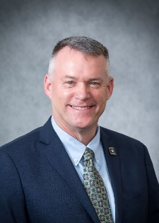
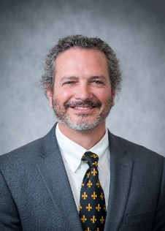
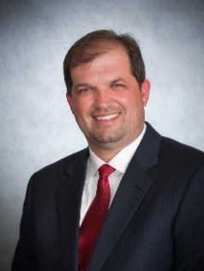
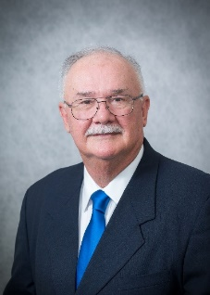
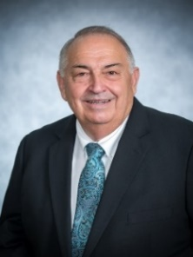
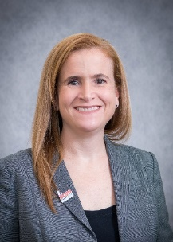
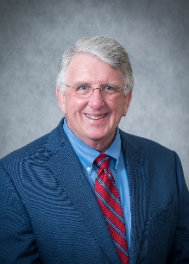
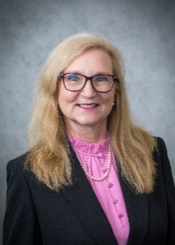
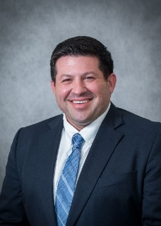
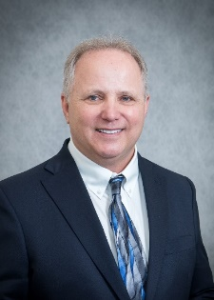
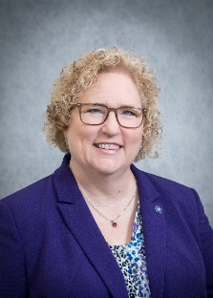
2021-2022 LAPELS BOARD
Jeffrey A. Pike
Chairman
P.E.
Academics
Appointed 2016
Term Expires 2022
Christopher K. Richard
Vice Chairman
P.E.
Private Practice
Appointed 2017
Term Expires 2023
Chad C. Vosburg
Treasurer
P.E.
Construction
Appointed 2017
Term Expires 2023
Edgar P. Benoit
Secretary
P.E.
Industry
Appointed 2018
Term Expires 2024
Wilfred J. Fontenot
P.L.S.
Surveying
Appointed 2018
Term Expires 2024
Reginald L. Jeter
P.E.
Academics
Appointed 2019
Term Expires 2025
Connie P. Betts
P.E.
Government
Appointed 2019
Term Expires 2025
Linda H. Bergeron
P.E.
Industry
Appointed2020
Term Expires 2026
Byron D. Racca
P.E.
Private Practice
Appointed 2020
Term Expires 2026
James H. Chustz, Jr.
P.L.S.
Surveying
Appointed 2021
Term Expires 2027
Janice P. Williams
P.E.
Government
Appointed 2021
Term Expires 2027

Slide 40
1920 NCEES President
LAPELS, established in 1908, is the 2nd oldest licensing board for engineers and surveyors in the United States.
New Orleans Civil Engineer, Marcel Garsaud, served as the first president of what is today known as NCEES.
Mr. Garsaud served on the LAPELS Board 16 years, from 1908 – 1924.

Slide 41
100 years later…..another civil engineer
Christopher P. Knotts, PE, served as the President of NCEES in 2020.
Mr. Knotts, is currently employed at DOTD as the Chief Engineer for the state. Knotts, an emeritus member of LAPELS, served on the Board from 2013 – 2019.

