Slide 1
Deep South Convention 2021
Private Market Briefing &
Economic Outlook
Erin McLaughlin
July 24, 2021

Slide 2
Introduction
Erin McLaughlin Vice President, Private Market Resources
American Council of Engineering Companies (ACEC)
Lead ACEC’s analysis of private market and economic trends, and connects these to policy implications for the engineering industry
Joined ACEC in 2017
18 years with A/E and CRE firms
MS / Transportation Planning MBA / Management BA / American-Urban Studies
Certificate in Economic Measurement
Former President of CREW (Commercial Real Estate Women) Northern Virginia

Slide 3
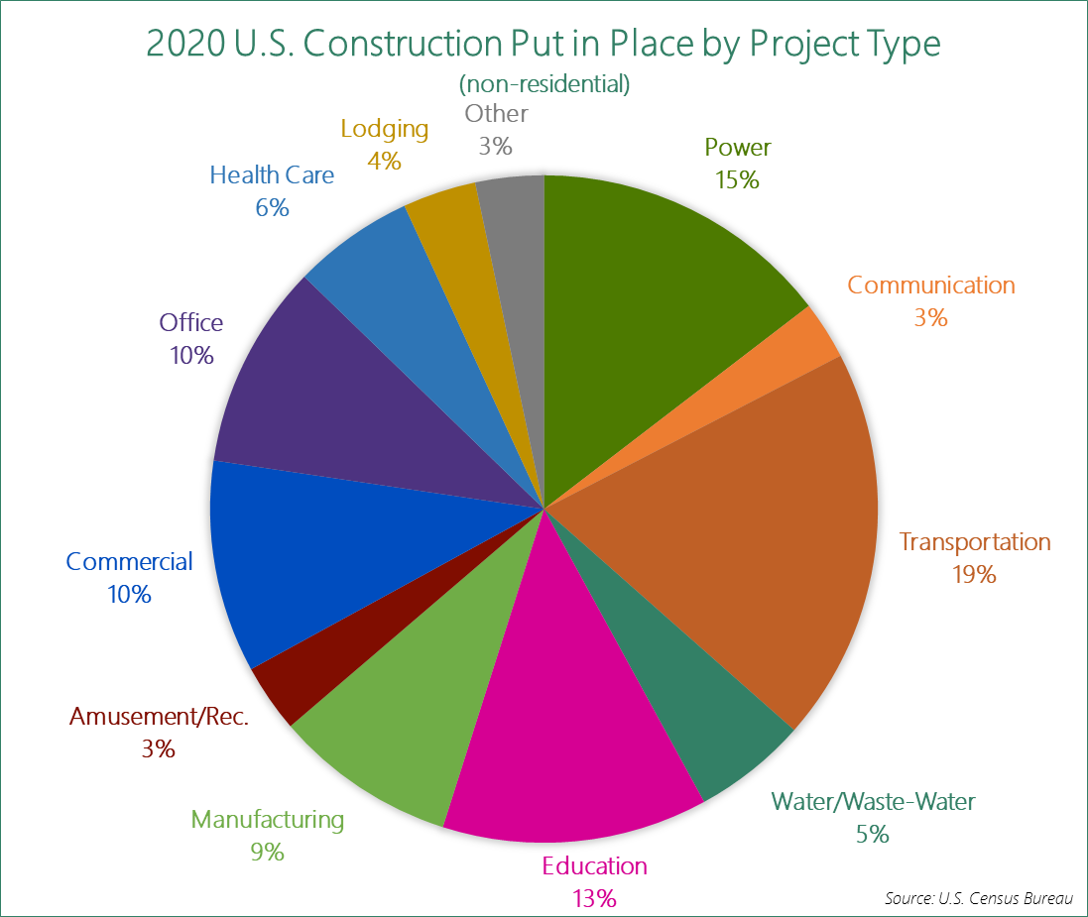

Slide 4
5 Macroeconomic Trends for H2 2021
Economy and Engineering Revenues are Beginning to Rebound
Proposed Infrastructure Bill Impact
Residential Market Booms
Inflation & Construction Material Price Concerns:
The Human Factor: Labor

Slide 5
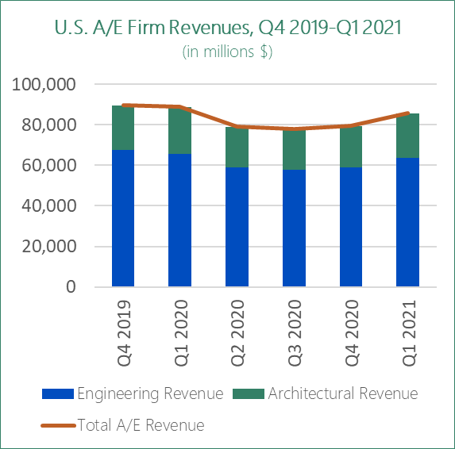
Q1 2021 A/E Revenues Up
Total A/E revenues are beginning to rise, buoyed by optimism from the largely successful vaccine rollout, ongoing federal fiscal stimulus, and increased consumer spending. The U.S. Census Bureau’s ‘preliminary estimate’ of total A/E revenues for Q1 2021 is $85.6 B, a 7.8% increase from Q4 2020.
This is the first substantial increase since the COVID-19 recession began in Q2 2020. A/E revenues were flat in Q3 and Q4 of last year, having declined about 11% during the recession. This may signal the beginning of growth back up to peak 2019 levels.
Source: U.S. Census Bureau

Slide 6
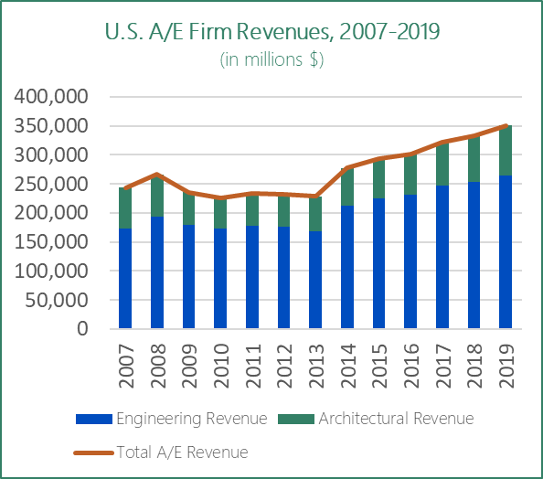
A/E Revenues Peaked in 2019
Great Recession began in Q4 of 2008
A/E revenues steadily increased since last recession, peaking in 2019 at $350.47B
The bottom was 2010
Growth non-existent for four years (2009-2013)
Of course not all recessions are the same
Source: U.S. Census Bureau

Slide 7
Construction Put in Place – Annual Numbers 2020 vs. 2019
Construction Put in Place | 2020 | 2019 | % Change
Total Construction | $1.430 T | $1.365 T | +4.8%
Residential (private) | $607.9 B | $544.4 B | +11.7%
Private (non-residential) | $471.5 B | $486.3 B | -3.0%
Public | $351.0 B | $334.4 B | +5.0%
Source: U.S. Census Bureau

Slide 8
Construction Put in Place – May 2021
 | May 2021 | May 2020 | % Change
Total Construction | $1.545 T | $1.438 T | +7.5%
Residential (private) | $751.7 B | $584.2 B | +28.7%
Private (non-residential) | $451.6 B | $479.2 B | -5.8%
Public | $342.0 B | $374.4 B | -8.7%
Source: U.S. Census Bureau
Source: U.S. Census Bureau

Slide 9
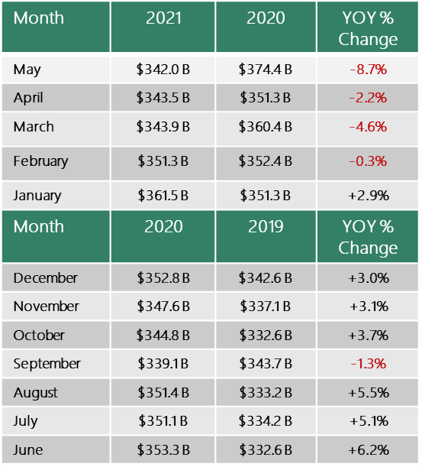
Public Construction Put in Place – YOY Change, June 2020-May 2021
Source: U.S. Census Bureau

Slide 10
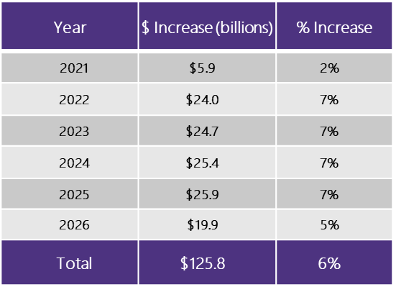
Forecasted Rise in A/E Output if Bipartisan Infrastructure Plan is Enacted
Source: ACEC Research Institute, Rockport Analytics

Slide 11
NABE Outlook Survey – May 2021

Slide 12
NABE Outlook Survey – May 2021
Continued COVID-19 spread greatest downside risk.
Source: NABE

Slide 13
NABE Outlook Survey – May 2021
Source: NABE
‘H2’ = second half of year
‘H1’ = first half of year

Slide 14
Inflation / Materials Concerns
Inflation concerns—which haven’t been an issue since the 1970s—are being debated, but many economists think this will be a short-term problem
NABE panelists in the May Outlook Survey expect inflation to ease in the second half of 2021, with no resurgence in 2022
However the price pressure is real; core inflation rates rose to 3.8% in May from 3.0% in April and 1.6% in March
When considering just materials and components of construction, the Producer Price Index showed a 17% rise in May 2021 compared to May 2020
While lumber prices have reportedly begun to stabilize, steel prices continue to rise

Slide 15
The Human Factor / Labor
For engineering firms, labor costs and availability remain a high concern
A tight labor market is expected to continue
Pandemic and recession had great impact on women and others with significant home and child-care responsibilities
Level of uncertainty (paradigm shift) regarding staff who strongly prefer remote work arrangements

Slide 16
What is a ‘Shecession’?
One has to do a double take when reading headlines in the business news like “The U.S. economy lost 140,000 jobs in December. All of them were held by women” (CNN.com, January 8, 2021). Could that be right? The unfortunate answer is yes.
The COVID-19 recession has not affected everyone the same—and it has been particularly impactful to U.S. women.
When the Bureau of Labor Statistics (BLS) released its monthly job numbers for December it showed that for the first time, jobs held by women disappeared at a faster clip then those held by men.
According to BLS, the country lost a net 140,000 payroll jobs in December, due to 156,000 women losing their jobs and men gaining 16,000 jobs. The only other month there has been such a drastic dip is September, when 865,000 women left the labor force—four times the rate of men. (Many blamed the start of the virtual school year for the September decline.)
This meshes up with the research the Bipartisan Policy Center has done on the subject. In its Impact of COVID-19 on the Workforce survey conducted in October 2020, BPC details that among women with children under two years old, 42% have left work during the coronavirus pandemic, and women are twice as likely as men to say they left work for caregiving responsibilities due to childcare provider or school closures.

Slide 17
Four Submarkets
Commercial & Residential Real Estate
Intermodal & Logistics
Energy & Utilities
Health Care & Science+Technology

Slide 18
Four Private-Market Sectors
Commercial & Residential Real Estate
Energy & Utilities
Example Clients | Fortune 2021 Ranking
Walmart | 1
CBRE | 122
D.R. Horton | 148
Lennar | 129
JLL | 186
Example Clients | Fortune 2021 Ranking
Exelon | 92
Duke Energy | 126
PG&E | 160
Dominion Energy | 193
American Electric Power | 204
Client types:
Real Estate Developers
Home Builders
Retailers
Client types:
Energy
Utilities
Telecommunications
Intermodal & Logistics
Health Care & Science+Technology
Example Clients | Fortune 2021 Ranking
UPS | 35
Fedex | 45
Union Pacific | 153
Waste Management | 202
CSX | 292
Example Clients | Fortune 2021 Ranking
Johnson & Johnson | 36
Procter & Gamble | 43
HCA Healthcare | 62
Pfizer | 77
Community Health Systems | 259
Client types:
Medical Facilities
Laboratories/Pharma
Universities
Data Centers
Client types:
Ports & Intermodal
Railroads
Logistics/Freight Delivery

Slide 19
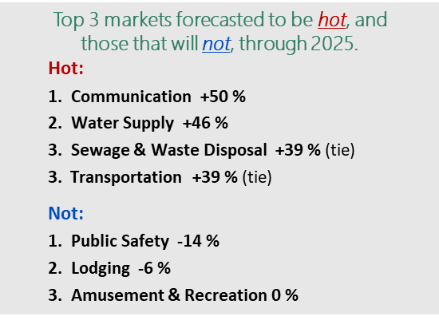
Market Expectations
Source: FMI

Slide 20
Key drivers/trends:
Office growth expected to be slow due to unknowns regarding remote-work future
Strong growth of the industrial/distribution market due to e-commerce, often in increasingly urban locations
‘Retail apocalypse’ with stores closing and adaptive reuse of properties expected to continue
Expected growth of close-in suburbs and second-tier cities as Millennials approach middle-age and expand families
Commercial & Residential Real Estate
Key: a=actual, e=estimate, f=forecast
Sources: U.S. Census Bureau & FMI Q3’21

Slide 21
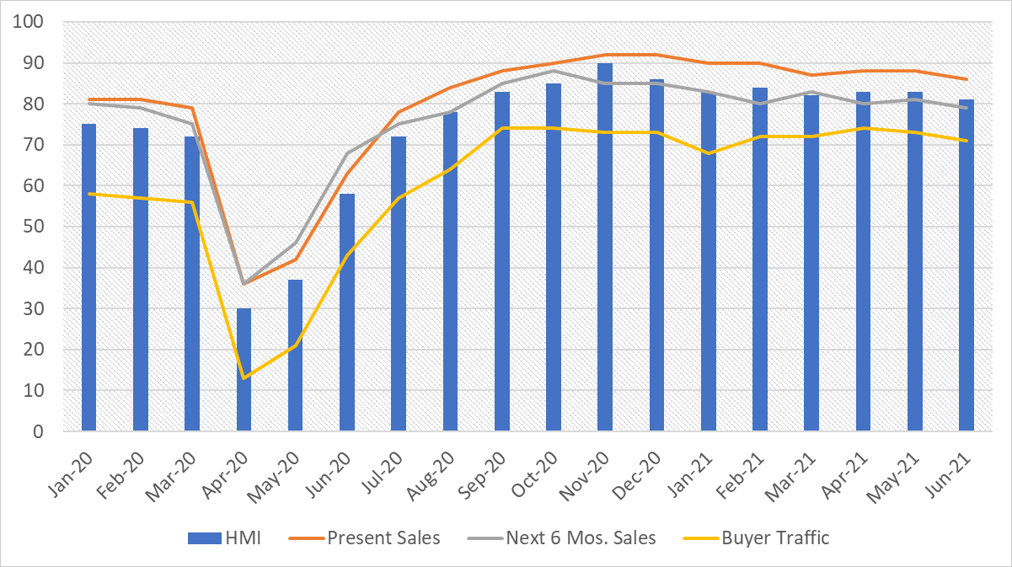
Housing Market Index for Single-Family Residential
Source: NAHB/Wells Fargo

Slide 22
Demographics: Millennials & Housing Growth
2019 Millennials accounted for largest share of all new home loans for the first time
Millennials (now mid 20s-late 30s) driving housing market
Were slower to become homeowners compared to past generations (student loans, witness of housing crash in 2008-2009, etc.)
Suburban growth—may be more like previous generations than once thought
Also in 2019 Millennials surpassed Baby Boomers as largest living adult generation
Sources: National Association of Realtors, WSJ, Pew Research Center

Slide 23
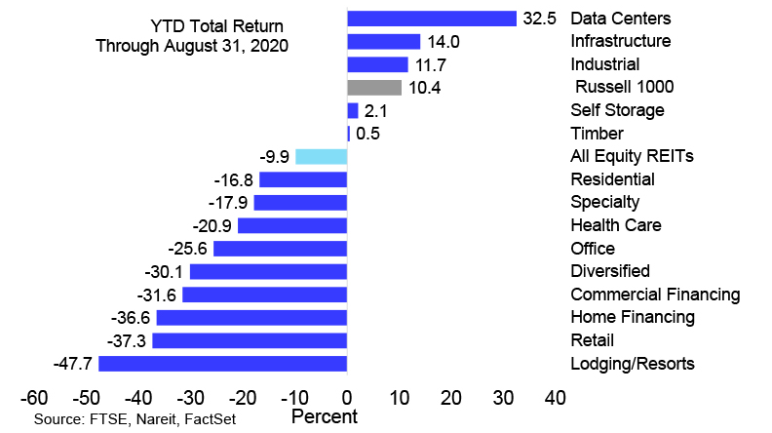
REIT Performance by Sector Jan.-Aug. 2020
REIT = Real Estate Investment Trust

Slide 24
Intermodal & Logistics
Key drivers/trends:
Infrastructure challenges related to urban locations and ‘last mile’ delivery needs
E-commerce continues to be a strong driver
Continued growth of Southeastern U.S. ports
Inland port growth
Manufacturing sector a focus of Biden Administration
Key: a=actual, e=estimate, f=forecast
Sources: U.S. Census Bureau & FMI Q3’21

Slide 25
Growth of Ports & Inland Infrastructure
Rank | Port | 2020 Import TEUs | 5-year % CAGR 2016-2020
1. | Tampa, FL | 76,358 | 20.3%
2. | Port Manatee, FL | 52,885 | 16.7%
3. | Mobile, AL | 251,363 | 15.4%
4. | Chester, PA | 124,578 | 13.5%
5. | Port Hueneme, CA | 89,902 | 12.3%
6. | Philadelphia, PA | 388,749 | 8.2%
7. | Savannah, GA | 2,430,789 | 7.3%
8. | Houston, TX | 1,995,734 | 6.3%
9. | Baltimore, MD | 524,695 | 5.9%
10. | Newark, NJ | 4,599,961 | 5.7%
Source: Panjiva, Logistics Management

Slide 26
Key drivers/trends:
Increasing demand for energy due to economic activity resuming
Focus on cybersecurity and resiliency after recent occurrences to pipelines, grids
Focus on energy efficiency goals driven by both public and private 2030/2050 commitments for carbon neutrality
Solar and wind continue strong growth in renewable energy sector
Energy & Utilities
Key: a=actual, e=estimate, f=forecast
Sources: U.S. Census Bureau & FMI Q3’21

Slide 27
Data Centers & Telecommunications
Top 5 Market Trends
Connectivity Becomes a True Necessity
Federal Government Ramps Up Broadband Plans
States Step Up to Coordinate Broadband Initiatives
Electric Co-Ops Become Key to Broadband
Focus on Data Center Innovation, Sustainability

Slide 28
Key drivers/trends:
Worldwide focus on vaccines shines a light on the biopharma and science and technology (S+T) industries
Demographic drivers with growth of 65+ population due to aging baby boomers
Increase of telehealth
‘Retailing’ of health care through CVS Minute Clinics and adaptive reuse of mall space to healthcare space
Expected demand for design changes due to pandemic
Health Care & Science+Technology
Key: a=actual, e=estimate, f=forecast
Sources: U.S. Census Bureau & FMI Q3’21

Slide 29
Is HC & S+T Recession Proof?

Slide 30
Growth of Outpatient Facilities

Slide 31
Public Sector & P3s
Key drivers/trends:
Tax revenues from gas, sales, and income taxes dropped sharply due to shutdowns and recession
Continued need for federal stimulus directed to state and local governments
Highway and street funding expected to grow substantially in the coming years, due to the anticipated 2021 infrastructure package
The education market (which is the second largest overall by annual construction-put-in-place value) may transform due to financial constraints and focus on virtual classrooms
Key: a=actual, e=estimate, f=forecast
Construction Put in Place Forecast by market segment | 2020a | 2021e | 2022f | 2023f | 2024f | 2025f | Change 2020- 2025f
Educational | $104.53 B | $102 B | $106 B | $113 B | $121 B | $129 B | +23 %
Highway & Street | $99.70 B | $101 B | $106 B | $114 B | $124 B | $132 B | +32 %
Public Safety | $15.09 B | $13 B | $11 B | $12 B | $12 B | $13 B | -14 %
Conservation & Development | $8.38 B | $8 B | $9 B | $9 B | $10 B | $11 B | +31 %
Sources: U.S. Census Bureau & FMI Q3’21

Slide 32
‘Alternative Data’ Economic Indicators Apple Mobility Trends Link: https://covid19.apple.com/mobility

Slide 33
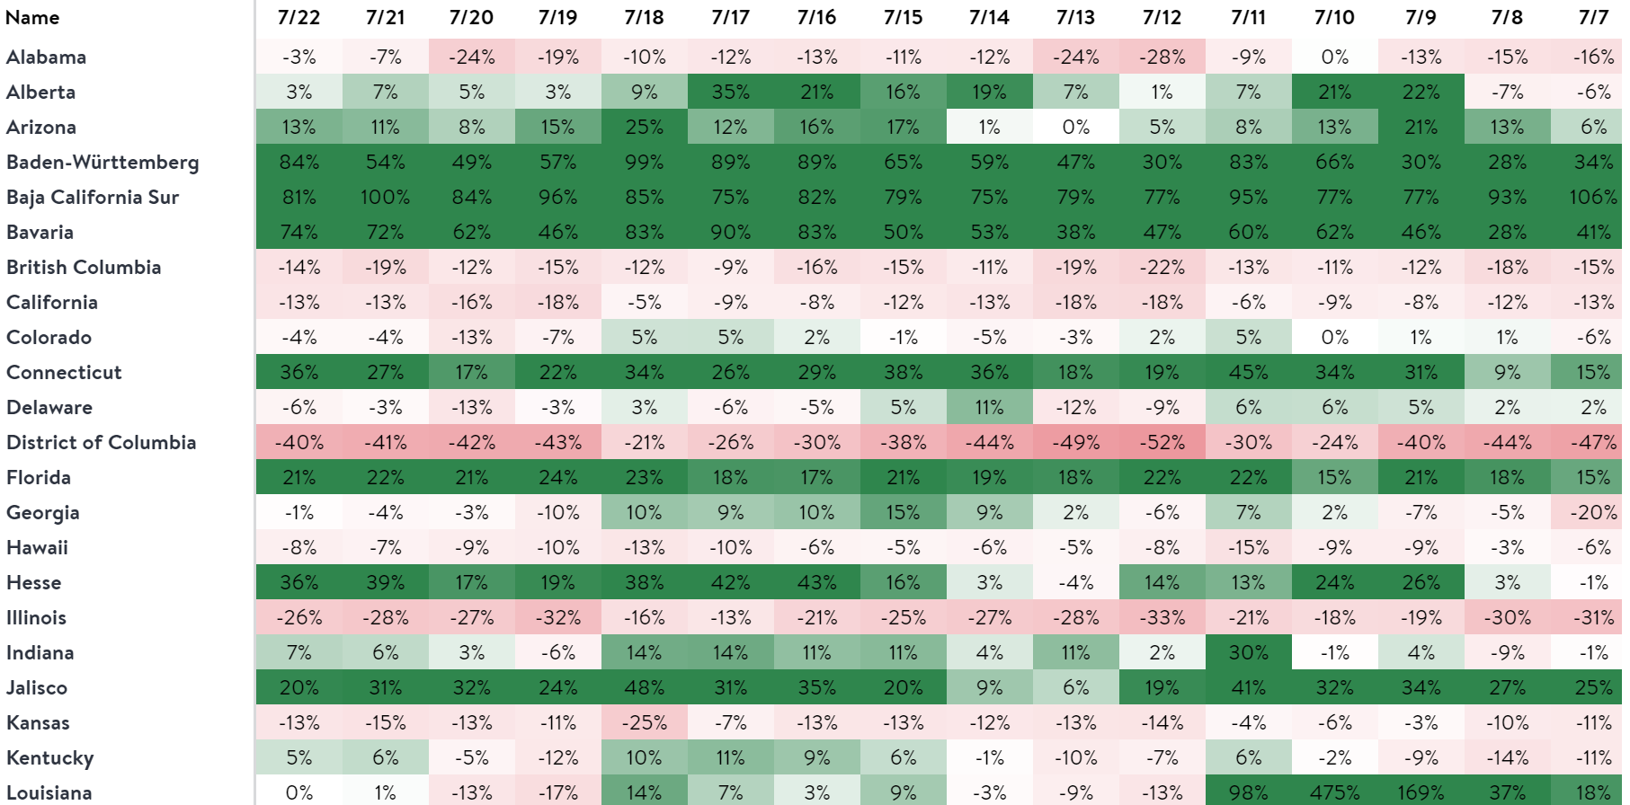
‘Alternative Data’ Economic Indicators Source: Open Table Metrics - YOY Data Link: https://www.opentable.com/state-of-industry
Note: 2021 data is being compared to same day in 2019 (pre-pandemic).

Slide 34
‘Alternative Data’ Economic Indicators TSA Checkpoint Metrics

Slide 35
Additional Resources
Private Industry Briefs
Private Side column in Engineering, Inc. magazine
Engineering Influence Podcast
Private/Vertical Roundtable Discussions

Slide 36
Thank You
Enter your subhead line here
Erin McLaughlin
Vice President,
Private Market Resources
202-682-4352
emclaughlin@acec.org
www.acec.org

