Slide 1
The Emerging Business Development Model for 2021 and Beyond
ACEC Deep South Convention
Mel Lester July 23, 2021

Slide 2
“The COVID-19 pandemic forced B2B buyers and sellers to go digital in a massive way. What started out as a crisis response has now become the next normal, with big implica-tions for how buyers and sellers will do business in the future.” — McKinsey

Slide 3
Why the Change Is Likely to Last
75%
75-80%
buyers and sellers
believe new sales
model as effective
or more so
buyers and sellers
prefer the digital model
over the traditional one
Source: McKinsey (October 2020)

Slide 4
What changes are you seeing in how clients are buying your services?

Slide 5
The Emerging Business Development Model
#1
TREND: Early stages of buying process
are increasingly happening online
independent of sellers
TACTIC: Fortify your online presence
through thought leadership
marketing

Slide 6
Based on our study of buyer behavior, we estimate that approximately 70% of buyers’ sales behavior happens in the digital space.
— Lee Frederickson, Hinge

Slide 7
Engineers Are Doing It Too
62%
70+%
complete over
half of the buying
process online
of buying process
online for buyers
under 45 years old
Source: TREW Marketing, State of Marketing to Engineers (2021)

Slide 8
How effective is
your firm in the
space where most of the buyer’s journey is taking place?
DIGITAL
VIRTUAL / F2F
❶
❷
❸
❹
❺
❻
Recognize
Need
Conduct
Research
Evaluate
Options
Scope the
Solution
Solicit
Proposals
Select
Provider

Slide 9
Today’s buying process begins with Google. If you don’t show up in a search and offer engaging content, your services will go unnoticed.
— Danielle Berg & Liz Alton

Slide 10
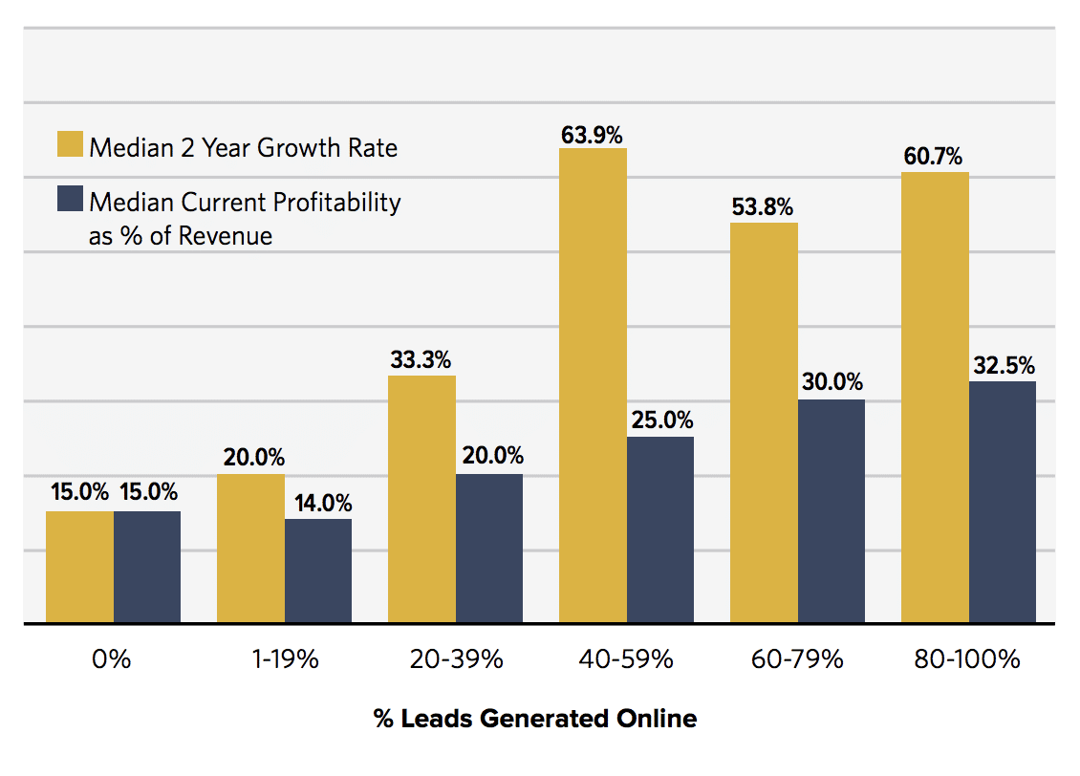
The Foremost Goal of Marketing
Is Lead Generation
Source: Hinge Marketing, A/E/C Online Marketing (2015)

Slide 11
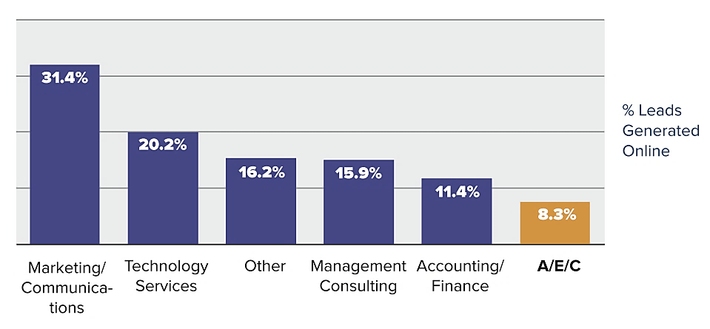
Leads Generated Online (by PSF Sector)
Source: Hinge Marketing, A/E/C Online Marketing (2015)

Slide 12
Exercise:
page 25
Why is thought leadership so difficult for A/E professionals?
Thought leadership is
being recognized as an authority in your field & respected for having a distinct point of view

Slide 13
The Missing Link
What’s most
lacking in our marketing efforts?
A fresh,
compelling
point of view

Slide 14
Where Do You Find a Fresh Take?
Always google
for inspiration
Seek out other perspectives
Frame it from the client’s POV
Explore the nontechnical aspects
Focus on
the results
Tell the story,
not just facts

Slide 15
The Emerging Business Development Model
#2
TREND: Virtual interactions with buyers are increasingly replacing
face-to-face meetings
TACTIC: Master the ability to connect
with buyers online and using
virtual meeting platforms

Slide 16
Top Virtual Selling Challenges
Getting buyer attention
and keeping buyer engaged
91%
Changing buyer’s point of view
regarding potential solutions
89%
Developing relationships with
buyers virtually
88%
Connecting with buyers
and building rapport
87%
Overcoming objections and
dealing with resistance
87%
Collaborating and interacting
with buyers virtually
82%
0
20
40
60
80
100
Source: RAIN Group, Virtual Selling Skills & Challenges (2020)

Slide 17
Top Factors Influencing Buying Decisions
Leading thorough discovery of
my concerns, wants, needs
71%
26%
Showing me what’s possible
or how to solve a problem
68%
34%
Listening to me
68%
26%
Making the ROI case clear to me
66%
16%
Educating me with new
ideas and perspectives
64%
44%
Communicating
their value
60%
36%
Connecting with me
and building rapport
54%
25%
Developing a
relationship with me
54%
25%
0
20
40
60
80
100
Seller effectiveness
per buyers
Source: RAIN Group, Virtual Selling Skills & Challenges (2020)

Slide 18
Top Seller Mistakes According to Buyers
Experiencing technology
problems
89%
Using poor or no visuals
during online meetings
86%
Not responding to my
questions or concerns
84%
Not prepared
83%
Lacking presentation
skills
80%
Sending poorly
written emails
80%
Distracted (by notifications,
people, disturbances, etc.)
77%
Making an unprofessional
impression
75%
0
20
40
60
80
100
Source: RAIN Group, Virtual Selling Skills & Challenges (2020)

Slide 19
Strategies for Virtual Selling
Provide
value
Build
rapport
Master the
medium
Goal: Connect your services to the buyer’s ROI and
desired outcomes
Goal: Make a personal connection with buyer to promote relationship and trust
Goal: Learn how to be proficient in using the technology for virtual meetings

Slide 20
Strategies for Virtual Selling
Build
rapport
Value the
buyer’s time
Avoid salesy,
be genuine
Focus on
the buyer
Collaborate with buyer
Goal: Make a personal connection with buyer to promote relationship and trust

Slide 21
Strategies for Virtual Selling
Master the medium
Be well
prepared
Know your platform
Look
professional
Use visuals for impact
Goal: Learn how to be proficient in using the technology for virtual meetings

Slide 22
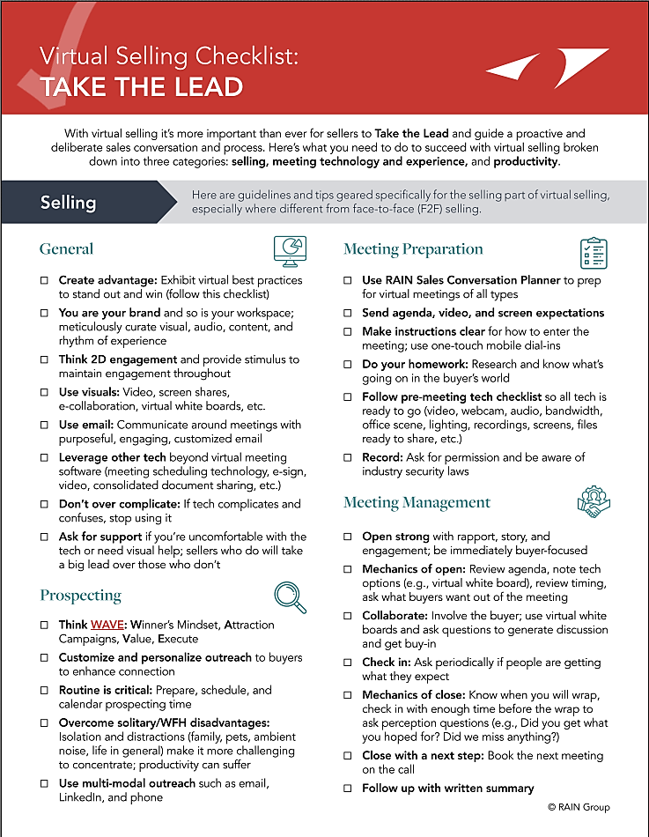

Slide 23
More Virtual Selling Tips
Research client needs prior to call
Maintain eye contact during call
Establish
call benefit
in advance
Close with follow-up agreed upon
Always plan your sales calls
Supplement conversation with content

Slide 24
The Emerging Business Development Model
#3
TREND: B2B buyers are prioritizing
business value in their
purchasing decisions
TACTIC: Shift emphasis from selling technical solutions to delivering
client business outcomes

Slide 25
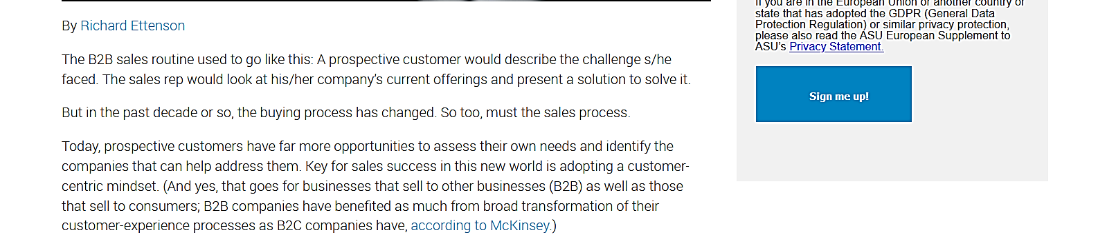
New Research Finds It’s Outcomes — Not Solutions — That Sell

Slide 26
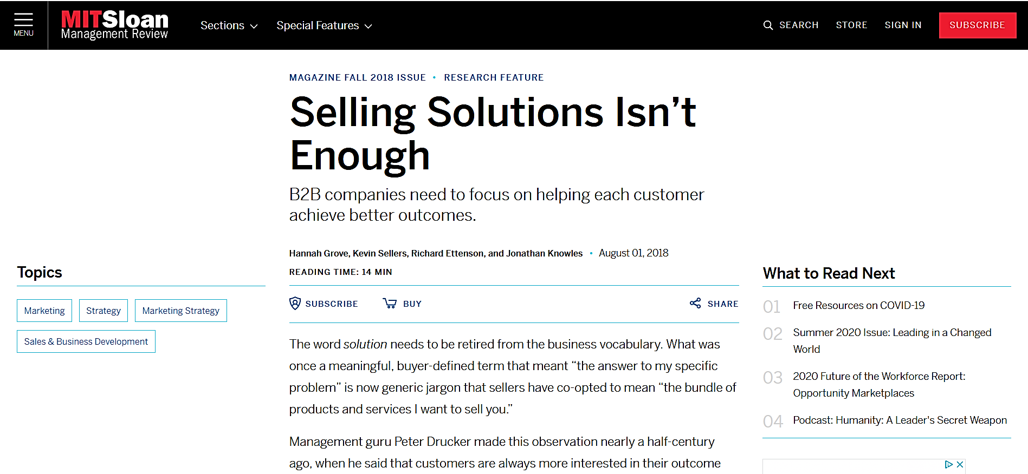
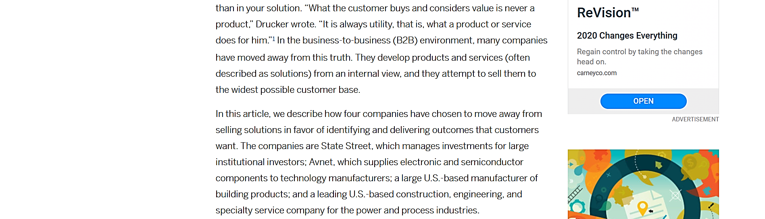

Slide 27
Value is created when desired outcomes are realized

Slide 28
The End That Matters: The Client’s ROI
Planning
Design
Construction
Operation
YOur Services
Completed
YOur Services
Completed
CLIENT’S
roi
VALUE GAP

Slide 29
Better: Problem → Solution → Results
FIRM
FIRM

Slide 30
Shaping Your Value Proposition
Definition: Your value proposition is your promise to deliver something of distinct value to the client
Solution
Outcomes
Benefits

Slide 31
Planning for Client Success
Inspired by Simon
Sinek’s Golden Circle

Slide 32
The Emerging Business Development Model
#4
TREND: Despite buying moving into
the digital space, it’s still ultimately
a human transaction
TACTIC: Sell as you serve, with the
focus on the buyer rather
than you and your firm

Slide 33
“I’d almost rather have nothing to sell so I could focus on what the client really needs.” — Bill Scheessele

Slide 34
Framing Your Discussion
Imagine: You are a non-profit agency created to help clients address their challenges related
to your areas of expertise.

Slide 35
The Server-Doer Model
Serving
Doing
Helping Clients Meet Their Needs
Point
of Sale
Uncompensated
Compensated
The Best Way to Sell Is to Serve

Slide 36
Where Will Your Firm Be Positioned
Relative to the Buyer’s Journey?
AVERAGE SELLERS
EXPERT SELLERS
DIGITAL
VIRTUAL/F2F
❶
❷
❸
❹
❺
❻
Recognize
Need
Conduct
Research
Evaluate
Options
Scope the
Solution
Solicit
Proposals
Select
Provider
DIGITAL PIONEERS
LAGGARDS

Slide 37
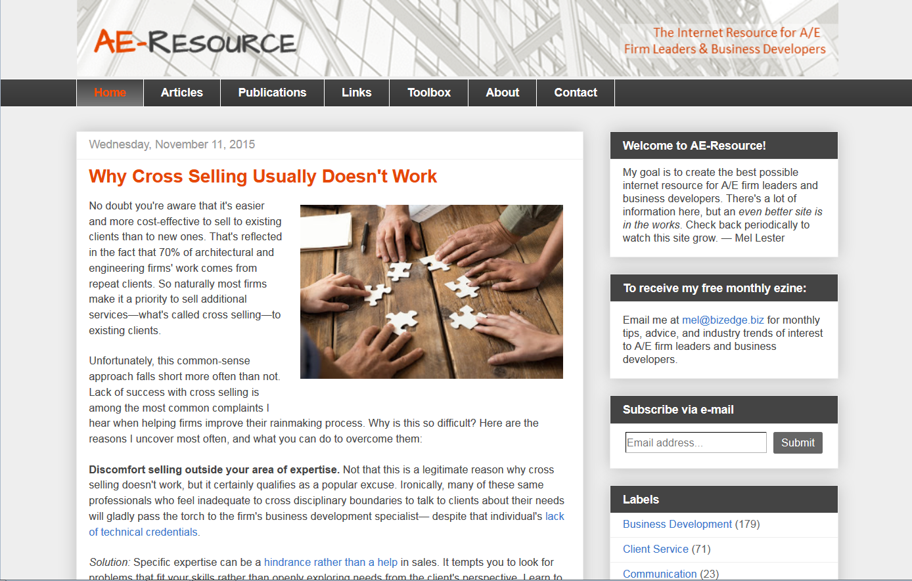
For More Information
Subscribe to my monthly ezine
www.ae-resource.com

