Slide 1
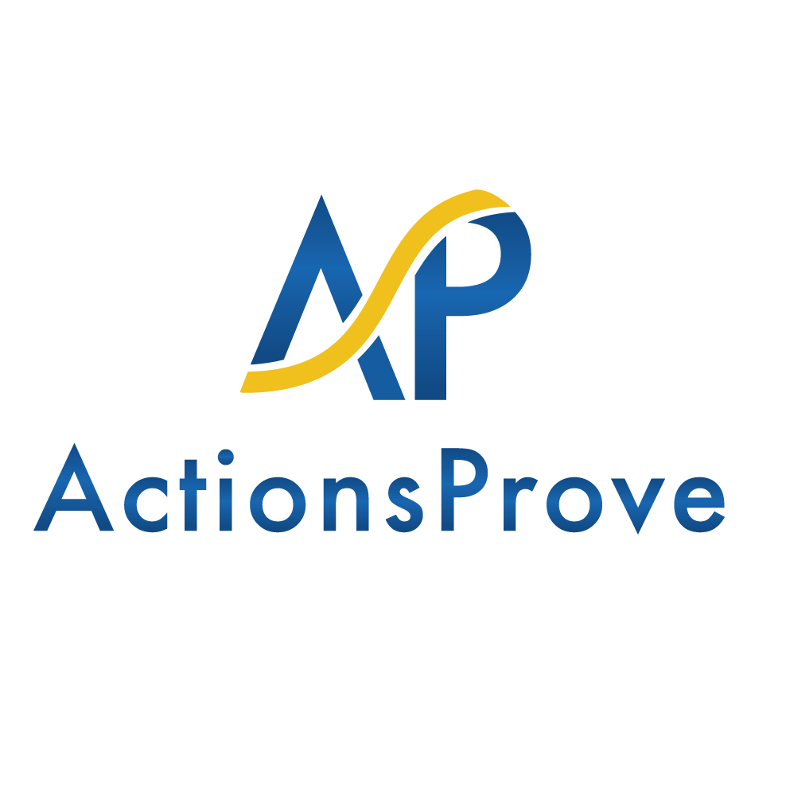
Winning Today with the 4 P’s:
Projects, Profits, People, and Purpose
How to Successfully Engage, Grow, and Win in the New Era
Peter C. Atherton, PE
President and Founder
© www.ActionsProve.com

Slide 2
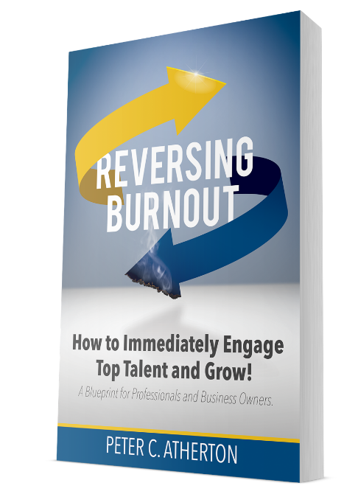
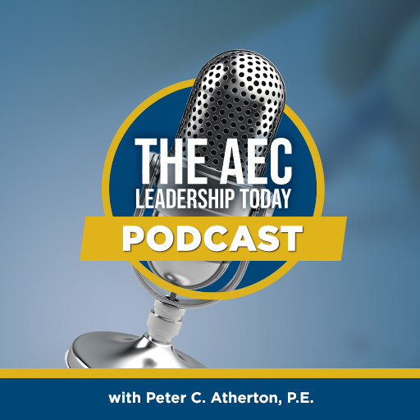
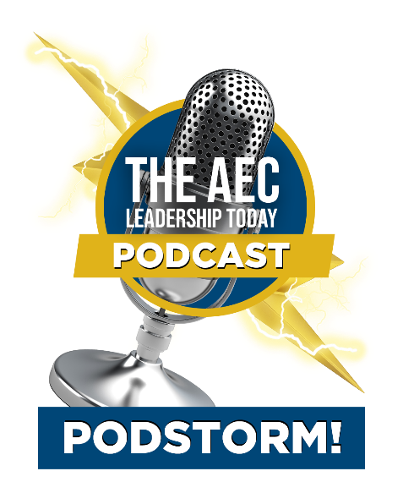
About Peter C. Atherton, P.E.
Consultant, coach, author, speaker, podcast and mastermind host
28+ years in the AEC industry
Experience at all levels: project engineer, project manager, team leader, principal, major owner, board of directors
Experience with large, small, and mid-size firms on a local, regional, and international scale
© www.ActionsProve.com

Slide 3
A New Era
The 8 Greatest Challenges Changing AEC
The post-pandemic reality
The use of technology and the rise of “digital natives”
The amped-up “war for talent”
The delayed “silver tsunami”
Outside money
The redefinition of ‘winning’
The “Great Resignation”
The decentralization of work
© www.ActionsProve.com

Slide 4
The Redefinition of Winning
Win at both work and life while making a difference and having an impact
The redefinition of business
The redefinition of leadership
© www.ActionsProve.com

Slide 5
New Era Leadership Strategy and Execution
Business Strategy
Culture
Diversity
Innovation
Sustainability
© www.ActionsProve.com
Notes:
Much of this is more about “people”… why is this necessary? … because business has changed

Slide 6
Business in the New Era
“The Purpose of the Corporation”
Provide value to clients
Invest in employees
Treat subcontractors and suppliers fairly and ethically
Support community
Protect the environment
Deliver long-term shareholder value
© www.ActionsProve.com

Slide 7
Positioning Us for Success in the New Era and Beyond…
“Most of us have been “raised” to believe in projects and profits… but do we also believe in people and purpose?” –Peter C. Atherton, P.E.
We need to figure out what we truly believe: How we define “winning”… and whether we’re aligned with the desires of ourselves, our talent, and our clients
© www.ActionsProve.com

Slide 8
Outline
Major issues and opportunities in AEC
Awareness
Traditional and new era growth models
Employee engagement
Why culture is critical
Why a great “experience” is not enough
A process for designing greater team and organizational IMPACT
Questions and discussion
© www.ActionsProve.com

Slide 9
Major Issues and Opportunities in AEC
C-Suite
Principals
Managers
Employees
Awareness
(busyness, connection)
Burnout
(workload+)
Engagement
(Alignment)
© www.ActionsProve.com

Slide 10
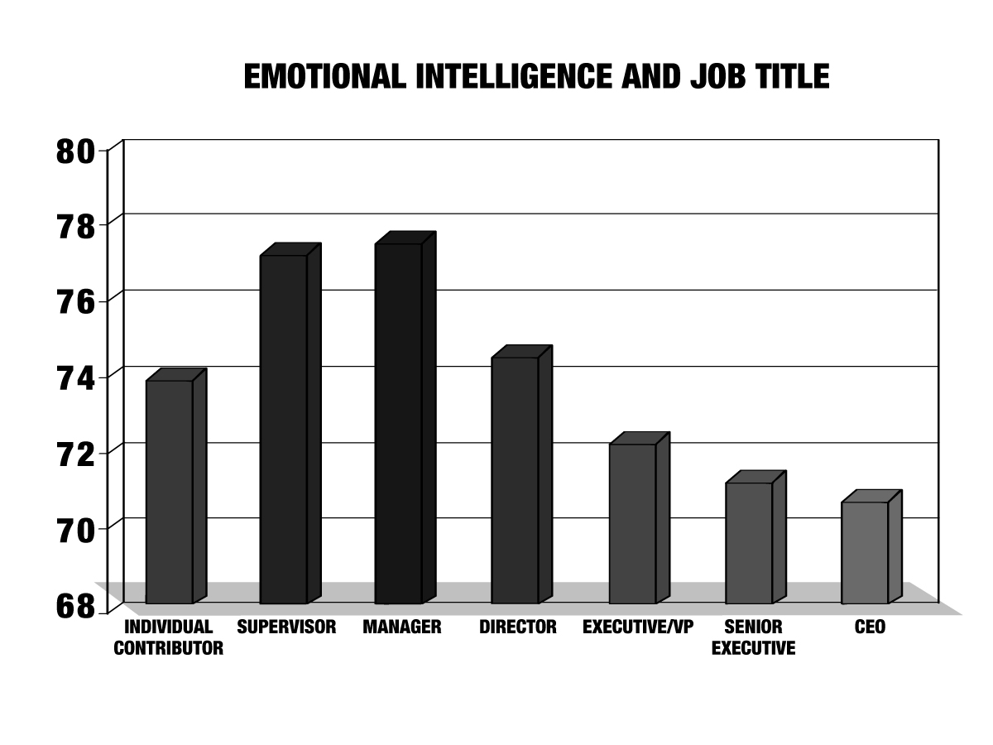
Awareness
Cornerstone of emotional intelligence (EI)
90% of top performers have high levels of EI
EI can be gained… and lost
Emotional Intelligence 2.0
© www.ActionsProve.com

Slide 11
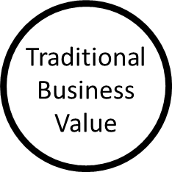
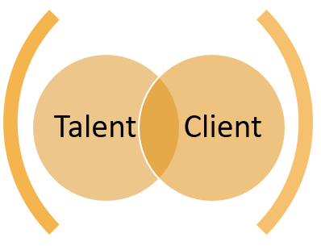
Traditional and “New Era” Business Growth
Fair Compensation, Bonuses, Advancement Opportunities
Great Products and Services On-Time and On-Budget
*
Talent Growth and Retention
Marketplace Growth and Retention
Enhanced Performance & Culture
New Era Business Value
Differentiated & Attractive Brand
Internal Employee Engagement
External Community Impact
© www.ActionsProve.com

Slide 12
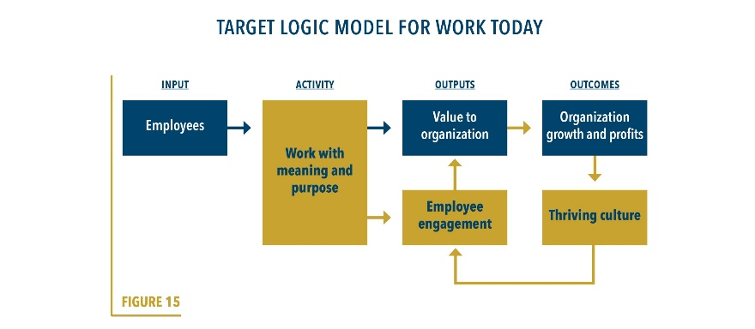
Employee Engagement
Not a “thing”
An employee’s mindset and state of being
Emotional connection to an organization and its leaders, especially one’s supervisor
Willingness to go “above and beyond”, expend discretionary effort
Feeling that the work and work environment supports their:
Goals, growth, and success, and
Pursuit of interests and passions
← Help provide “work with meaning and purpose”
© www.ActionsProve.com

Slide 13
Engagement
Satisfaction and Happiness
Basic needs met
Temporal feelings of affection
One-way relationship
Engagement
Alignment
Goals, interests, passions
Two-way relationship
Grows and evolves, especially as we work through our different seasons
© www.ActionsProve.com

Slide 14
Why Culture is Critical
© www.ActionsProve.com

Slide 15
Designing More Than An Experience
The “Experience Economy” and the Scale of Economic Value:
Commodities
Goods
Services
Experiences
Transformation
→ Employee | Client | Community | Organizational growth and success
Experiences tied to greater meaning and purpose
© www.ActionsProve.com

Slide 16
New Era Strategic Planning and Organizational Development
I.M.P.A.C.T. Process
Inventory – where are we?
Mission – where do we want to go / what do we want to be known for / who do we want to be?
Plan – how to we get from “here” to “there”?
Authenticity – will others believe and join us?
Capacity – will we be able to get there?
Trigger – will we take the first (and then the next) step?
© www.ActionsProve.com

Slide 17
Key Take-Aways
A new era is here
There’s been a redefinition of winning in terms of work, life, business, and leadership
A greater investment in people and purpose will drive greater success in projects and profits
There’s a process to help you retarget your teams
Time is of the essence
© www.ActionsProve.com

Slide 18
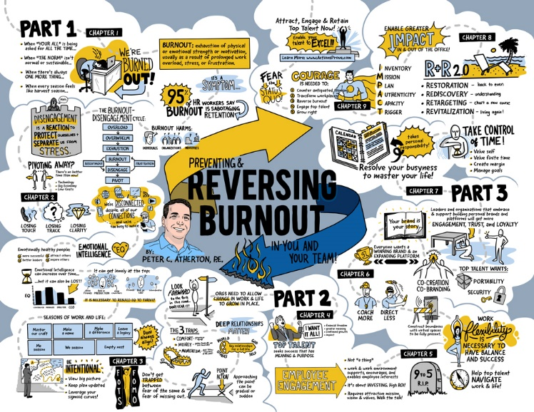
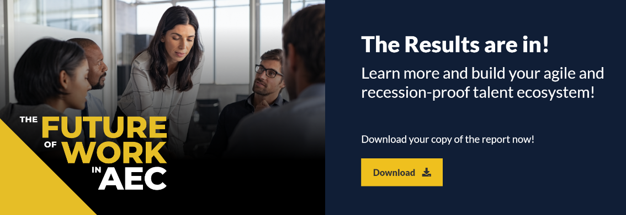
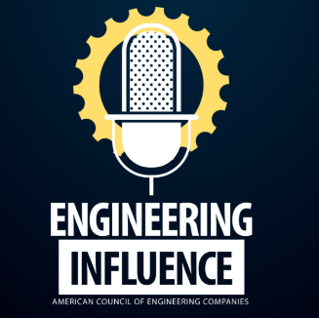
RESOURCES
Download Important Chapters:
https://actionsprove.com/products/
http://www.futureofworkinaec.com/
© www.ActionsProve.com

Slide 19
THANK YOU!... QUESTIONS AND DISCUSSION
© www.ActionsProve.com

Slide 20
Slide intentionally left blank
www.ActionsProve.com

Slide 21
Why Culture is Critical
© www.ActionsProve.com

