Slide 1
DOTD Post COVID-19 Update Webinar
Shawn D. Wilson, Ph.D.
Secretary
April 28, 2020
@onevisionary

Slide 2
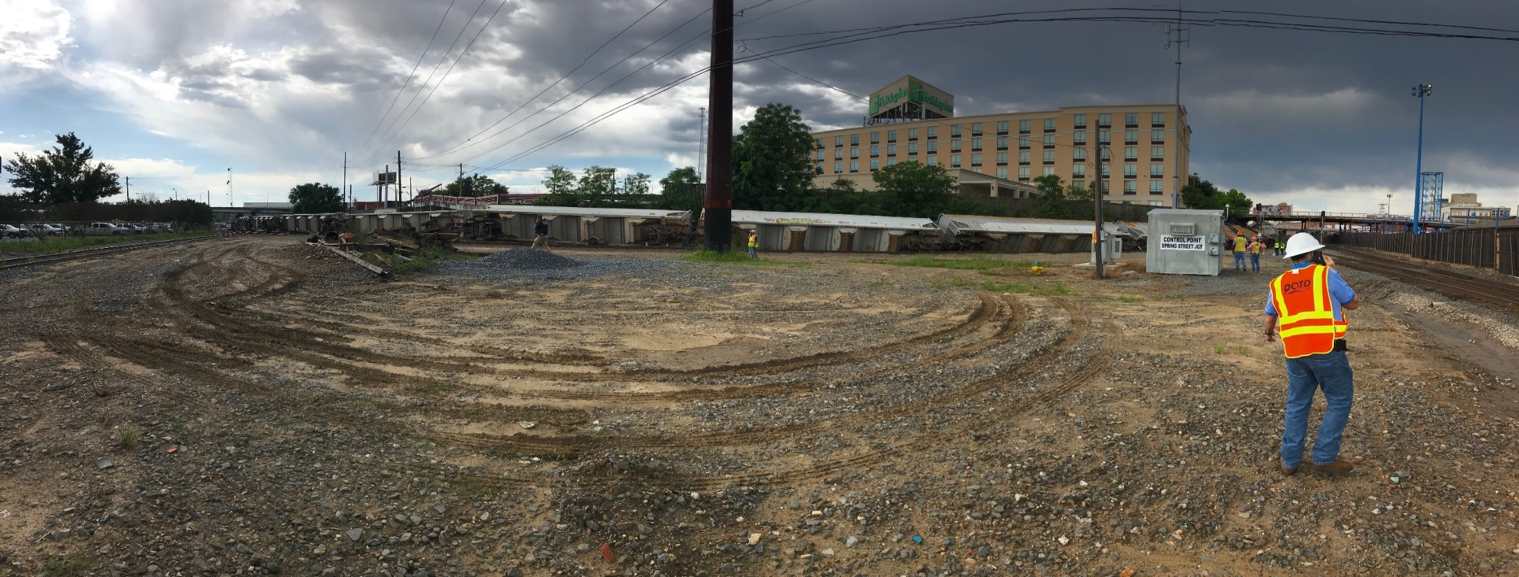
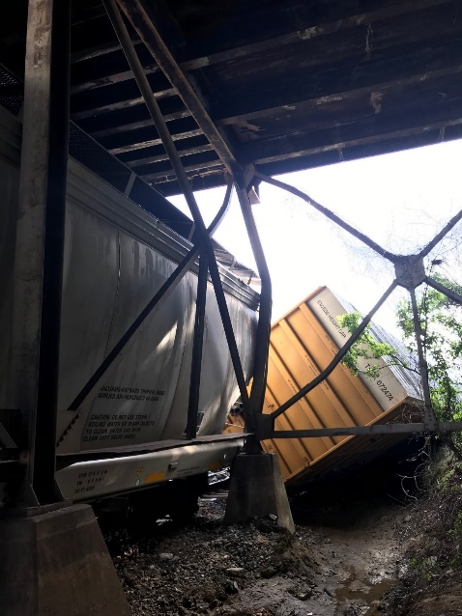
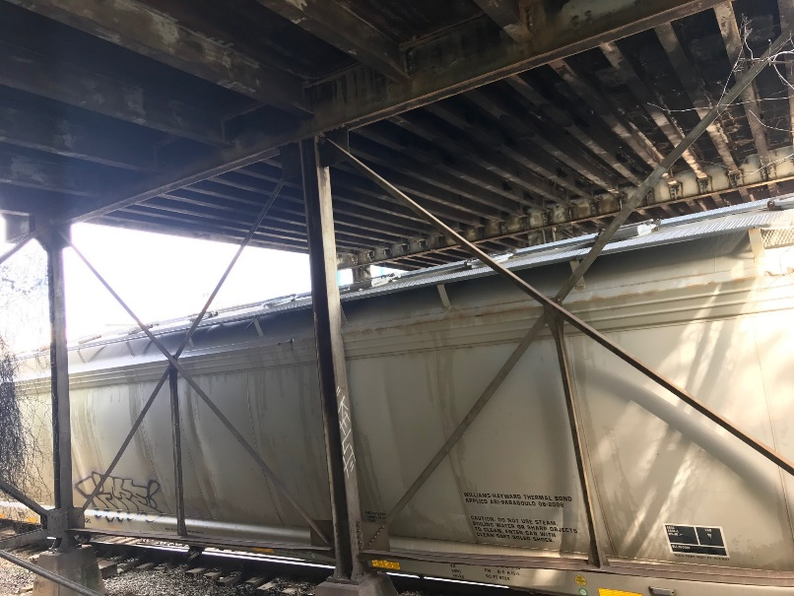

Slide 3
How is DOTD faring during this Emergency Declaration and what changes have been implemented?
Revoked all flex time schedules except Operations
Telecommuting
Closed facilities
Provided Truck Permit relief
Postponed all public meetings
Pushed back deadlines for grant applications
Maintained lettings and project development
Redirected messaging on the system to COVID related topics

Slide 4
Transportation and Infrastructure are ESSENTIAL for recovery
How is DOTD responding?
54% of HQ’s staff working from home
17% of District Operations capable staff are telecommuting
District gangs who are not capable of telecommuting are working alternative workweek schedules, reducing the workplace footprint by 50%

Slide 5
Status of large projects DOTD was planning prior to COVID19
Innovative Procurements had minimal impacts.
I-10 to Split: Completed one-on-ones and CMAR Award
Comite: Proceeding with CMAR contractor selection
Advancing the efforts to move the HB578 projects forward thru the Build America Bureau
I-10: Texas State Line to E. of Coone Gully Reconstruction
- $150M
- 2nd highest value project (behind Post Katrina Twin Spans)
February - April, 2020: 31 Projects Let totaling $78M

Slide 6
Delivery model changes necessary?
No anticipation of changes in models.
We should consider using Design build selection on smaller scale that allows for an accelerated process.
Experience with CMAR will benefit the state as a delivery model for projects.
Anticipate bridge bundling.

Slide 7
Thoughts on resuming regular session or future special session and stimulus or job programs?

Slide 8
Federal Infrastructure Funding
1) When do you anticipate the stimulus could happen?
2) How much funding do you anticipate it will include in total and specifically for DOTD programs?
3) How would DOTD use the funding?
4) Will any funds be allotted for local governments to dedicate towards projects?
5) What federal assistance are you anticipating/hoping for to cover reduced gas tax revenue of COVID-19?
6) What is the likely timeline for that assistance?

Slide 9
AASHTO’S Request to Congress
$49.95 billion in immediate backstop funding to DOT’s
Treatment as State Revenue
Operations and Maintenance Support
100% Federal Share
Sensible Reporting
Obligation Timeline
Included in Louisiana’s request…
Elimination of State match for SFY 20 and 21
100% of obligation authority of current apportionment balances without any matching funds

Slide 10
NGA’s Request to Congress
Flexible federal funding to fill immediate budgetary gaps caused by critical revenue losses for our essential utilities, highways, transit system, and other revenue generating public authorities.
An aggressive infrastructure plan is essential to both near-term supply chain needs and long-term economic stimulus.
Large scale investments in our nation’s traditional
infrastructure systems, including not only roads, bridges, transit, and aviation systems, but also substantial investment in our energy, water, broadband, and cybersecurity infrastructure.

Slide 11
Impacts to the TTF
The COVID-19 Pandemic impacts are projected to reduce DOTD’s excise tax revenues up to 30%-40% for the remainder of SFY20 and into SFY21.
Based on reduced traffic counts early estimates suggest the COVID-19 impacts could result in up to $50M per QTR lost revenues until traffic counts increase to normal levels.
Impacts will be felt across the operating and capital program.
Traffic counts will likely increase at a slower rate than they declined due to the economy gradually returning as business’ open and people return to work.

Slide 12
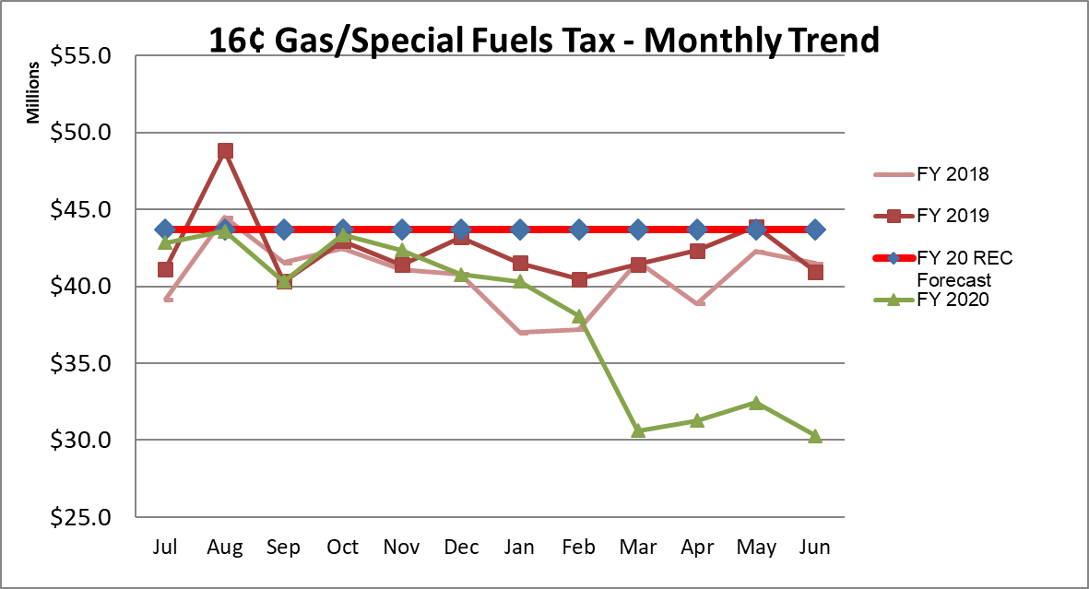
…TTF Impacts Continued
Based on reduced traffic counts revenues are projected to be $68.3M under the current REC forecast for FY20

Slide 13
How can ACECL help?
Support the Governors message on flattening the curve and adhere to guidance to protect you, your families, and your business.
Spread the message about the need to invest more during these most critical times.
Stay engaged as the legislature has the ability to respond to the financial crisis in ways that could impact transportation dollars.
Use your relationships with Congressional members - they need to hear the message as well.
Stay engaged in the Resilient Louisiana Commission and Transportation Infrastructure Task Force that I am co-chairing with Greg Morrison.

Slide 14
Questions
Shawn D. Wilson, Ph.D.
Secretary
April 28, 2020
@onevisionary

