Slide 1
Best-in-Class Professional Liability Insurance
The ACEC BIT Professional Liability Insurance Exchange, featuring pre-negotiated, best-in-class policy terms, conditions, and enhancements with industry leading professional liability insurance carriers could result in significant premium savings.
Only one application – or use your existing application – will allow us to approach all carriers in the exchange
The Professional Liability coverage is offered through a vetted panel of carriers with best-in-class coverage enhancements.
Offered through the website acecbit.org.

Slide 2
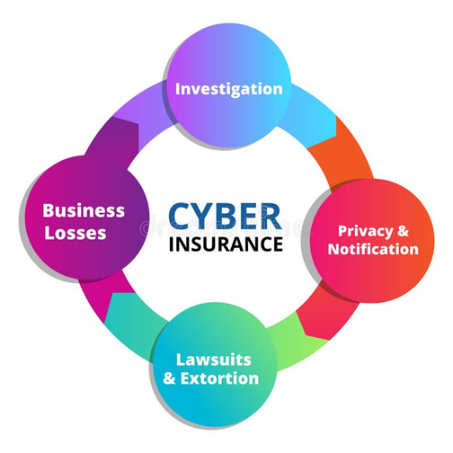
Complete Cyber Risk Insurance Solution
Program Features
FREE Cyber Risk Assessment
Customizable insurance
Rapid quoting
24/7 Security monitoring
Alerts of cyber incidents
Security tools to minimize risk
Access to security experts
Visit https://acecbit.org/cyber-quote for your Free Cyber Risk Assessment
Notes:
As our industry evolves and goes more virtual to achieve growth and
engagement, the rate of Cyber Security attacks continues to increase.
To address this growing risk, the ACEC Business Insurance Trust has
partnered with Greyling Insurance Brokerage, a division of EPIC, and
Coalition, a cyber risk management firm, to offer you what we view as
a best in class solution.

