Slide 1
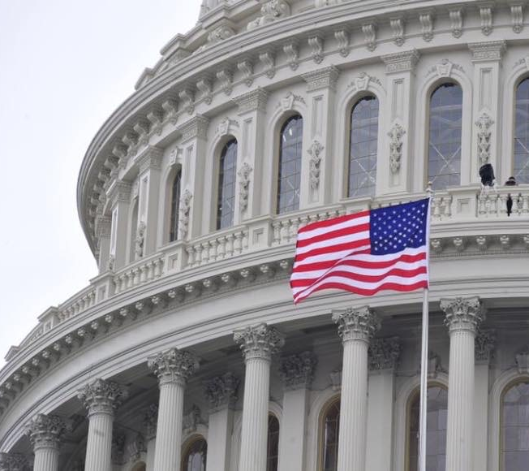
ACEC Deep South Convention
On Point: Federal Issues Update
Steve Hall, Senior Vice for
Advocacy
July 24, 2021

Slide 2
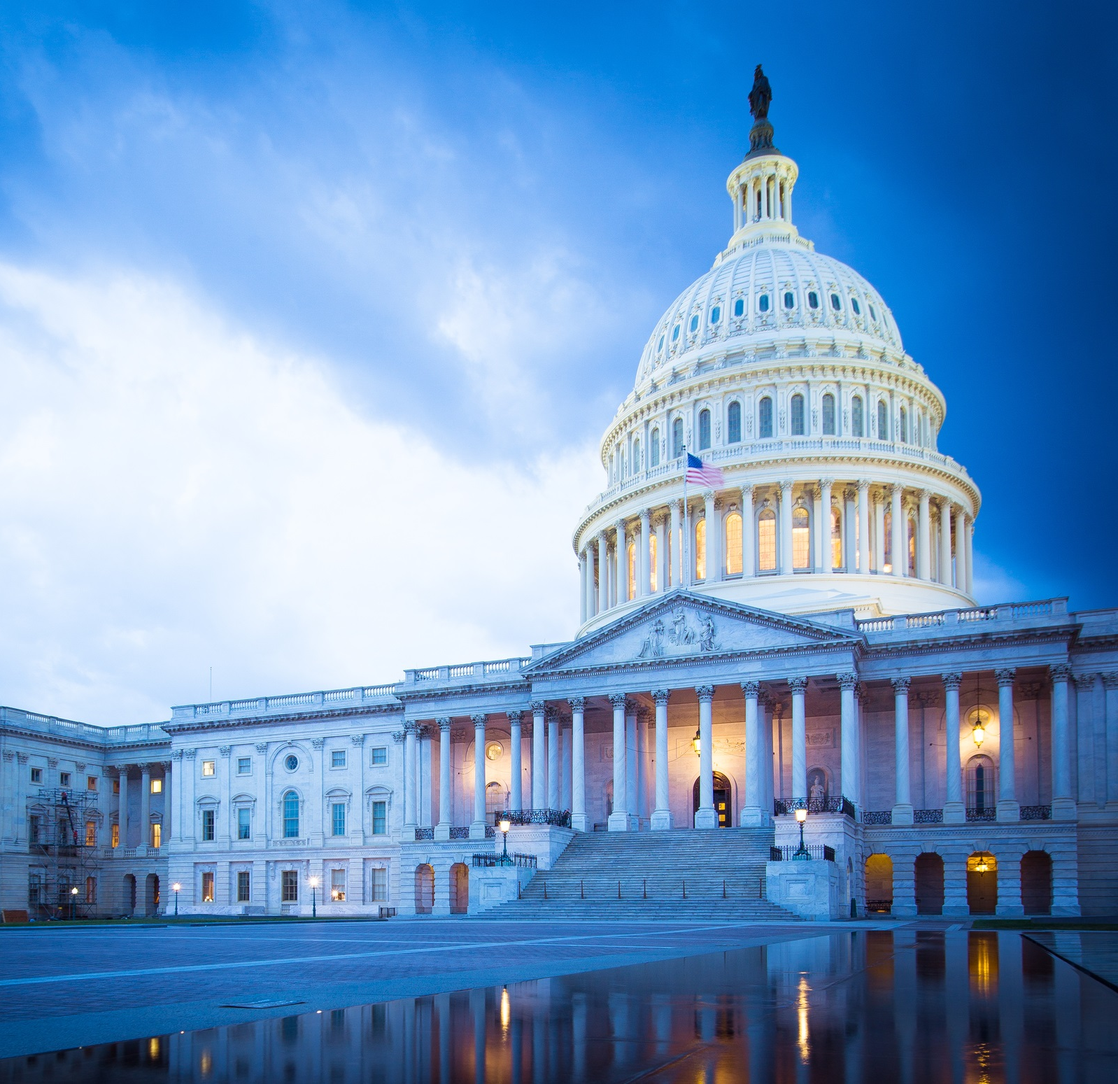
ACEC Policy Priorities for 2021
Secure passage of a robust infrastructure-based economic recovery agenda.
Protect member firms with Paycheck Protection Program (PPP) loans from regulatory overreach due to the FAR credits clause.

Slide 3
Infrastructure – the Biden Plan
$2.3 trillion American Jobs Plan:
Between $900 billion and $1 trillion focused on built environment.
Includes traditional infrastructure plus school construction, public housing, federal facilities, and energy.
Pay-fors problematic.

Slide 4
Infrastructure – Senate Republican offer
Started at $568 billion over five years, grew to $1 trillion.
Focused on traditional infrastructure plus rural broadband.
Funded through diverting previously authorized COVID resources and user fees.
Negotiations suspended.

Slide 5
Infrastructure – Bipartisan Agreement
Major Components:
Roads/bridges, transit, airports;
Passenger rail, freight;
Water, ports, waterways;
Power, broadband.
Baseline + new spending:
$1.2 trillion over 8 years.
$579 billion in new spending.

Slide 6
Infrastructure – Bipartisan Agreement
Negotiators adding substance:
Senate EPW-passed $311 billion highway bill.
Commerce-passed $79 billion rail/safety bill.
Banking to add transit?
Senate-passed $35 billion drinking water bill.
Senate Energy Committee-passed bill.

Slide 7
Infrastructure – Bipartisan Agreement
Pay-fors a work in progress:
Bonding, private investment, asset recycling.
Unused COVID funds, repurpose state/local assistance.
Strategic Petroleum Reserve sale.
Reinstate Superfund fees.

Slide 8
Infrastructure – INVEST Act
House-passed $715 billion bill:
$550 billion for highways, bridges, transit, safety.
$51 billion for wastewater.
$117 billion for drinking water, replacement of lead service lines, and other water needs.
Impact to bipartisan bill?

Slide 9
Infrastructure – Path Forward
Senate to lead – vote on bipartisan plan this month?
House vote to follow – goal is completion by September 30th.
$3.2 trillion “reconciliation” package moving concurrently – if infrastructure falters does reconciliation offer another path forward?

Slide 10
PPP/FAR Credits Clause – Regulatory
FHWA guidance:
Limited to federally funded contracts.
Clarifies that fixed price / lump sum contracts aren’t affected.
Limits on multi-year contracts.
ACEC/DOT FAQ guidance provides common framework for implementation.

Slide 11
PPP/FAR Credits Clause – Legislative
ACEC negotiating bill language to either:
Waive the credits clause on PPP loans – ACEC lobbying Senators now.
Restrict State DOTs from going beyond FHWA’s policy – language included in the House-passed INVEST Act.

Slide 12
Questions?

