Slide 1
ACEC Louisiana
Federal Advocacy Briefing
Steve Hall, Senior VP – Advocacy
November 18, 2021

Slide 2
Major 2021 Agenda Items
$1.9 trillion American Recovery Plan (ARP) – done
$1.2 trillion Infrastructure Investment and Jobs Act – done!!
$1.9 trillion “reconciliation” package – in process
PPP/FAR credits clause fix – in process.

Slide 3
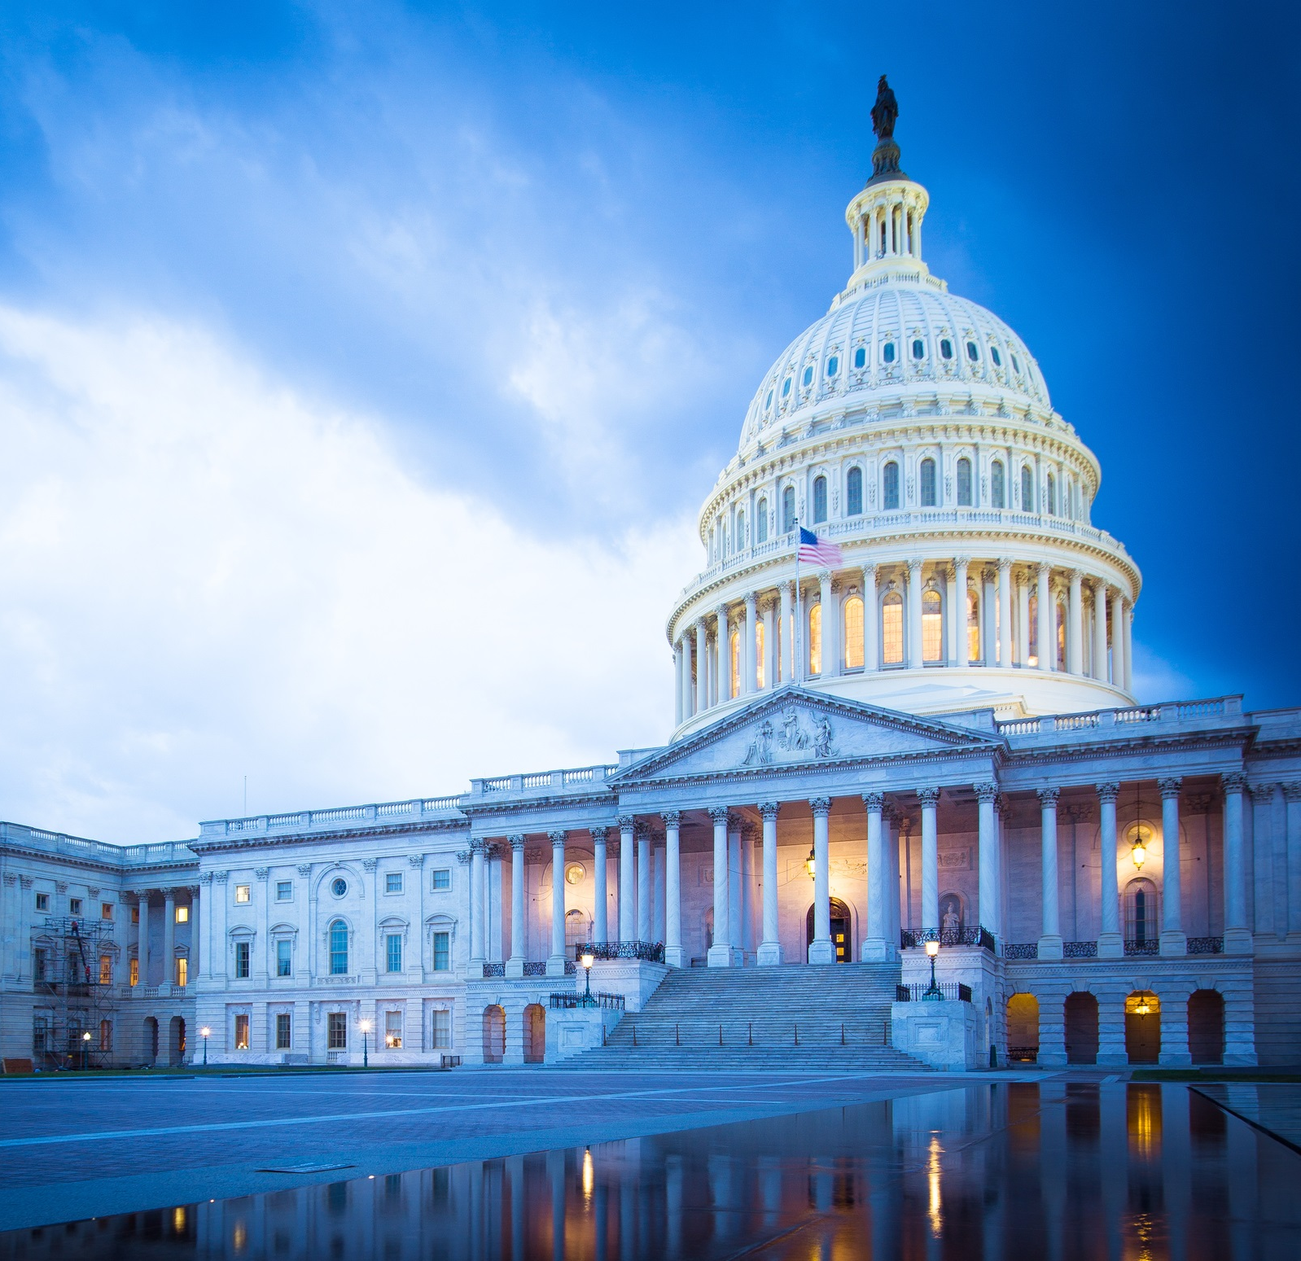
Infrastructure Investment & Jobs Act
Major Components:
Roads/bridges, transit, airports;
Passenger rail, freight;
Water, ports, waterways;
Power, broadband.
$550 billion in new spending over five years, $1.2 trillion total.

Slide 4
Infrastructure Package – New Investment
$110 billion for roads, bridges.
$32.9 billion for transit, $66 billion for rail.
$65 billion for broadband.
$25 billion for airports.
$55 billion for water and wastewater, PFAS, lead pipes.
$73 billion for power grid.
$46 billion for resiliency.

Slide 5
Infrastructure Package – Pay-Fors
Pay-Fors are Bipartisan:
$205 billion from unused COVID relief.
$49 billion from delay of Medicare rule.
$56 billion in anticipated economic growth.
SPR sale, Superfund & Customs fees.

Slide 6
Infrastructure Package – Highways
5-year reauthorization of the FAST Act, 34% increase in funding;
Plus an additional $55 billion:
$36.7 billion for bridges;
$15.7 billion for projects of regional/national significance;
Boost PABs $15 to $30b.

Slide 7
Infrastructure Package – Transit
5-year reauthorization of the FAST Act, $69.9 billion or 43% increase in transit funding;
Plus an additional:
$10.25 billion supplemental appropriations over five yrs;
$8 billion for capital grants;
$1.75 billion for disability access.

Slide 8
Infrastructure – Passenger/Freight Rail
Northeast Corridor grants -- $6 billion;
Intercity Passenger Rail -- $36 billion;
Amtrak National Network -- $16 billion;
Safety/reliability -- $5 billion;
RR crossing hazard elimination -- $3 billion.

Slide 9
Infrastructure Package – Airports
Airport Improvement Program (AIP) funding -- $15 billion over five years;
$5 billion for Airport Terminal Program over five years;
$5 billion for FAA air traffic control projects over five years.

Slide 10
Infrastructure Package – Ports/Waterways
$9.55 billion for Corps of Engineers navigation and port projects;
$455 million a year for five years for USDOT’s Port program;
$3.85 billion for land ports of entry at the northern and southwest borders.

Slide 11
Infrastructure – Water
$55 billion for water projects:
Reauthorizes Clean Water & Safe Drinking Water SRF programs through FY’26;
Appropriates $11.713 billion for each; 49% for grants & forgivable loans to disadvantaged communities.

Slide 12
Infrastructure – Water
$15 billion for lead pipe replacement;
Funding for PFAS/emerging contaminants;
$1.6 billion for SSO, stormwater reuse;
$75 million for WIFIA;
Resiliency, sustainability, technical assistance programs.

Slide 13
Infrastructure – next steps
ACEC to focus on implementation:
Education programming;
Working with AASHTO and other client organizations;
Working with federal agencies on implementation, e.g. Buy American requirements.
Talent shortage challenge.

Slide 14
PPP/FAR Credits Clause
Provision in the FAR conflicts with forgiveable PPP loans, forcing engineering firms to return this assistance.
Fix is particularly critical for engineering firms to work on infrastructure.

Slide 15
PPP/FAR Credits Clause – State of Play
House -- Brown-Katko amendment to National Defense Authorization Act -- waives the credits clause on PPP loans used for payroll (adopted).
Senate -- Bipartisan Braun-Duckworth– USDOT spending bill or NDAA (pending).

Slide 16
Reconciliation Package – tax impacts
15% AMT for publicly traded companies with over $1 billion in revenues;
1% surcharge on stock buy-backs;
15% global minimum tax;
Expansion of 3.8% net investment income tax (NIIT) to active business owners with income over $400K;
5% surtax above income of $10 million, added 3% above $25 million.

Slide 17
Federal Vaccine Mandates
ACEC engaging on two fronts:
Federal contractors – January 18th deadline for vaccination mandate; coalition letter advocated for delay.
All businesses – vax mandates for firms with 100 or more employees; OSHA guidance challenged in court, implementation on hold.

Slide 18
ACEC/PAC Status
Over $900,000 raised to date.
20 states at goal.
Capitol Hill Townhouse events with 100 Members of Congress attending raising nearly $700,000.
ACEC/PAC critical to the success of our advocacy program.
Thank you Louisiana for your support!

Slide 19
Questions?

