Slide 1
Understanding Water An Introduction to Hydrology and Hydraulics
An introduction of how to approach water in a highway setting
Alexander Mann & Lindsey Merrifield
Notes:
Introduce us and note flowing water is a fun and amazing study. There is also tremendous power and energy in flowing water that is important to understand.

Slide 2
What We Will Cover - Hydrology
The Equations used for Calculating Flow Rate (Q)
Rational
Q = C*I*A
USGS Regression
$Q_{T} = b{(A)}^{a}{10}^{−w(W)}{10}^{c(I)}$
Variables
Topography and drainage areas (A)
Time of Concentration – Tc and the rainfall intensity – (I)
Rainfall Intensity and NOAA Atlas 14 data
USGS Lag to Peak equation
Runoff Coefficient – (C)
National Wetland Inventory NWI wetlands – (W)
Notes:
These equations convert rainfall into Flow.
These equations, which are embedded in the Maine DOT Hydrology Workbook, convert measured values (DA, C, W) to flow rate for the design flows.

Slide 3
What We Will Cover - Hydraulics
Channels and what to look for
Culverts
Gutter flow and spread on the road
Flow over the curb
Away from the road
Closed System Pipe Sizing
Notes:
Water interacts with the road at a variety of scales. It has to drain off the road surface to prevent Hydroplaning and icing, Ditches have to be stable so the road is not compromised, and culverts and drain pipes have to be sized to carry the calculated flows. Additionally neighboring structures and properties have to be considered so that they are not inadvertently damaged.

Slide 4
What Is Hydrology?
Hydrology is how water flows and concentrates on the surface of the earth. The flow rate at any point is directly related to the changes in land use and the recent and existing weather at the location that results in rainfall, snowmelt, or extended dry periods.
Hydrologic analysis necessary for determining the rate of flow, runoff or discharge that the drainage facility will be required to accommodate. The design discharge is a hydraulic “load” on the highway facility and the determination of its magnitude and possibly its duration is as important as the determination of the proper structural load. - AASHTO
MaineDOT uses two methods to calculate flow
Rational Equation
USGS Regression Equations
Documents
Drainage Practices & Procedures
Design Guidance – Hydrology
Hydrology Workbook

Slide 5
Flow Calculation - Rational Equation
Q = C*I*A
Most appropriate for smaller area with significant impermeable area
The Runoff Coefficient (C)
The composite Runoff Coefficient is calculated by averaging the individual land use runoff coefficients – see Table 3-1 of HEC22 for coefficient values
Rainfall Intensity (I) and the Time of Concentration (Tc)
The Maine DOT worksheet incorporates the USGS Lag to Peak equations for the Time of Concentration calculation (on the Rational - Multisites worksheet tab of the Hydrology Workbook)
Two tables (Precipitation Intensity and Precipitation Depth) need to be copied from the NOAA Atlas 14 website to the Atlas 14 DDF & IDF tabs in the Maine DOT Hydrology Workbook
The Area (A) that drains to the point of interest
For drainage areas (A) less than 200 acre
Video on Rational Method: https://www.youtube.com/watch?v=k7mcoGlq9IA
Notes:
The Tc (min), I (in/hr), and A (acres- ft2) are combined to create the flow rate cfs. The C value is a percentage of the flow that makes it to the point of interest.

Slide 6
Flow Calculation - The USGS Regression Equation
The regression equations are for drainage areas between 0.3 mi² (200 ac) and 12 mi² (7680 ac)
$Q_{T} = b{(A)}^{a}{10}^{−w(W)}{10}^{c(I)}$
Q = Design flow (ft³/s) – Flow for a specific return period.
T = Design return period (years)
b,a,w,c = Coefficients dependent on T value
A = Drainage area, (acres) – Area that drains towards the point of interest.
W = Percentage (%) wetlands as determined from National Wetlands Inventory
(NWI) maps
I = Rainfall Intensity of the 24 hour storm for a return period, T.
Notes:
The USGS regression equations were developed from measured rainfall, and flow rates at the various sites they monitored around the state.

Slide 7
USGS Regression Equation
The newest small area regression equations from the USGS will be available in the fall of 2021
They are based on the drainage area, recorded rainfall and measured flow rates
The equations were developed from
Drainage areas larger than 192 acres (0.3 Square miles)
Undeveloped watersheds (mostly forest, some field and few houses)
The NWI wetlands (W) are also incorporated in the equation
They also incorporate the NOAA Atlas 14 DDF and IDF data tables into the equations
Notes:
The newest report and equations and being reviewed currently and will be incorporated in the Hydrology Workbook when they are published.

Slide 8
Defining ‘A’ – Drainage Area
Drainage Area – the area on which all the runoff will eventually flow to the point of interest
Understanding contours
Contoured channels form a V with the point facing higher elevations
Water flows perpendicular to contours
Ridge lines form drainage divides
Ridge lines can form a V in the contour with the point facing lower elevations
Ridge lines can also occur at the high point between contour lines that have the same elevation
Notes:
Introduce drainage Area - let Alex speak then introduce contour specifics with Mapviewer section.
Though programs exist to calculate drainage areas from elevation data, the necessary data both accuracy and density is seldom available to allow the programs to work effectively for small drainage areas. So understanding contoured data is essential for accurate determination of these small drainage areas.

Slide 9
Microstation
For smaller drainage areas – use survey data
Set up a working drawing
Highway_drainage.dgn
Use Drainage Area Linestyle
Under Plan - Drainage Tab
CADD Update available
Measure areas and record
Alter areas as design changes
Lidar
Can pull in external lidar as needed
Notes:
Lidar data can be brought in and incorporated with the survey and design topographic data for some of the areas that lack sufficient survey data over adjoining properties. These drainage areas delineated in Microstation will typically be less than one half an acre.

Slide 10
MapViewer Areas
https://www.maine.gov/mdot/mapviewer/
The Map Layers and Basemap Layers tabs include much of the data
The mapped data - catch basins, crosspipes, roads, etc. can be queried on the map to find recorded information on the feature.
The NWI wetlands are shown as light blue areas with the grass symbol and are associated with the wetlands layer typically listed at the bottom of the Basemap layers tab
Notes:
How many of you have explored the State’s mapviewer application? A lot of valuable data is accessed by Mapviewer including the Lidar data (contoured), the catch basin, culvert, and bridge data, the NWI wetland data, aerial photography, and street viewer. Additionally there are tools that allow drainage areas to be delineated based on the two foot Lidar contours. Here is a quick review of Mapviewer.

Slide 11
Map Viewer Summary
Existing air photos, catch basins, wetlands, and culverts can be accessed
Drainage areas and flow lines can be delineated using the 2’ Lidar contours (currently most of the state is covered, soon the state will have complete coverage)
Drainage areas can be determined (best for areas between 0.2 and 200 acres)
Drainage area shape files can be saved
Notes:
Go to Mapviewer for quick show and tell. Flow lines, drainage area, open window with calculated area (make certain it is in acres). Adjoining areas can then be delineated. If areas need editing open editing tools wrench?) Note, be very careful vertex balls are grabbed and not lines. The lines allow the whole polygon to be moved. It can be moved back by noticing how it meets roads and other drainage areas.
Export area files and import to google earth for saving

Slide 12
USGS StreamStats
https://streamstats.usgs.gov/ss/
For larger drainage basins and culverts (greater than 0.3 to 0.5 square miles (200 to 320 acres))
Pay attention to areas within 0.3-0.5 square miles – often find errors
Calculates flows based on USGS small area regression equations
Uses Lidar DEM data (for areas that were available when StreamStats was last updated) for drainage basin determination
Near road ditches and crosspipes limit accuracy on drainage areas less than half a square mile
Many of the drainage basins appropriate for StreamStats will also be possible fish passage structures. The Environmental Office should be contacted if a larger drainage basin is encountered.
In general, this will be for crosspipes 36” and larger
Notes:
Alex can discuss –
Input areas to Hydrology Workbook

Slide 13
Defining ‘I’ – Rainfall Intensity
Based on Time of Concentration, Tc, and Precipitation Data
Time of Concentration – Tc
The time it takes for water to travel from the most hydraulically distant point to the collection point. The Tc is used to determine the appropriate rainfall intensity and duration for a particular flow event. The storm intensity and duration data is reported in the NOAA Atlas 14 data tables.
USGS Lag to Peak Regression Equation
This equation, adapted to calculate the time of concentration, is incorporated in the MaineDOT Hydrology Workbook.
Notes:
Also note the storm intensity (in inches per hour of rainfall), for a given return period event, is based on the time of concentration which is in turn based on the size and characteristics of the drainage basin. The USGS Lag to Peak regression equation uses the drainage basin size and the maximum rainfall intensity for a site to determine the time of concentration for the various return period runoff events.

Slide 14
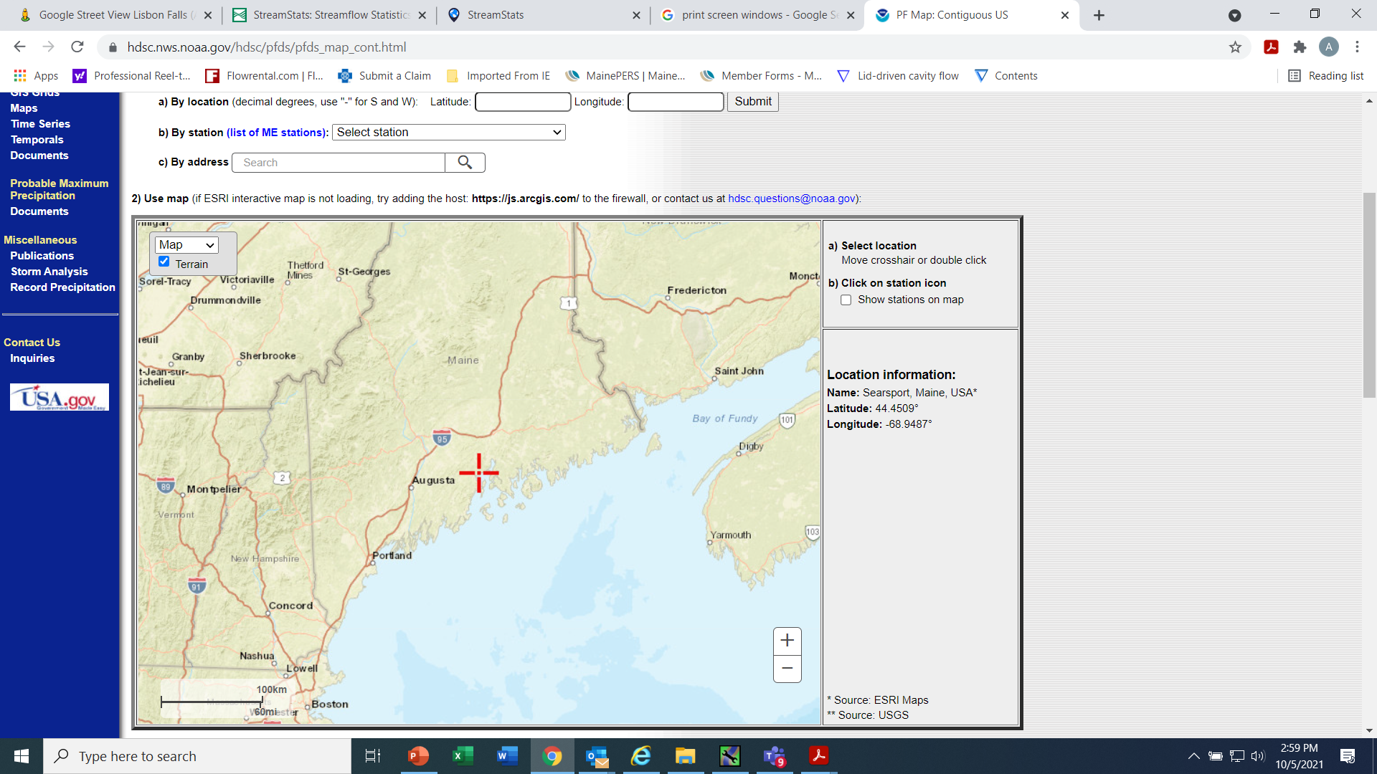
NOAA Atlas 14 website – Precipitation Data
https://hdsc.nws.noaa.gov/hdsc/pfds/pfds_map_cont.html?bkmrk=me

Slide 15
Collecting the data from Atlas 14
Move the red + sign to the project location
Zoom in until the + sign is over the project area
With Precipitation Depth visible at the top of the screen
And Precipitation Frequency visible at the bottom of the screen
Press the Submit button to generate a CSV file of the rainfall depth data
Copy this data, the cells with data values, and paste it to the Depth tab of the MaineDOT Hydrology Workbook
Also copy the reference map into the Precipitation Depth tab
Go to the Precipitation Depth tab at the top of the webpage and press the down arrow to bring up the Precipitation Intensity
Again, go to the bottom of the page and press the Submit button to generate a CSV file of the rainfall intensity data.
Copy this data, and paste it to the Intensity tab of the Maine DOT Hydrology Workbook

Slide 16
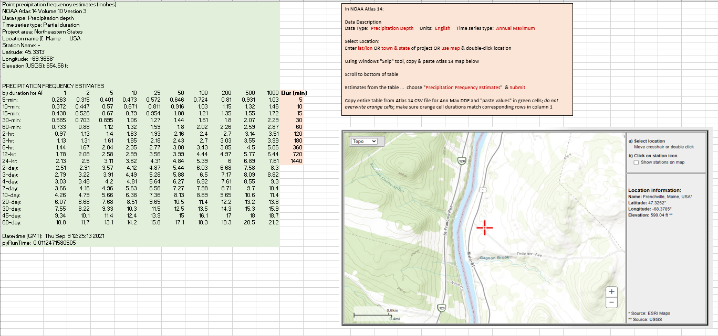
NOAA Atlas 14 Data and Map in the Hydrology Workbook
Notes:
On the workbooks on only copy over the data in green.
Save your NOAA excel files to your project file

Slide 17
Defining ‘C’ – Runoff Coefficient
Used in the Rational Equation
‘C’ is the percentage of the rainfall that reaches the collection point
Assumed constant based on each drainage area
‘C’ is actually variable based on the following characteristics:
Land use – Forest, Field, Residential housing, Urban, paved
Soil Type – Sandy to clayey
Ground slope
Wetlands – be aware if they exist in an area
Rainfall Intensity – heavier rainfall results in higher runoff
Notes:
Land use and impermeable areas are a big factor

Slide 18
Calculating the Runoff Coefficient Information Sources
Soil, Land Use and the Runoff Coefficient
General soil types can be found on the NRCS Web Soil Survey https://websoilsurvey.sc.egov.usda.gov/App/WebSoilSurvey.aspx
Under Soil Reports –> Water Features –> Hydraulic Soil Group and Surface Runoff
General Land Use can be determined by the Map Viewer Imagery layer
The Runoff Coefficient ‘C’ is determined from Table 3-1 of HEC22 by combining these two factors
Notes:
Pavement area – 0.95
Forested area – 0.15
View HEC 22 – 3.2.2.1

Slide 19
NRCS Web Soil Survey
Notes:
The NRCS soils survey website for the country.

Slide 20
The Soil Types in the Project Area
Under Soil Reports –> Water Features –> Hydraulic Soil Group and Surface Runoff
Notes:
Zoom into the project location and open the Hydraulic Soil Group data. Open the NRCS soils survey site (if time and questions)

Slide 21
Defining ‘W’ – Wetlands Area
Used in the Regression Equations
W is the percentage of the drainage area that is covered by wetlands
Can be found on Mapviewer
or using the National Wetlands Inventory (NWI) Wetlands Mapper
Notes:
Delineate as its own area

Slide 22
Hydrology Workbook
Compiles and organizes the hydrology data
Calculates flow rates for both the Rational Equation and USGS Regression Equations
Calculates the time of concentration (Tc) from the USGS Lag time regression equations for the Rational Method calculation
Provides preliminary estimates of pipe sizes for the culvert site
Provides easy comparison of calculated flows (especially for drainage areas approximately 200 acres in size (i.e. areas that are mostly forested and grassed are likely to be represented most accurately with the USGS Regression equations. Areas that are largely urban would be better represented by the Rational Method).

Slide 23
Hydrology Workbook - Instructions
Enter NOAA Atlas 14 Intensity and Depth data into appropriate sheets
In the blue fields on the Input and Results page, enter Project name & number, drainage area number, stationing of drainage structure, calculated drainage area, calculated National Wetland Inventory (NWI) percentage, and the calculated runoff coefficient
The calculated flow rates (Q in cubic feet per second) for a 10, 25, 50, and 100 year events are given for both the Rational Method and the USGS Regression equation Method. The estimated minimum pipe size is given for each flow rate for both the Hw/D of 1 and 1.5. These are only approximate values and final pipe size calculations should be done using HY8
The Rational – Multi Site page also lists calculated time of concentration and rainfall intensity.
Notes:
Open Hydrology Workbook
P&P
Hydrology DG

Slide 24
Hydrology Workbook
Input page:
Notes:
The data entry, in blue, for the Hydrology Workbook combined page. Enter the station, Asset ID, drainage area, NWI %, and the calculated runoff coefficient C. Only enter in the blue cells!

Slide 25
Rational - Multi Sites Worksheet of the Hydrology Workbook
Calculation Page: No input needed
Notes:
Opening the Rational Multi-Sites page shows the calculated time of concentration from the USGS Lag to Peak regression equations. For the catch basin drainage areas, runoff coefficient, and time of concentration can be copied from this worksheet for use in the closed system worksheet that will be covered later. This workbook is the main way of organizing and analyzing the hydrologic data.

Slide 26
Questions!

Slide 27
General Design
Remember to think about drainage ‘Early and Often’
Where is the water coming from and where does it want to go?
Reuse existing outlet locations when possible
Consider adding additional outlet locations if necessary to keep systems small and manageable
Think about your vertical alignment
How does it impact superelevation?
How is it going to affect catch basin runs?
How is it going to affect your outlet locations?
Culvert cover? Etc…
Drainage design should be well defined by PDR
Notes:
Think about where is the water coming from and where is it going?

Slide 28
Hydraulics – Channel Design
Channels are natural or designed waterways that flow under gravity (downhill). When they are near the roadway, they will need to be designed or evaluated for both size and stability.
Designed for the 10-year flow
Purpose
Reconfigure major flow
Collect offsite water and convey to a crosspipe (i.e. swales with F-basins)
Collect flow from median in roadway
Lining materials
Grass
Temporary erosion control mat, Turf Reinforced Mats (TRM)
Stone Ditch Protection
Rip Rap
Documents
Drainage Practices & Procedures
Design Guidance – Open Flow
Notes:
Taking the flows we just calculated we have to make certain the water from a “design storm” is contained and conveyed effectively. Lets start with channels. Channels can be anything from swales to keep water behind the curb and off the road, to roadside ditches, to actual stream channels. We will be primarily concerned with the first two.

Slide 29
Channels – When to Design
When the ditch carries more than 10 cfs
When the drainage area is greater than 30 acres
When the ditch carries a stream – contact ENV
Other
Confer with H&H Engineer
Where the contours indicate offsite water is carried through a ditch to the culvert is a good place to note in design/process of determining drainage areas
ditch areas are often categorized as sub-watersheds and not automatically considered in the creation of the hydrology workbook

Slide 30
Channel Design Specifics
Slope determines the water’s energy and ability to carry sediment
Steep slopes > 0.06 consult the H&H Engineer on the design
Shallow slopes < 0.005 – Sediment can be deposited
Existing soils
Sands and some silts are extremely erodible (which includes subgrade gravels)
Proximity to the road
Channel depth relative to subgrade
Culverts constrain channel flow by means of the culvert inlet geometry, size, slope, and roughness. This will be covered in more detail in the following slides.
Notes:
Alex - The channel size, geometry, and lining material can be designed once the channel slope and design flow are determined. To help with this and other highway hydraulic problems Federal Highways Admin. (FHWA) had the Hydraulic toolbox developed.

Slide 31
Hydraulic Toolbox - Channel Analysis Calculator
For grass ditches use ‘n’ = 0.04
Notes:
This tab is for channel analysis with inputs of channel geometry, channel slope, roughness (Manning’s n), and flow rate.

Slide 32
Hydraulic Toolbox - Channel Lining Design Analysis
Notes:
This can then be used to analyze the channel lining material. Many other types of analysis can also be done with the toolbox. This will come up when we get to the closed system section.
Open DG – Open Channel Flow

Slide 33
Questions!

Slide 34
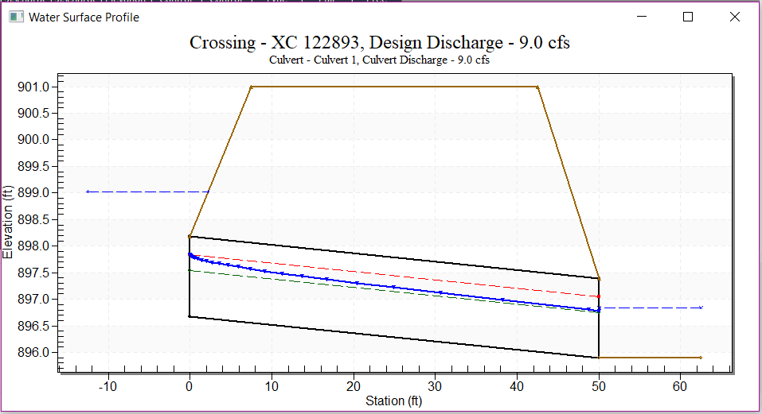
Hydraulics - Culverts
Designed for the 50-year flow unless otherwise noted
Design Standard is $\frac{H_{w}}{D} ≤1.5$
H_{w} = Headwater, D = Diameter
Documents
Drainage Practices & Procedures
Design Guidance – Culvert Hydraulics
Culvert Workbook
H_{w}
Notes:
Once the channel brings the flow to the structure, the culvert has to be analyzed. HY8 is another program developed by Federal Highways to assist designers in hydraulic analysis. Here the allowable headwater (Hw) of 1.5 pipe diameters is shown. Also shown is the calculated water surface (blue line).
Keep water out of the subgrade

Slide 35
Culvert Materials
RCP
Relatively expensive
Socket end upstream is an effective hydraulic inlet (approximately C = 0.2)
Smooth bore relatively low friction Manning’s n (n = 0.012) - High outlet velocity
Very durable
CMP
Inexpensive
Typically poor inlet geometry – “thin end projecting” (approximately C = 0.9)
“Rough” better for fish passage (n = 0.024)
Reduced outlet velocity
Corrodes short life span
Plastic – HDPE, PVC etc.
Relatively inexpensive
Moderate inlet efficiency
Bell inlets can be attached to reduce the contraction coefficient from C = 0.5 – 0.6 to C = 0.2
Similar to RCP but less strong
Smooth bore (n = 0.011 to 0.009) – High outlet velocity
Resists abrasion and corrosion – long life expected
most common type for construction
Notes:
Alex - Typically, deep pipes and crosspipes for reconstruction projects are RCP, plastic pipes are used in underdrain system and other locations, and CMPs are sometimes used for drives

Slide 36
Culvert Outlet Design
Culverts with Steep Slopes and Steeply Sloping Outlet Channels
Avoid having large culverts discharge on steep slopes and on fill slopes
High velocity flow creates scour at outlet
Hung outlets are a typical result of high outlet velocity flow or for water that is outlet on a steep slope
Flow velocity affected by culvert roughness and slope
Internal Energy dissipation can be accomplished by a series of five dissipator rings near the culvert outlet – See the H&H Engineer for help with the design (also HEC 14).
Exterior Energy Dissipation can be accomplished by a Rip-Rap basin Energy Dissipator – See the H&H Engineer for help with design (also HEC 14).
Low culvert slope (S < 0.02) only typical outlet rip-rap apron may be necessary
Moderate slope (0.06 > S > 0.02) Energy dissipator should be considered for larger pipes and higher design flow rates
Steep slopes (S > 0.06) energy dissipator necessary on most culverts that have high flow rates. See H&H Engineer for guidance and help with design determination
Low Culvert slope and channel slope (S < 0.005)
Design to facilitate cleaning sediment and plant matter from outlet area
The Federal Highway Administration computer-based design tool HY8 is the primary tool for designing culvert crossings
Notes:
General notes on characteristics of the culvert design to watch.

Slide 37
HY8
Assume stream channel ‘n’ of 0.035 for rocky/sandy channels or 0.04 for grassy channels
Notes:
The inputs for the culvert analysis include the flows (range or for the various return periods and the geometry of the culvert, road, and downstream channel as well as the number of barrels.

Slide 38
HY8 Sketch of Culvert Design Flow
Notes:
Note, this culvert has a Hw/D of just over 1. It is quite likely that the next smaller pipe would have an Hw/D of over 1.5.

Slide 39
Culvert Summary Table
Notes:
The culvert summary table displays much of the important information including the flow going through the culvert (a check on overtopping), the inlet water surface elevation, and the outlet velocity.

Slide 40
HY8 Additional features
Energy Dissipator – See H&H Engineer for guidance
Necessary when the outlet velocity is over 10ft/s and/or the Froude Number (Fr) is greater than 1 due to the slope of the pipe (generally 2% or greater) and/or high flow rates
Options include
Riprap Apron (near horizontal) for low flow rates For Fr<1
Design External Dissipator - Rip Rap basin – follow HEC 14 guidance For Fr<3
Design Internal Dissipator – Internal Ring dissipator – follow HEC 14 guidance For Fr>1

Slide 41
Energy Dissipation and Scour Hole Calculator
Notes:
The energy dissipator/scour hole calculator can help to better understand the outlet flow conditions and the approach necessary to manage the water’s energy at the outlet. See the H&H engineer for assistance when designing energy dissipators.

Slide 42
National Highway Institute Training Videos associated with HY8 Analysis
Open Channel Flow https://www.youtube.com/watch?v=8vmTYmt0Y8Q&t=13s
Culvert Hydraulics https://www.youtube.com/watch?v=vnXmGyb_hKQ&t=15s
Culvert Liners https://www.youtube.com/watch?v=stZUgSuM_zg
Energy Dissipators https://www.youtube.com/watch?v=H6mbC7MJbEc&t=639s
Fish Passage https://www.youtube.com/watch?v=hASKoo8Jvuc&t=238s
Notes:
Several videos were prepared by the National Highway institute for demonstrating the topics we just covered in a small lab flume.
HDS 5, HEC-14, HEC-22

Slide 43
Cross Culvert Workbook
Notes:
This Cross Culvert Workbook was prepared to help summarize the data from the Hydrology Workbook, the Hydraulic Toolbox, and HY8 as well as data obtained from the design plans.

Slide 44
Hydraulics Summary
Manning’s equation is used for free surface flow in channels and culverts
The roughness & the slope of the channel or culvert controls the water’s depth, velocity, and energy
Channels and culverts are analyzed to carry the design flow
Stable channels and culvert outlets can be designed with the assistance of the Hydraulic Toolbox and HY8

Slide 45
Questions!

Slide 46
Hydraulics - Closed Systems
Made up of inlet grates, catch basins and pipes
Grate and Catch Basin have required locations and locations based on Spread Calculations
Pipe Sizing is based on calculated flow through the system
Designed for the 10-year storm based on low storage capacity
Strategic placement of catch basins is necessary to maximize the hydraulic effectiveness and cost effectiveness of the design.
The pipe diameter in closed systems can be limited by existing utilities and outlet elevation.
In urban systems the outlet location is typically constrained to the existing system you’re tying into.
Documents
Drainage Practices & Procedures
Spreads Workbook
Closed System Workbook
Notes:
Closed system design is somewhat similar to channel and culvert design but the channels (road shoulders) are much smaller and more precisely designed. This results in limiting the capacity of the flow which, in turn, limits the size of the drainage basin. Additionally, the catch basin grate has a limited ability to capture the flow.

Slide 47
Closed Systems - Potential Basin Locations
Locate a catch basin
uphill of the upper side of a super-elevated curve transition
where there is an existing or required pipe connection (stub pipe, F-Basin, town or private drainage connection, including outlet locations)
where the contours show concentrated flow toward the curb
Will the curb block the flow to the road and create a closed basin behind the curb?
at locations where town roads slope toward the road/project location
on the uphill side of any bridge where the road slopes toward the bridge
uphill of drives where drive bumps can not maintain the flow in the road shoulder
at all vertical sag locations that are in curb sections
If there are no breaks in the curb (i.e. drives) to provide relief for a CB grate that is plugged, one or more flanking basins will be necessary
on the steep side of where a vertical curve transitions from steep to shallow
in locations between these required locations where the spread exceeds the design standard
Notes:
Some general notes on where catch basins are required and how to determine the locations of necessary additional catch basins.
1st bullet- Not always, what if the spread is less than a ft in a 6’ shoulder? Should be based on spread calculations and the area draining to it
3rd bullet- Not always, once again based on spread calculations
4th bullet- depends on area draining to mainline
9th bullet- based on spread calculation

Slide 48
Gutter and Spread Calculations
The gutter, like any hydraulic channel, has a width and depth associated with a given flow rate. Both of these factors are associated with important design considerations, including:
overtopping the highside break in superelevated curves,
excessive spread on high speed roads, or
excessive depth causing water to drain down driveways, that slope away from the road, and into structures.
Spread is the width of water in the roadway during a storm measured from the curb toward the travel lane
Notes:
Several important notes to be aware of when designing the catch basin locations and flow in the shoulder/gutter.
Catch Basin is most effective as a 2’ width – large spreads create larger bypass flow.

Slide 49
Spread Calculations - Process: Hydraulic Toolbox
Determine road profile slope and cross-slope of the shoulder and the road at the basin or just upstream of the basin
Determine the shoulder width at the basin
Starting at the uppermost basin, find the Q10 flow from the Rational method on the Hydrology Workbook for that basin and enter the value in the appropriate box
Does this side of the road have driveways that slope away from the road? Or do driveways slope toward the road?
Are drive bumps necessary? Typically, they are 2.88” or in sidewalk sections they are 1.92” high, this can limit the spread and the allowable flow in the shoulder at that location.
Is there a downhill transition to a superelevated section or road crossing?
Does the profile grade flatten before the next catch basin?
Does the cross-slope of the shoulder change downhill of the basin?
Do the contours indicate there will be a significant amount of flow over the curb in this area?
Notes:
Some notes on the process to proceed through when beginning to analyze the locations of basins and the spread on the shoulder and possibly the road. As a note, make certain all of the required basins are located before beginning this analysis..

Slide 50
Hydraulic Toolbox - Curb and Gutter Calculator
Notes:
The hydraulic toolbox calculator for Curb and Gutter Analysis (which includes Catch Basin Grates). The necessary data includes the slope of the shoulder at the curb (this is sometimes, but not always the profile slope at the centerline), the cross-slope of the shoulder and travelway just upslope of the CB, the width of the shoulder, the Manning’s n of pavement (change to 0.013), the design flow, and the CB grate and size. Then press “Compute Inlet Data”. The important calculated information is the spread width (T), the flow depth at the curb, and the bypass flow. Though the intercepted flow is actually what gets to the underdrain pipes, traditionally, I have used the total flow because of the way the Closed System Worksheet functions.

Slide 51
Catch Basin Spreads Workbook
Notes:
The Catch Basin Spreads Workbook records the important data related to spread and bypass and captured flow at each of the catch basins.

Slide 52
Questions!

Slide 53
Create a drainage sketch
For your own sanity and clarity
Notes:
Preparing a sketch of the Catch Basins, F Basins, Stub Pipes, Outlet, and all the adjoining pipes with lengths and invert elevations. When the flows and Bypass flows, Spreads and flow depth are included it represents a concise summary of this drainage network.

Slide 54
Closed System Workbook
Extract the drainage basin number and station, drainage area, runoff coefficient, and the time of concentration from the Rational Multi-sites sheet of the Hydrology Workbook
Determine the catch basin’s outlet pipe length and invert elevations (at this catch basin and at the downhill end of the pipe)
Copy the NOAA Atlas 14 Intensity and Depth tables to the appropriate sheets (from the Hydrology Workbook)
The calculated minimum pipe size is given near the top of the Closed System workbook
Note: a 3” drop in invert elevation should be included from pipe coming into the basin to the pipe leaving the basin
The 3” drop in invert elevation may not be possible in areas where the pipe slope is low (0.005 or less typically)
FHWA Catch Basin Grates https://www.youtube.com/watch?v=-TLP3uBB55o
Urban Stormwater Design https://www.youtube.com/watch?v=wdcXmerZWDc
Notes:
A summary of the data necessary for the Closed System Workbook.

Slide 55
Closed System Workbook
Notes:
The Closed System Workbook is used to primarily calculate the pipe size, flow velocity, and total flow rate of the closed system network.

Slide 56
Hydraulic Toolbox Additional Features
Channel Analysis Culvert Analysis
Channel Lining Analysis Bridge Scour Analysis
Weir Analysis Horizontal Grade Inlet Analysis
Rational Analysis
Detention Basin Analysis
Rip Rap Analysis
Sediment Gradation Analysis
Median Ditch Drop Inlet Analysis
Notes:
Some of the other types of analysis the Hydraulic Toolbox is capable of.

Slide 57
Drainage Summary Report
Template on Website
Includes a summary of existing conditions, proposed drainage, methods, spreadsheets and other documentation
Set up a Hydrology folder on the y-drive and save all related documents here.
Notes:
Bringing it all together with the Drainage Summary Report. This is to concisely summarize both what existed before and after the project was built.

Slide 58
Final Thoughts
Careful determination of the drainage area is essential for the determination of flow rate (Q).
While the flow rate varies significantly over time, channels, culverts, and catch basin location and spacing are determined by the design flow rate – typically the maximum flow occurring in a 10 or 50 year storm event.
The channel and it’s lining, the culvert size, and catch basin locations and spacing are designed to accommodate this flow.
The energy generated in flowing water is related to the velocity of the water squared. The water velocity, in turn, is closely related to the slope. Since many culverts are relatively smooth, the water’s velocity and energy at the culvert outlet can be quite high. To avoid scour and channel degradation, an energy dissipator may be necessary.
In closed systems, catch basin tubs can act as effective energy dissipators.
Notes:
Alex

Slide 59
Wrap It Up
Hydrology
Rational and Regression Equations
Variables – A, Tc, I, C and W
Hydrology Workbook
Hydraulics
Channels
Culverts
HY8
Culvert Workbook
Closed Systems
Spreads
Hydraulic Toolbox
Spreads Workbook
Layout
Pipe Sizing
Closed System Workbook

Slide 60
Questions!

Slide 61
Slides on Mapviewer

Slide 62
MapViewer Layers
Notes:
The layers can be turned on or off by checking/unchecking the boxes. Lables, like contour elevations, and culvert asset numbers, can be checked, and additional layers can be added from the extended database.

Slide 63
2’ contours and major roads and drainage features, catch basins (green) and cross pipes
MapViewer
Notes:
Show concentrated flow from the contours at the upper right. Also note the CBs and their asset numbers.

Slide 64
Drainage Area and Flow Lines
MapViewer
Notes:
A drainage area, in pink, and flow lines, black arrows. At this location this summer, the shallow ditch along Black Road could not contain the flow which resulted in the road overtopping and draining into a house at the corner of Black Road and Rt1.

Slide 65
MapViewer – Drawing Tab
Notes:
The drawing tools allow points (for CBs or culverts), lines, for flow lines, and polygons (for drainage areas) to be crated and saved. Note, I currently save them at the end of a day by sharing/mailing myself a link to the Mapviewer page and drawings I created at the end of each day.
Naming things appropriately
Double click to finish a shape

Slide 66
Use Imagery for Land Use Calculations (defining ‘C’)
MapViewer - Imagery
Notes:
The land use for this area can be seen in the photo. In this case it appears that 2/3 of the area is half acre house lots (about C=0.3) and 1/3 of the area is forest/woods (about C=0.15).

Slide 67
Slides on Streamstats - how to edit a drainage basin

Slide 68
StreamStats
Notes:
Press “Access application” to open StreamStats. Most of the next slides are for reference after the training.

Slide 69
StreamStats - Instructions
Notes:
Zoom in to area of interest, Searsport Maine in this case. Press Maine button to activate drainage analysis.

Slide 70
Press the delineate button and place the marker on the stream at the point of interest – where the channel crosses the road.
Notes:
Blue lines will appear if you are zoomed in far enough. Press the delineate button to get cursor to select the point of interest/drainage structure. Place the cursor over the blue line where it crosses the road and click on that point. Note, in some cases a drainage sub-basin, that is contained by a road ditch, is shown crossing the road. In this case place the cursor just downstream of where the two blue lines meet.

Slide 71
The drainage basin will then be delineated. Then press the Base Maps, and World Topographic button to bring up the contours.
Notes:
After a minute, the delineated drainage basin will appear. Zoom in and view the boundary with the contours turned on to determine if the delineation is accurate. If changes need to be made press the edit button.

Slide 72
If an area needs to be edited press the Edit Basin button at the left of the screen
Notes:
Here an additional area has to be added so press the edit basin and +/add area buttons to outline the additional area. Continue around the drainage basin adding or subtracting areas that were misrepresented.

Slide 73
Then scroll down and press the Add Area button. Place the cursor on the revised drainage line and Left click the mouse to create new data points around the additional drainage area. Repeat or press the Remove Area tab to remove area from the drainage basin. Then press the Submit Edited Basin button to update the drainage basin. This basin should be field checked. The added areas are green and the subtracted areas are red. Small basins will typically need to be edited.

Slide 74
Press Continue to proceed with the analysis of the drainage area, percentage of area that is covered by NWI wetlands and to calculate the flows. Select the analysis you would like from the tabs at the left then press continue to generate the report.

Slide 75
StreamStats Report gives all the desired drainage basin characteristics. It should be noted that this drainage basin is 0.68 square miles and needed significant editing.
Notes:
Open StreamStats and go through an analysis (if there is time)

